Slide 1
Positive Behavioral Interventions and Supports (PBIS) to Create Positive Out-of-School Time Program Culture
VTPBIS State Leadership Team

Slide 2
Objectives
After this training, participants will:
Understand PBIS rationale and features, as well as see examples in action
Explore the universal practices needed to increase social/behavioral success of participating children and youth in afterschool and summer learning programs

Slide 3
Overview
What is PBIS?
  Description
  Vermont PBIS
  Rationale
  People involved
  Tiers of intervention
  Evidence-based practices
  Examples
Resources

Slide 4

Reflection and Share
Think back to your own school/afterschool experiences.
What made your experience positive for you as a child?

Slide 5
Share
What do you know about PBIS already?
Are any of you implementing PBIS in your afterschool program?

Slide 6
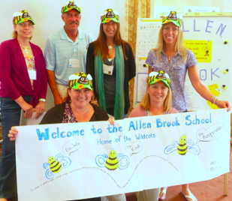
What is PBIS?
Evidence-based, school-wide approach to creating a positive and safe climate in which students can learn and grow
Used with all students and across all school environments
Structured, predictable

Slide 7
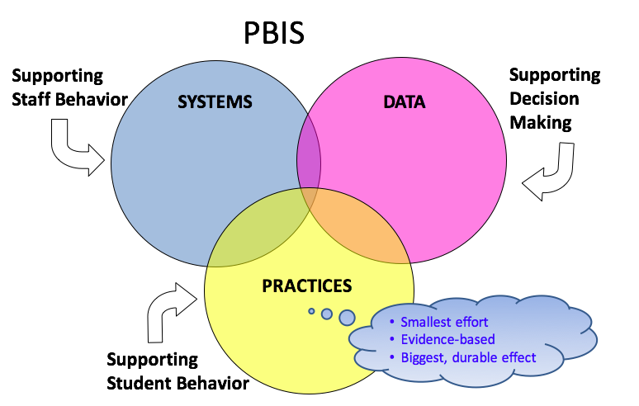
Systems, Data, Practices

Slide 8
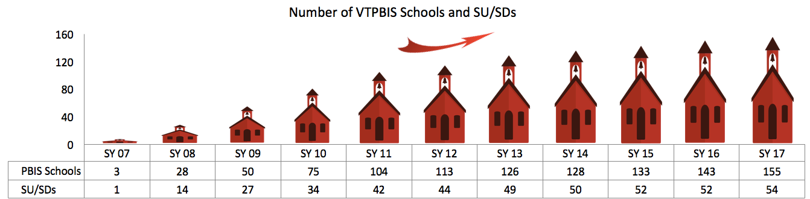
Vermont PBIS
VT schools began implementing PBIS in 2007
Currently, 53% (155) of VT schools are implementing PBIS in 98% (54) of Supervisory Unions/Supervisory Districts

Slide 9
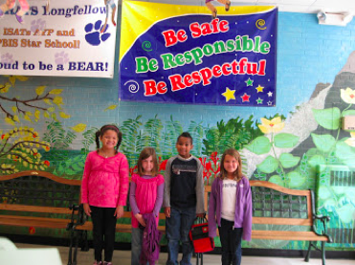
Why PBIS?
When schools take a positive approach toward addressing discipline:
  School climate improves
  Suspensions, expulsions, and dropouts decrease
  Time in class, on task increases
Notes:
Students spend more time in their classrooms rather than in the principal’s office, and teachers spend more time on instruction rather than on discipline.

Slide 10
Why PBIS?
When a student...
Doesn’t know how to read – what do we do?
WE TEACH.
Doesn’t know how to add – what do we do?
WE TEACH.
Doesn’t know how to swim – what do we do?
WE TEACH.
Doesn’t know how to drive – what do we do?
WE TEACH.
When a student doesn’t know how to behave – what do we do?
What can we do?

Slide 11
Why PBIS for Afterschool Programs?
ASPs are charged with providing academic support and enrichment to (often) at-risk students/families, with the intention of fostering resilience and building community
ASPs often have high accountability demands and limited resources for staff development
Staff often ask for behavior management training
(Farrell, Collier-Meek, & Pons, 2013)

Slide 12
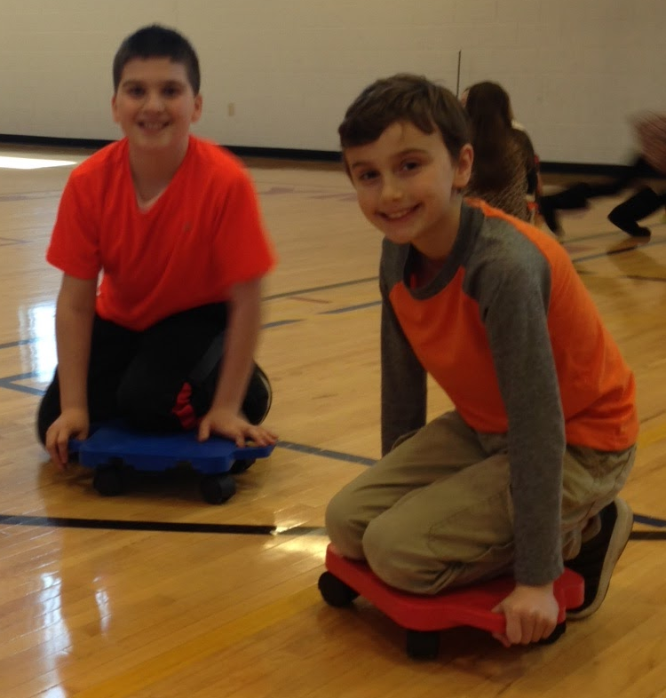

Why PBIS for Afterschool Programs?
General Character of School Day vs. ASP
School day:
  Highly structured
  Instruction = primary emphasis
  Many problem behaviors occur outside classroom in common areas (e.g. playground, hallway) (Newcomer et al., 2009)
ASP:
  Relatively unstructured, ambiguous, less predictable
  More recreational activities
  More transitions
  Socially complex
  Can make problem behaviors more likely (Newcomer et al.)
(Farrell, Collier-Meek, & Pons, 2013)

Slide 13
Why PBIS for Afterschool Programs?
Provides effective and efficient systems and practices
Makes expectations and routines explicit, predictable = less socially complex
Continuity throughout students’ day
Resources are freely available online
  VTPBIS frequently hosts free webinars
(Farrell, Collier-Meek, & Pons, 2013)

Slide 14

Bridge the Gap
School Day
PBIS
After School Program

Slide 15
Who is Responsible for PBIS in Schools?
School leadership team made up of school staff (ex: principal, general educators, special educators, school counselors, cafeteria workers, etc.):
  Meets regularly to review school-wide and student data
  Makes decisions about practices and systems
Parents may also be members of school-wide team

Slide 16
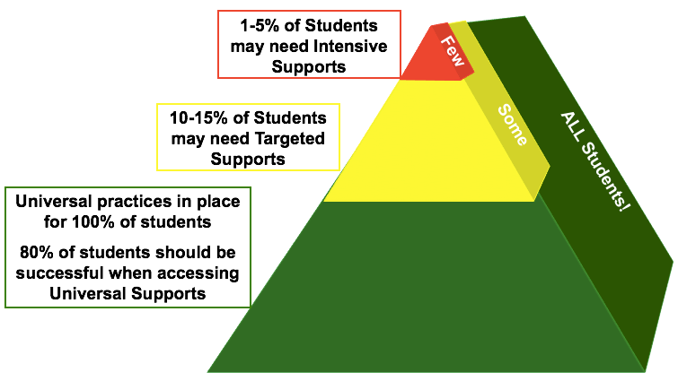
Tiers of Implementation

Slide 17
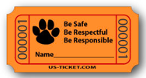
Universal
Schools define positively-stated universal behavioral expectations (in all settings)
  (e.g. “Be Respectful, Safe, & Responsible”)
Students are:
  Explicitly taught behavioral expectations
  Positively reinforced for exhibiting expected behaviors
  Re-taught expectations based on data

Slide 18
What are your program’s rules or expectations?
Do staff and students know them?

Slide 19
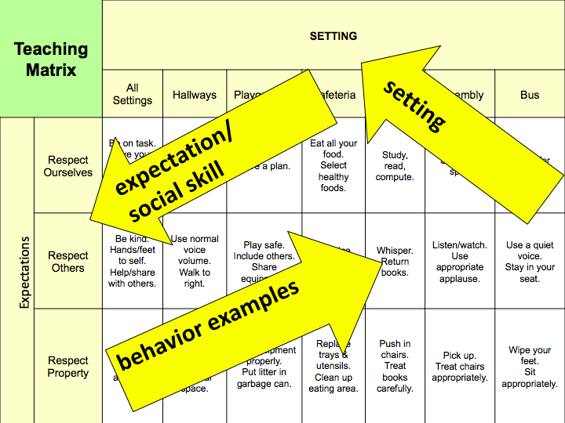
Notes:
Examples are positively stated! All your rules in your handbook can be reframed to fit within this matrix.
Identify the most common behavioral error in that location, and identify the positive alternative.
The matrix is a living document. Can change depending on what behaviors are happening

Slide 20
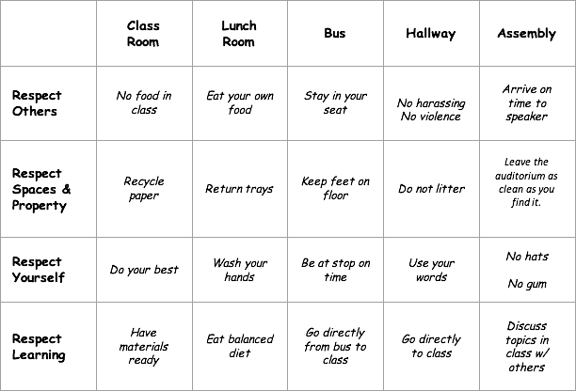
Teaching Matrix: Identify cells to change

Slide 21
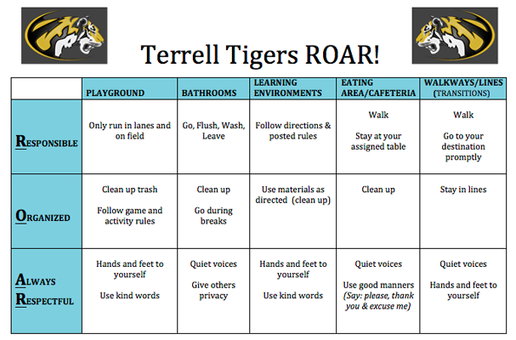
Example

Slide 22
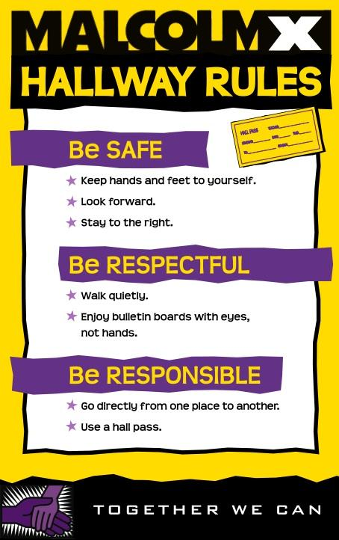
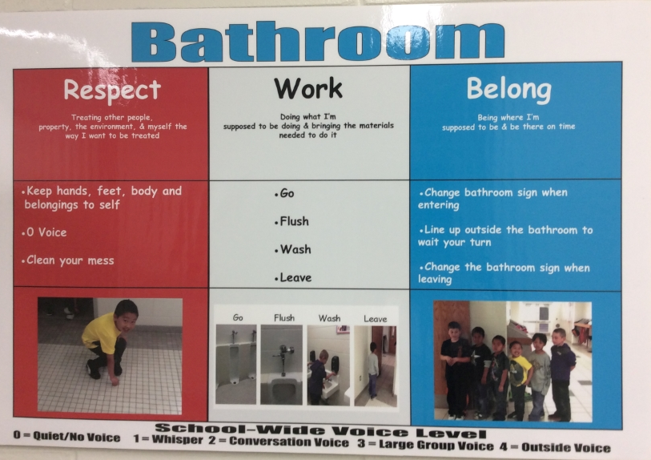
Visuals

Slide 23
Activity
What might your program-wide expectations be?
What do those expectations look like in different locations/for different routines?
How can you make these expectations visual?

Slide 24
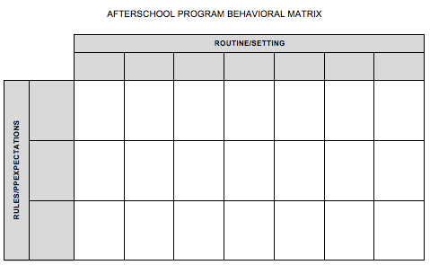
Activity
Choose one setting and one expectation
Define 1-2 positively stated skills

Slide 25
Teaching the Expectations
Use a specific, positive statement
Provide the reason and describe
Model and provide practice
Use prompts and reminders
Give reinforcement and feedback
Evaluate effectiveness of instruction & redesign instruction, if necessary

Slide 26
Teaching the Expectations
Teach school-wide expectations as specific, observable behaviors
Teach in the actual settings
Teach what to say and what to do
Make expectations crystal clear
Differentiate for learning styles and abilities
Teach so that students will succeed

Slide 27
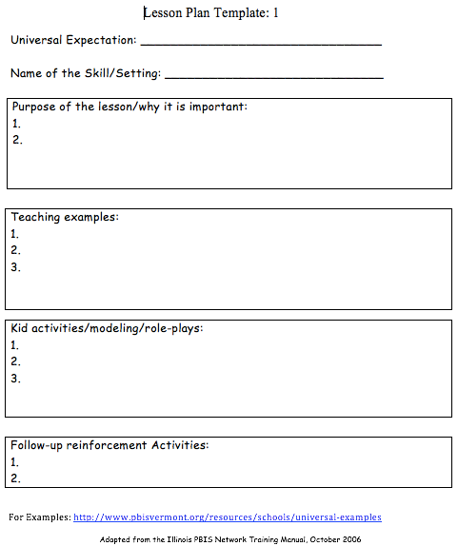
Lesson Plan Template

Slide 28
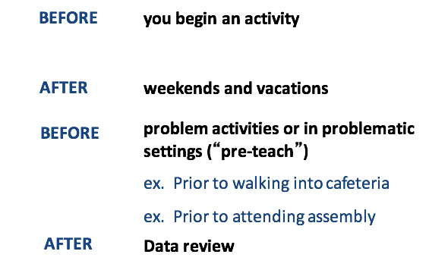
Review Expectations Frequently

Slide 29
Brainstorm
How/when/where might you teach behavioral expectations to students in your program?

Slide 30
Acknowledging Positive Behavior
Use descriptive reinforcement/feedback
  It's more effective at increasing desired behavior.
  Non-descriptive: Good job!
  Descriptive noticing example: John, I notice you are walking safely in the hallway, good job!

Slide 31
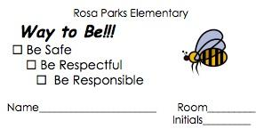
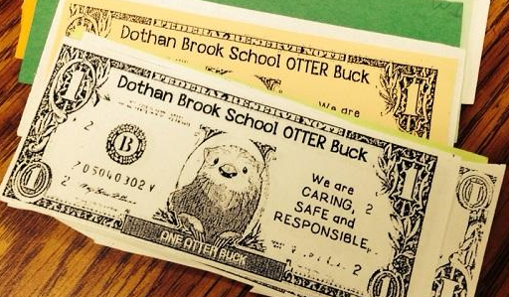
Acknowledgement System Components
What it looks like
What it’s called
How students get it
What students do with it
How to keep track of it
Notes:
What it looks like: Title Examples: Skipper slips, Found Being Incredible (FBI), Carver Coins, Caught Being Good, Passport to Success, Panther Points
it visible in the school….just like the expectations and teaching matrixes.
What’s it called?
Molly Stark Stars
BEST Bucks
Pride Tickets (Craftsbury)
How do students get it?
•specific ways student earns the reinforcement
•how often will it be delivered
•how many students/staff receive it
•how/when/where student is reinforced
•(consider publicly or privately)
What do students do with it?
•turn in for drawing/raffle
•post in classroom or hallway
•contribute to school-wide collection
How do you keep track of it?
•build in ways to collect data: by quantity
•by location, by grade levels (color coded slips)
•by who is using (signature on slips)
Award Examples: Going with principal to fill Coke machine, slips or coins
Criteria

Slide 32
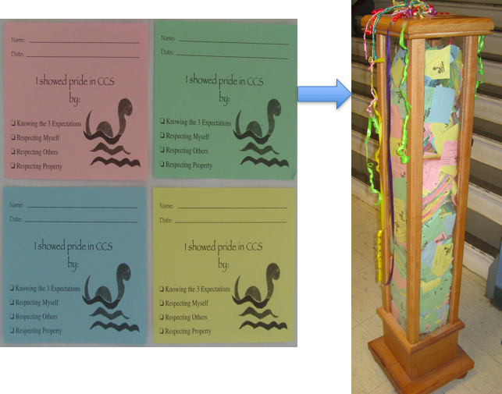
Example

Slide 33

PBIS Big Ideas
PBIS is about systematically changing adult behavior
We are trying to achieve a ratio of 5-6 positives to 1 negative adult-to-student interactions

Slide 34
Activity
What might your acknowledgement system look like for your program?
If you aren’t able to do a program-wide system, what might it look like for individuals?

Slide 35
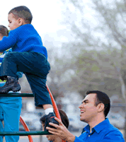
Active Supervision
High levels of engagement, supervision, and interaction
Positive feedback to students
Pre-correct problem behaviors
Calm, brief responses to problem behaviors

Slide 36
Proactive
Remind:
  Use neutral tone to remind students of expected behaviors
Reinforce:
  Positively reinforce displays of desired behavior
Pre-correct:
  Recurring problems:
    Identify triggers and functions
    Set modifications that prevent the behavior
Change the environment (e.g. reduce wait time)
Provide choice

Slide 37
Reactive
Calm, neutral, private (when possible)
Signal that expectation has not been met
State the expected behavior
Ask student to show expected behavior
  If they do, give positive feedback
  If they don’t, calmly ask them to take a quick break from the group

Slide 38

Targeted
Provide the student with more structure, predictability, and feedback
Interventions:
  Small group social skills instruction
  Mentoring
  Check-In/Check-Out
  Increased Home-to-school communication
Monitor student progress, gather, and use data to make decisions

Slide 39

Intensive
Students may have a mental health issue and/or significant behavior challenges that require a high degree of individualized attention and support
Interventions:
  A Functional Behavioral Assessment (FBA)
  A Behavior Support Plan (BSP)

Slide 40
Functional Behavioral Assessment
Define behavior in observable and measurable terms
Ask about behavior by interviewing staff and student; specify routines where & when behavior occurs; summarize where, when, and why behavior occurs
See the behavior; observe the behavior during routines specified to verify summary from interviews
Hypothesize; a final summary of where, when, and why behaviors occur

Slide 41
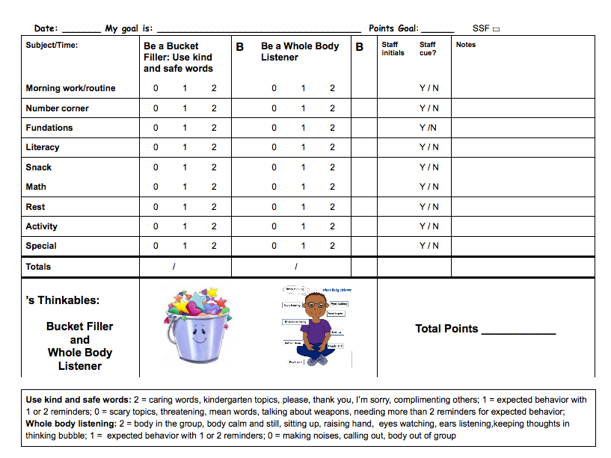
Behavior Support Plan
Two Goals:
1. Reduce problem behavior
2. Teach alternative desired behavior

Slide 42
Wrap-Up
What do you like/not like about PBIS?
What questions do you have about PBIS?
What practices will you start adding or improving?

Slide 43
Resources
National Center on Positive Behavior Interventions and Supports: http://www.pbis.org: The Center assists states in implementing schoolwide PBIS to improve problem behavior and enhance learning environments
VTPBIS Leadership Team: http://www.PBISvermont.org: Look here for more information about PBIS in VT schools including steps to getting started and upcoming trainings

Slide 44
Resources
Association for Positive Behavioral Support: http://www.APBS.org: The Association for Positive Behavior Support is an international organization dedicated to the advancement of positive behavior support
Vermont Family Network (VFN) 1-800-800-4005: http://www.vermontfamilynetwork.org: VFN is a family support and advocacy organization. Staff can answer questions about your child’s behavior, PBIS, and parent involvement in the PBIS process

Slide 45
Resources
Farrell, A; Collier-Meek, M; & Pons, S. (2013). Embedding positive behavior interventions and supports into afterschool programs. Beyond Behavior. https://www.researchgate.net/publication/264977490_Embedding_positive_behavior_interventions_and_supports_into_afterschool_programs

