Slide 1

Vermont Positive Behavior Interventions & Supports
Sample Staff Presentation

Slide 2
Objectives
After this presentation you will have…
Learned about PBIS within a Multi-tiered Framework
Viewed examples of PBIS
Briefly explored PBIS at the Targeted and Intensive Levels
Had the opportunity to vote:
  Yes;
  Yes, with Reservations; or
  No

Slide 3
What is your current knowledge about PBIS?
I know a lot
I know a little bit
I’m just learning
Notes:
Thumbs up, side and down…

Slide 4
Multi-tiered Systems Framework for Implementing Evidence-based Practices
Prevention-focused continuum of supports;
Data-based decision-making;
Regular universal screening and progress monitoring;
Systems change through effective professional development and coaching;
Effective team leadership; and
Research-validated practices for improving behavior and learning

Slide 5
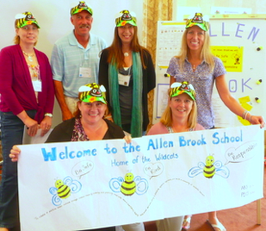
What is PBIS?
Evidence-based, school-wide approach to creating a positive and safe climate in which students can learn and grow
Used with all students and across all school environments
Structured, predictable

Slide 6
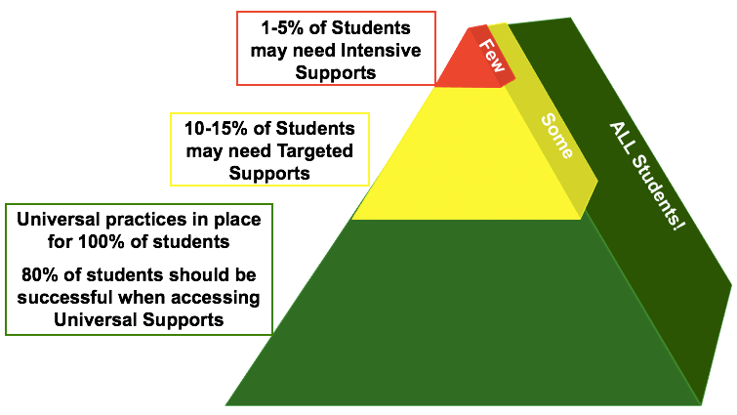
Tiers of Implementation

Slide 7
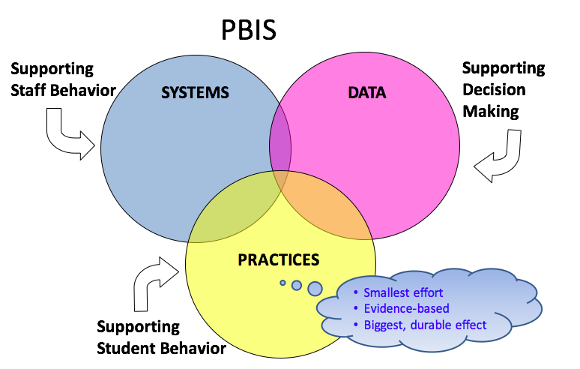
How is VTPBIS Sustainable?

Slide 8
Implementation Science
Exploration
Installation
Initial Implementation
Full Implementation
Innovation
Sustainability
3-5 years (this is normal!)

Slide 9
Infusing Restorative Principles
The Restorative Approach is about:
    Voluntary Participation
    Exploring Relationships
    Meaningful Engagement
    Participatory Decision-Making
The VTPBIS State Team is actively working to infuse restorative principles into our PBIS work.
We hope you’ll agree they enhance the PBIS work and made it more engaging and meaningful for staff and students.

Slide 10
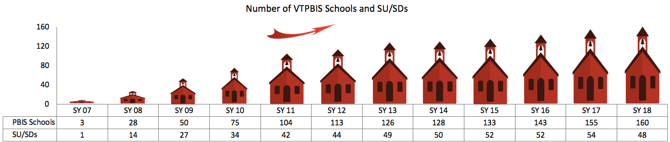
Vermont PBIS
VT schools began implementing PBIS in 2007
Currently, 160 VT schools are implementing PBIS in 48 Supervisory Unions/Supervisory Districts

Slide 11
PBIS Primary Outcomes
Increase in
Decrease in
academic performance
on-task behavior
parent, student, and staff satisfaction
staff retention
office referrals
suspensions, detentions
disruptive classroom behavior

Slide 12
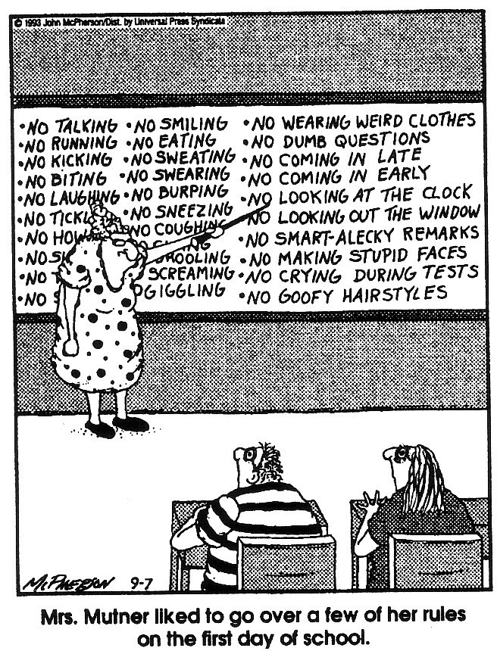
(Close to Home c Reprinted with permission of Universal Press Syndicate. All rights reserved.)

Slide 13
Why PBIS?
When a student...
Doesn’t know how to read – what do we do?
WE TEACH.
Doesn’t know how to add – what do we do?
WE TEACH.
Doesn’t know how to swim – what do we do?
WE TEACH.
Doesn’t know how to drive – what do we do?
WE TEACH.
When a student doesn’t know how to behave – what do we do?
What can we do?

Slide 14
Who is responsible for PBIS in Schools?
PBIS team made up of school staff (ex: principal, general educators, special educators, school counselors, cafeteria workers, etc.) who develop and carry out school-wide PBIS
Schools appoint in-school and district-level PBIS coordinators
Parents may also be members of school-wide team

Slide 15

What does the team do?
At regular meetings, the PBIS Leadership Team:
  Reviews school-wide student data
  Uses data to make decisions about:
    Interventions
    Practices
    Systems

Slide 16
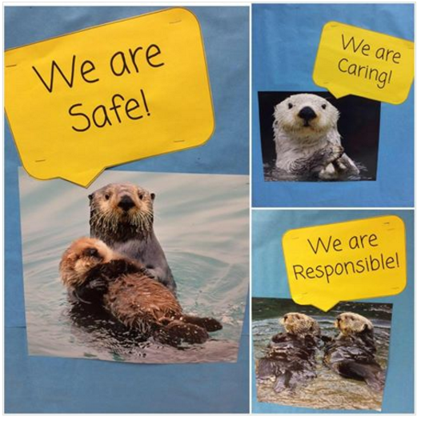
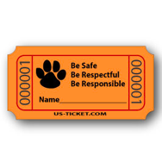
Universal
Schools define positively-stated universal behavioral expectations (in all settings)
  (e.g. “Be Safe, Be Respectful, Be Responsible”)
Students are:
  Explicitly taught behavioral expectations
  Positively reinforced for exhibiting expected behaviors
  Re-taught expectations based on data

Slide 17

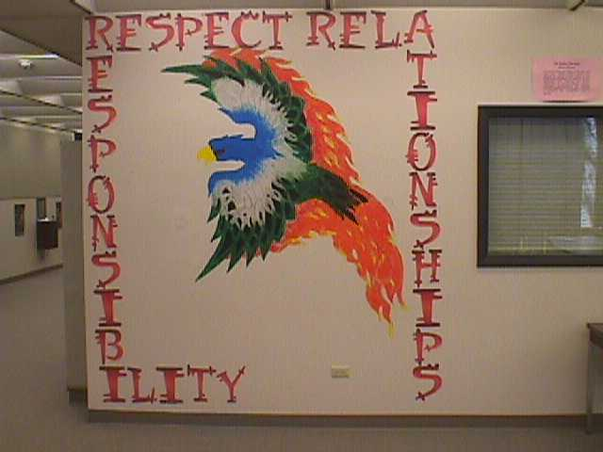
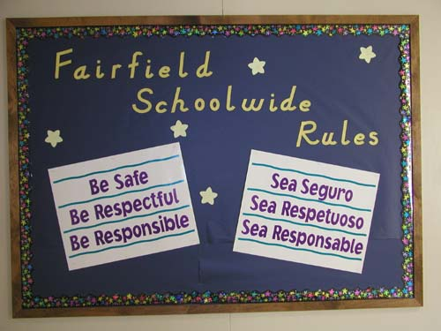
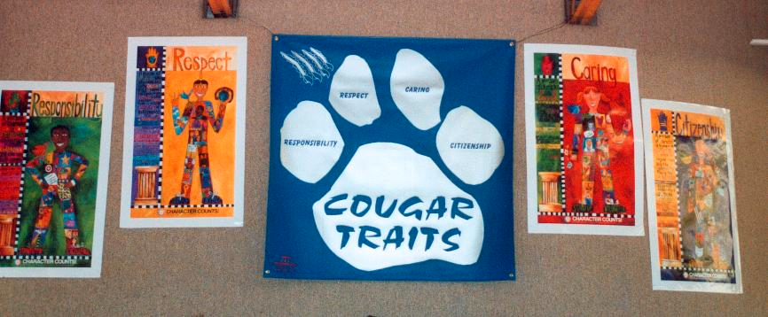
Few positive SW expectations defined, taught, & encouraged

Slide 18
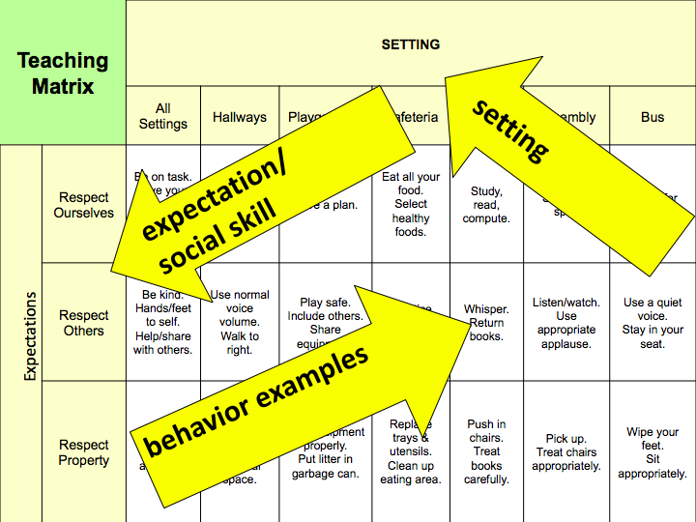
Notes:
Examples are positively stated! All your rules in your handbook can be reframed to fit within this matrix.
Identify the most common behavioral error in that location, and identify the positive alternative.
The matrix is a living document. Can change depending on what behaviors are happening

Slide 19

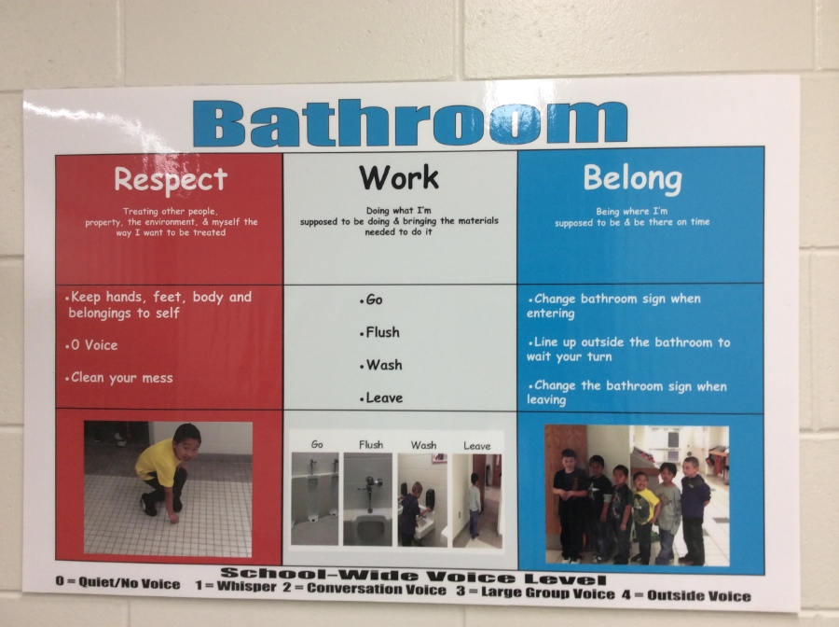
Visuals

Slide 20
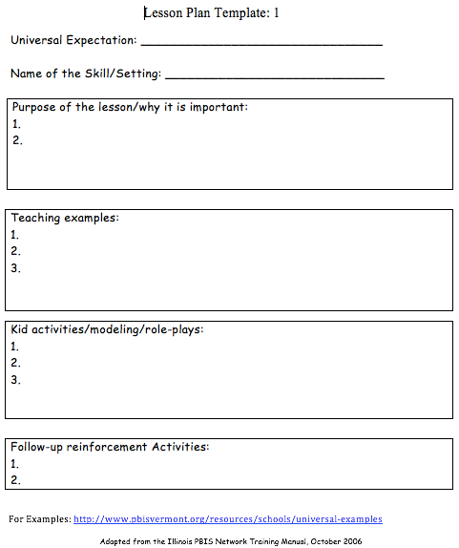
Lesson Plan Template

Slide 21
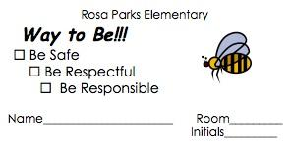
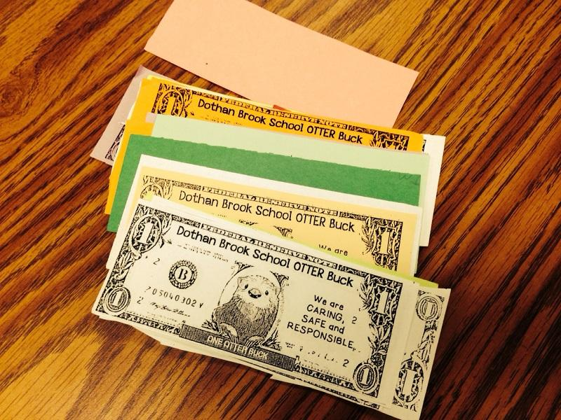
Acknowledgement System Components
What it looks like
What it’s called
How students get it
What students do with it
How to keep track of it
Notes:
What it looks like: Title Examples: Skipper slips, Found Being Incredible (FBI), Carver Coins, Caught Being Good, Passport to Success, Panther Points
it visible in the school….just like the expectations and teaching matrixes.
What’s it called?
Molly Stark Stars
BEST Bucks
Pride Tickets (Craftsbury)
How do students get it?
•specific ways student earns the reinforcement
•how often will it be delivered
•how many students/staff receive it
•how/when/where student is reinforced
•(consider publicly or privately)
What do students do with it?
•turn in for drawing/raffle
•post in classroom or hallway
•contribute to school-wide collection
How do you keep track of it?
•build in ways to collect data: by quantity
•by location, by grade levels (color coded slips)
•by who is using (signature on slips)
Award Examples: Going with principal to fill Coke machine, slips or coins
Criteria

Slide 22
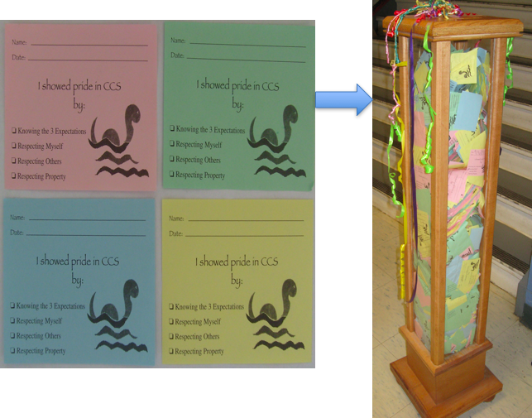
Example

Slide 23

PBIS Big Ideas
PBIS is about systematically changing adult behavior
We are trying to achieve a ratio of 5-6 positives to 1 negative adult-to-student interactions

Slide 24
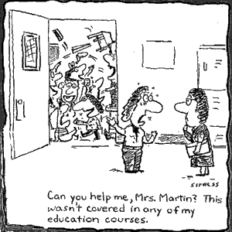
Discouraging Problem Behavior
Consistent practices for preventing problem behaviors
Distinguishing between minor and major behaviors
Practices for responding to problem behaviors
Continuum of procedures for responding to problem behaviors

Slide 25
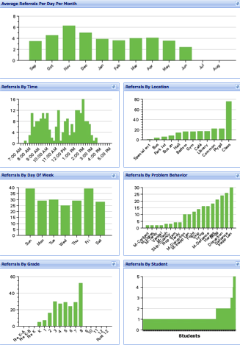
Record-Keeping and Decision-Making
Avg. Referrals Per Day Per Month
Time
Location
Day of Week
Problem
Behavior
Grade
Student

Slide 26
What should you expect to hear/see in a PBIS School (at the Universal level)?
  80% of students can tell you the school-wide expectations and can say that they have been rewarded for following them
  80% of staff can tell you the school-wide expectations and can say they have acknowledged students for following them
  School staff have taught the school-wide expectations to all students
  Positive adult-to-student interactions exceed negative
Notes:
School staff agree on which behaviors involve a referral to the office.
The school has a leadership team that is representative of school staff and includes an administrator
Function based behavior support is foundation for addressing problem behavior.
Data & team-based action planning & implementation are operating.

Slide 27
What should you expect to hear/see in a PBIS School?
  School staff agree on which behaviors involve a referral to the office
  The school has a leadership team that is representative of school staff and includes an administrator
  Function based behavior support is foundation for addressing problem behavior
  Data & team-based action planning & implementation are operating

Slide 28

Targeted
Provide the student with more structure, predictability, and feedback
Interventions:
  Small group social skills instruction
  Mentoring
  Check-In/Check-Out
  Increased home-to-school communication
Monitor student progress, gather and use data to make decisions

Slide 29

Intensive
Students may have a mental health issue and/or significant behavior challenges that require a high degree of individualized attention and support
Interventions:
  A Functional Behavioral Assessment (FBA)
  A Behavior Support Plan (BSP)

Slide 30
Voting by Ballot
  Yes;
  Yes, with Reservations; or
  No

Slide 31
Resources
National Center on Positive Behavior Interventions and Supports: http://www.pbis.org: The Center assists states in implementing schoolwide PBIS to improve problem behavior and enhance learning environments
VTPBIS Leadership Team: http://www.PBiSvermont.org: Look here for more information about PBIS in VT schools including steps to getting started and upcoming trainings

Slide 32
Resources
Association for Positive Behavioral Support: http://www.APBS.org: The Association for Positive Behavior Support is an international organization dedicated to the advancement of positive behavior support
Vermont Family Network (VFN) 1-800-800-4005: http://www.vermontfamilynetwork.org: VFN is a family support and advocacy organization. Staff can answer questions about your child’s behavior, PBIS, and parent involvement in the PBIS process

