Slide 1
Classroom Behavior Practice Coaches (CBPC) Cohorts 1, 2, & 3 Meeting

Slide 2
Agenda
Brief overview of where we’ve been
Report out on:
Summer work
In-service training(s)
Coaching
Next steps
Feedback to Inform Cohort 4

Slide 3
Our Goal
To help schools build their capacity to support teachers' implementation of evidence-based classroom management practices
(e.g., behavior specific praise, opportunities to respond, etc.)

Slide 4
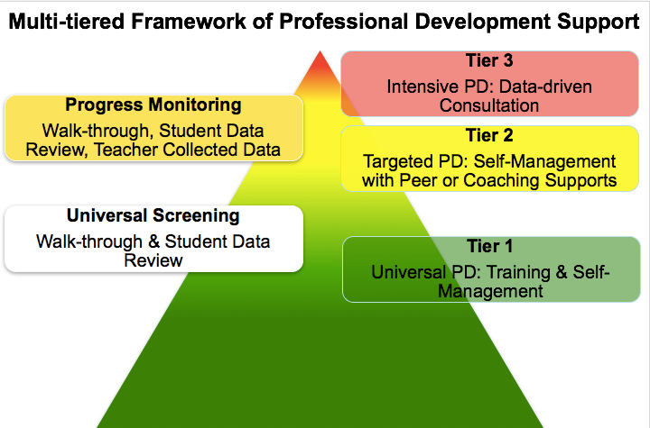
(adapted from Simonsen, MasSuga, Briere, Freeman, Myers, Scott, & Sugai, 2013)

Slide 5
Materials Used

Slide 6
Skills
OUTCOMES
VT PBIS BEST Team
supports
SYSTEMS
DATA
Classroom Behavior Practice Coaches
who
support
PRACTICES
Teachers within School(s)
Train-the-trainer, coach-the-coach, or turn-key approach to building capacity.

Slide 7
How are we doing?
Short answer: We don’t know
Major ODRs from the classroom fluctuating
Only 2 schools trained in Cohort 1 have seen a decline each year
5 out of 9 Cohort 2 schools saw a decline in the first year
Hard to know which schools truly rolled out
Hard to know if data collection methods have changed

Slide 8
Evaluation Tools
DATA
Existing Data
Classroom Office Discipline Referrals (ODR)
Classroom Item on Tiered Fidelity Inventory (TFI)
Checklists During Training
Classroom Management Assessment (CMA)
Classroom Systems Assessment (CSA)
Possible Additional Sources of Data
School Climate Survey
Direct Observations (by self, peer, coach, etc.)
Which of these indicators have you used to assess change?

Slide 9
Discussion Questions
How should we assess success of this project?
Should we continue this cohort model if we aren’t seeing a decline in major ODRs from the classroom?
What changes have you noticed in your teachers/students as a result of this work?

Slide 10
Classroom Behavior Practice Coaches Report Out

Slide 11
What struggles have you encountered? What are you proud of? Summer work In-service training(s) Coaching

Slide 12
Classroom Behavior Practice Coaches Next Steps

Slide 13
What’s Next?
Continued full staff PD?
Coaching?
Coach – teacher
Peer coaching
Self-monitoring

Slide 14
What’s Next?
Post-implementation assessments:
Walkthroughs
Self-Assessments
Share baseline and post-implementation results to staff in the aggregate at a staff meeting and celebrate growth!
Update Action Plan

Slide 15
Opportunity to Connect
Option to attend in-person session (or two) in January and/or May following the Coordinators Networking Meeting(s)
Would you like the option to attend Cohort 4’s webinars?
What other support do you need?

Slide 16
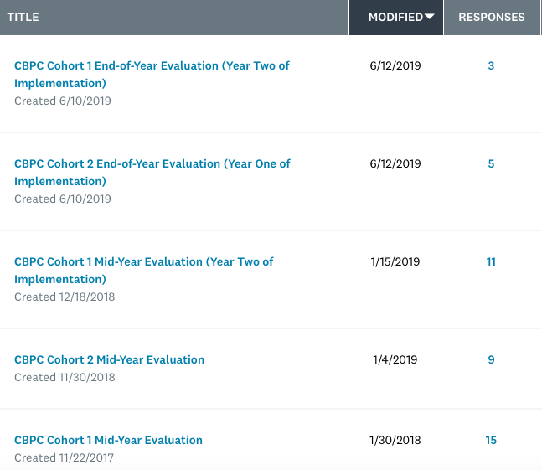
Data Collection
VTPBIS State Team will analyze overall classroom major ODRs
Survey to CPBCs 2x/year collecting data on training and coaching
This method is not working; we’ve lost you
Only 3 Cohort 1 CBPCs responded to the end-of-year eval

Slide 17
Feedback to Inform Cohorts 4+?

Slide 18
Resources Reminders
Calendar of Activities (this one is Cohort 3’s): https://docs.google.com/document/d/10uqtsPgkTp3pYEYhtUgSEcgy6VE7FQ53tCIVNqvt1XM/edit
NEPBIS Website: http://neswpbs.org/VT-Area
Each other!
Brandi, Amy, and Sherry

Slide 19
Questions?

Slide 20
Additional Content if Needed

Slide 21
PCBS Practices Decision-making Guide: 3 Key ?s
Are the foundations of effective PCBS in place?
Effectively design the physical environment of the classroom
+
Develop & teach predictable classroom routines.
+
Post, define, & teach 3-5 positive classroom expectations.
Are proactive and positive PCBS practices implemented consistently?
Provide high rates of varied opportunities to respond.
+
Use prompts and active supervision.
+
Acknowledge behavior with specific praise & other strategies.
Do data indicate that students are still engaging in problem behavior?

Slide 22
Are students still engaging in problem behavior?
Are behaviors minor or major expectation violations?
Well done! Monitor outcomes and adjust as needed
Use brief, specific error correction & other strategies
How many students are involved (many or few)?
Review, adjust & intensify CWPBIS. Ask for help!
Request additional (tier 2 & 3) support for students.
Yes
No
Minor
Major
Do data indicate that students are still engaging in problem behavior?
Many
Few

Slide 23
PCBS Systems Action Planning Guide:
3 Key Questions
Are the foundational systems in place to support PCBS practice implementation by all staff?
PCPS implementation is a clear school and district priority
+
School and district resources are available to support PCBS implementation
+
School and district teams have considered alignment and integration of PCBS with other district priorities and initiatives
Do all staff know what PCBS practices to implement and if they’re doing it accurately?
Clear expectations and explicit training about practices that should be implemented by all staff
+
Coaching and/or regularly available performance feedback on the use of PCBS practices
Do data indicate that staff are implementing PCBS practices effectively?

Slide 24
Are staff implementing PCBS with fidelity?
Determine the number of classrooms needing support (many or a few)
Review and adjust universal support
Determine type and severity of implementation changes (minor or major)
Provide supplemental support to small groups of staff needing support
Consider individualized supports and other strategies for staff members needing intensified support.
Well done! Monitor outcomes and adjust as needed
Yes
No
Minor
Major
Many
Few
Do data indicate that staff are implementing PCBS practices effectively?

Slide 25
Action Plan
OUTCOMES
DATA
SYSTEMS
1st page sets norms and aligns this action plan with PBIS action plan for school.
2nd page prompts foundations, explicit training, and coaching.
3rd page prompts performance feedback, data, and differentiation.

