Slide 1
Maximizing the Effectiveness of your PBIS Team Meetings
Bonnie Poe, VTPBIS Coach and Trainer
VTPBIS Annual Leadership Forum, October 2018

Slide 2
Maximizing Your Session Participation
Consider these questions:
Where are we in our implementation?
What do I hope to learn?
What did I learn?
What will I do with what I learned?
By when?
Use the Learning Reflection Sheet

Slide 3
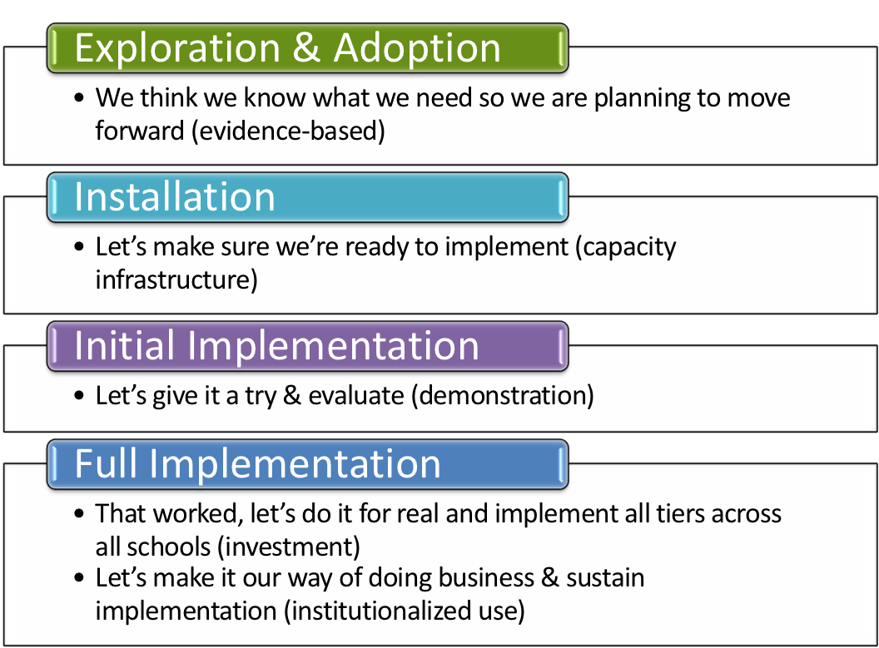
Where is your school in the implementation process?
Adapted from Fixsen & Blase, 2005

Slide 4
Objectives:
Implement meeting work with fidelity
Self identify what you want to work on in your meetings
Identify some strategies for looking at data

Slide 5
People who enjoy meetings should not be in charge of anything.
Thomas Sowelle
Why refresh team
meeting skills?

Slide 8
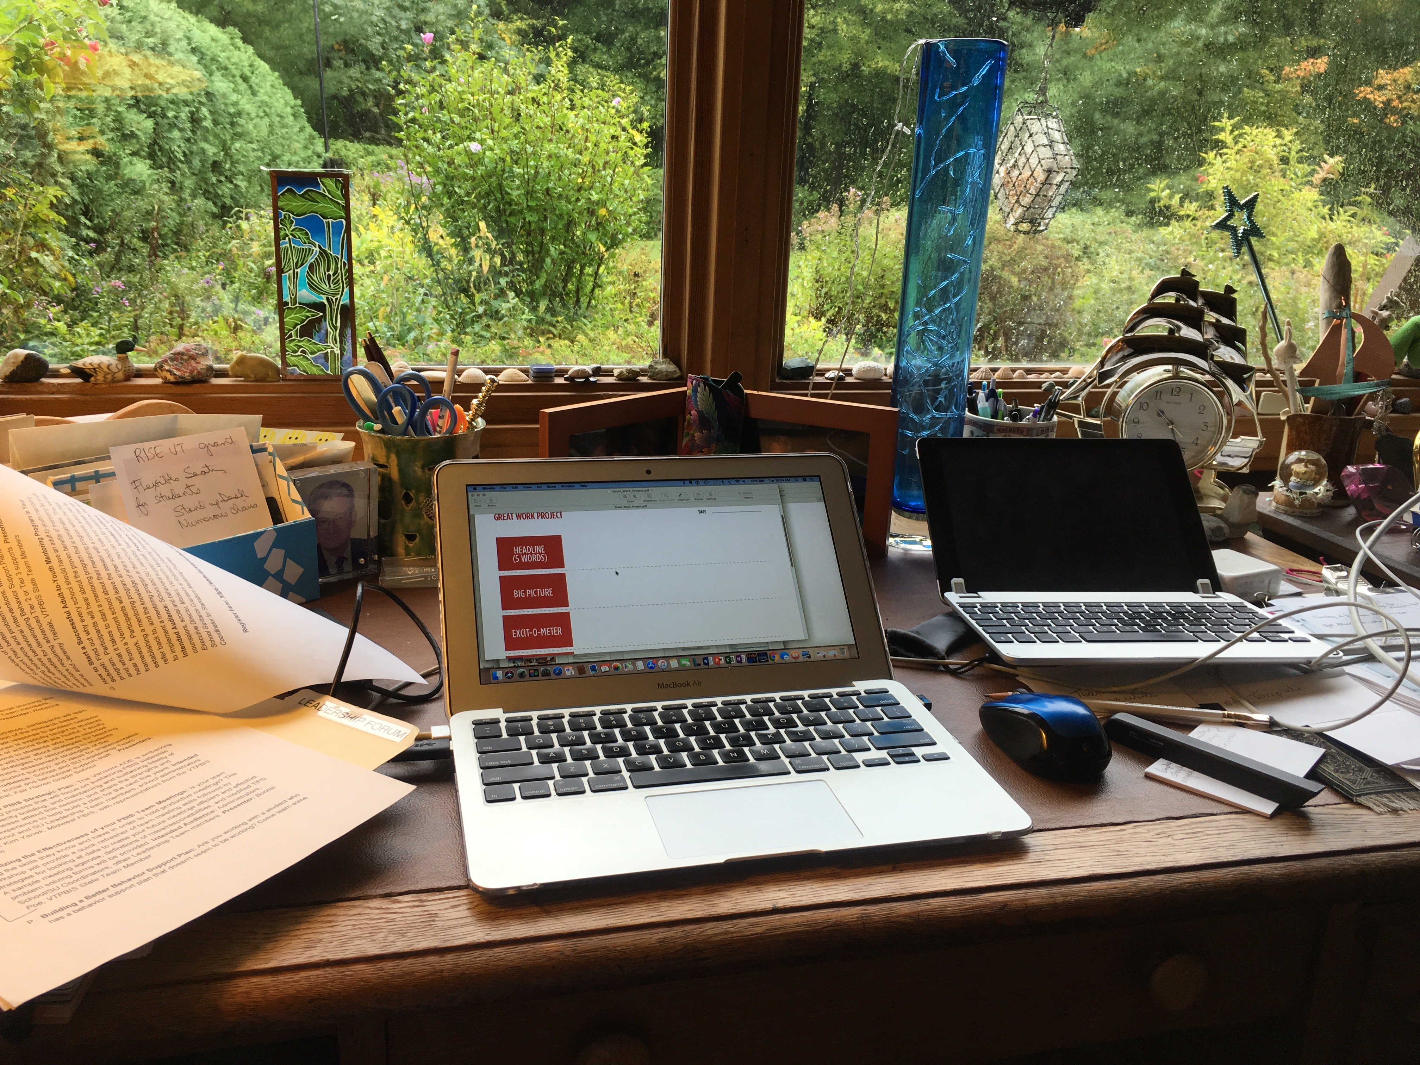

Slide 9
Non-example

Slide 10
Some Basics:
Team members
Agenda
Google Doc
Projector
Comfortable Environment

Slide 11
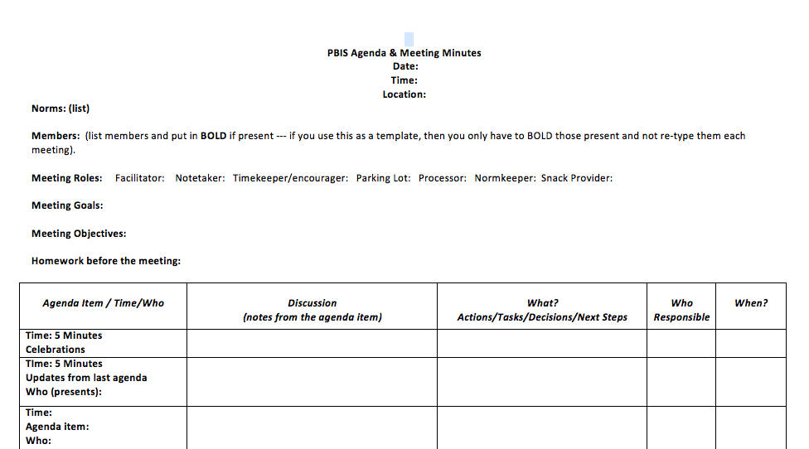

Slide 12
Norms:
Be prepared
Be on time
Keep on task
Share the air
Decisions based made on data
Encourage others
The culture of a workplace - an organization's values, norms and practices - has a huge impact on our happiness and success.
Adam Grant

Slide 14
Members
Save time and list them and then Bold them when present

Slide 16
Member roles*:
Determine at previous meeting
*role definitions online

Slide 18
Importance of Goals and Objectives for a Meeting
One way to keep momentum going is to have constantly greater goals.
Michael Korda

Slide 20
Homework????
When you go to meetings or auditions and you fail to prepare, then prepare to fail. It is simple but true.
Paula Abdul

Slide 22
Capture the key information for future use
How will decisions be made?

Slide 24
+As the meeting progresses, note
potential next meeting agenda items
+ Choose next member roles

Slide 25
Notes:
.

Slide 27
Take 5 –
Reflect on anything you want to address at your PBIS team meetings
Stretch, stand up

Slide 28
“In God we trust. All others must bring data.”- W. Edwards Deming, Statistician

Slide 29
Some Data Tips:
SWIS Proficiency
https://www.pbisvermont.org/

Slide 30
If teachers are reporting minors and majors, then share the data as frequently as you can! WHY?

Slide 31
“I think you can have a ridiculously enormous and complex data set, but if you have the right tools and methodology then it’s not a problem.” – Aaron Koblin, Entrepreneur in data and digital technologies

Slide 32
https://www.youtube.com/watch?v=3FIgioXyJlU&feature=youtu.be

Slide 33
Protocols

Slide 34
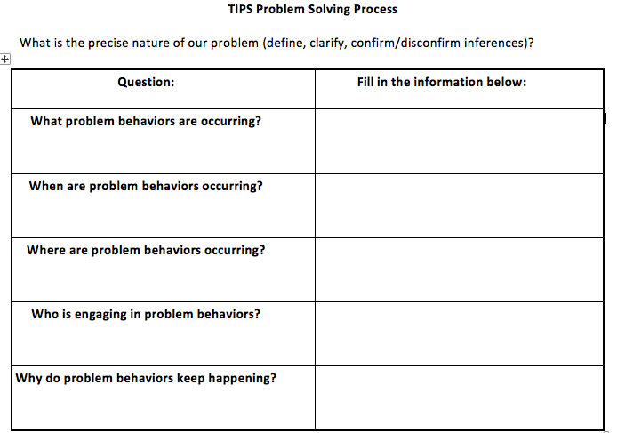

Slide 35
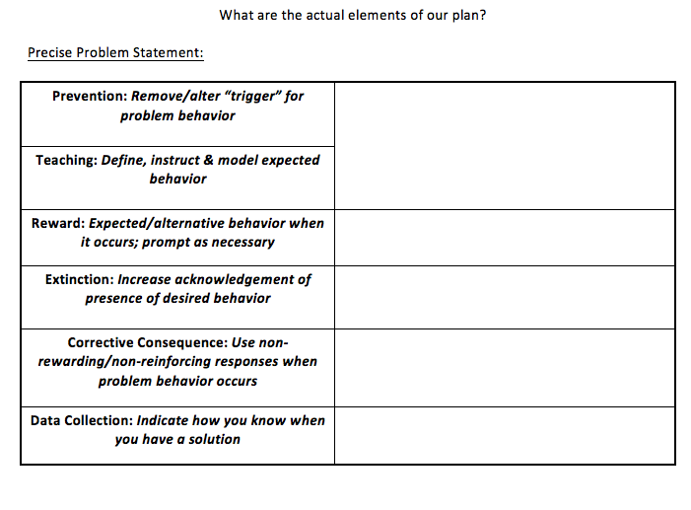

Slide 36
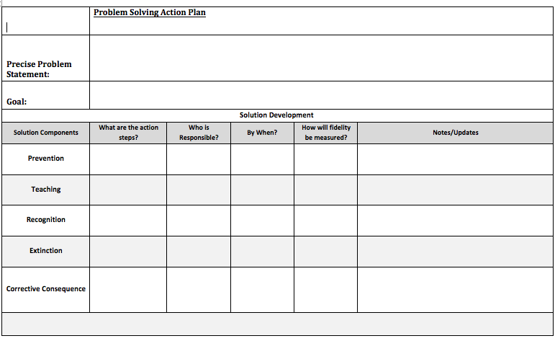

Slide 38
Some thought provoking quotes about data:

Slide 39
It is a capital mistake to theorize before one has data. Arthur Conan Doyle

Slide 40
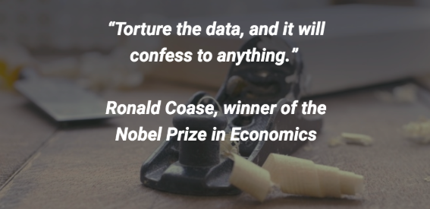

Slide 42
“You can have data without information, but you cannot have information without data.”
– Daniel Keys Moran, an American computer programmer and science fiction writer

Slide 43
Final thoughts:
Data should drive how decisions are made.
Data will help avoid looking for the “silver bullet” (a simple and seemingly magical solution to a complicated problem).

Slide 44
CREDITS
Special thanks to all the people who made and released these awesome resources for free:
Presentation template by SlidesCarnival
Photographs by Unsplash

