Slide 1
How to Start a Successful Adult-to-Youth Mentoring Program in Your School
A Tier 2 Intervention that works!
October 11, 2018
Amy Johnston, MS, School Counselor, Mentor Coordinator
Chad Butt, Executive Director, MENTOR Vermont

Slide 2
Maximizing Your Session Participation
Consider these questions:
Where are we in our implementation?
What do I hope to learn?
What did I learn?
What will I do with what I learned?
By when?
Use the Learning Reflection Sheet

Slide 3
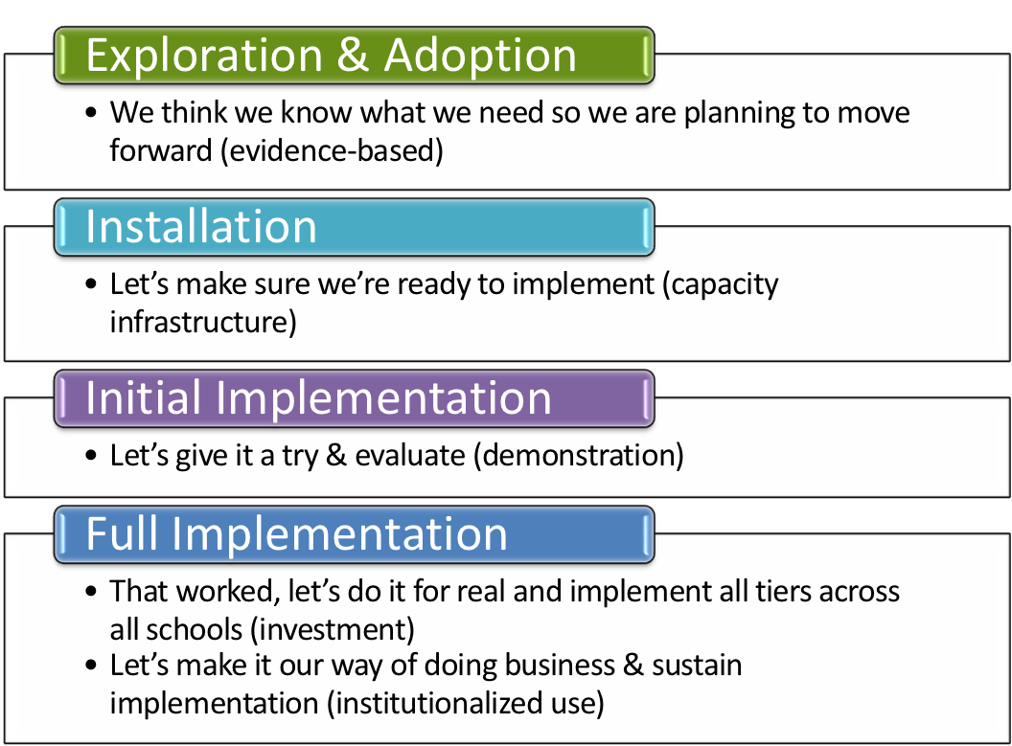
Where is your school in the implementation process?
Adapted from Fixsen & Blase, 2005
Notes:
Emphasis is that you have identified that you have a need. How did you identify it? Is it climate, behavioral challenges, both? Why do you want to explore an evidence based practice?

Slide 4
Introductions
Goals
Starksboro Mentoring Program
Mentoring In Vermont
Why Mentoring
How to Start a Program
Questions

Slide 5
Introductions

Slide 6
Introductions
Name
School
Position
What is one obstacle you perceive for starting a mentoring program at your school?

Slide 7
Goals

Slide 8
Goals for Workshop
Reaffirm that you made a good decision
Gain better understanding of mentoring
Leave with tools & resources to start a program
Answer any questions you may have

Slide 9
Starksboro Mentoring Program

Slide 10
A Mentoring Story

Slide 11
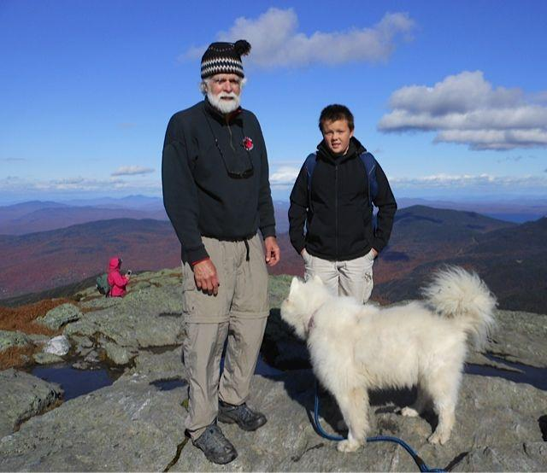
How We Built Our Program
Starksboro Mentoring Program
Brief history-EST and the need in rural isolated town
Community and School Program
1:1 and Whole group gatherings (buses)

Slide 12
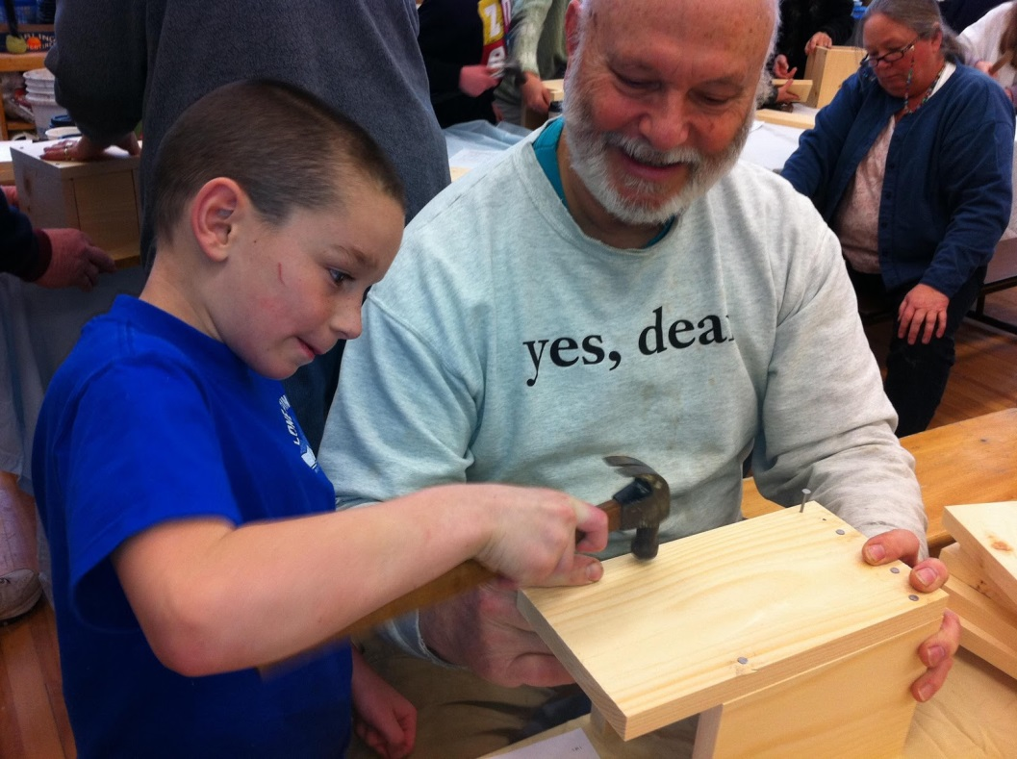
Supporting Mentors So They Can Support Mentees
Sense of Importance - posters, quilts, nametags, birdhouses, brochures, letters
Sense of Significance (sharing mentee stories)
Sense of Belonging & Connectedness (mentor only events)
Sense of Fun
Sense of Identity

Slide 13
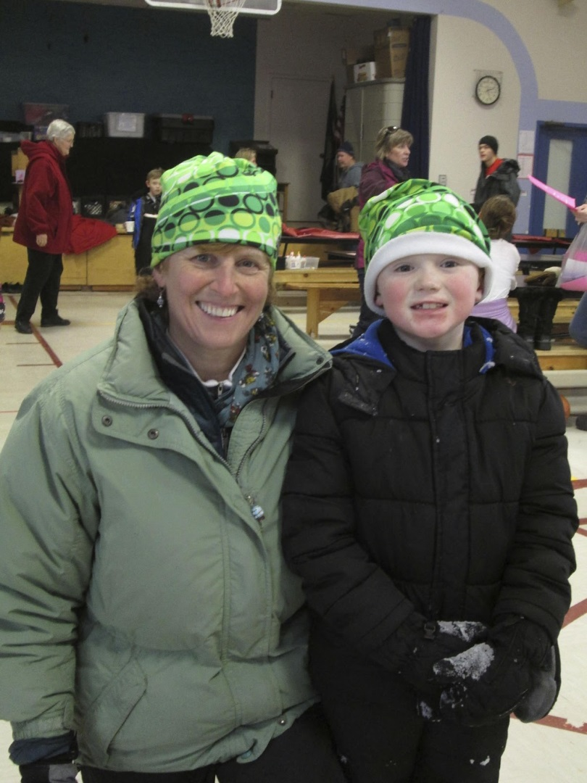
Community Support of Program
Teachers: field trips, emails, stories, recognition
Community Members: awareness, front page forum, town meeting, library, town report
Board: check-ins with new mentors
Mentees: training/giving back
Administration: speak at Town Meeting

Slide 14
ROBINSON TEACHERS REFLECT:
I know that the mentoring program fosters transformative relationships. When mentors and children are matched they are able to begin a new, unconditionally supportive relationship. This relationship provides so much light and life to children that are often in need of positive and engaged time with a involved, caring adult. Building this relationship allows the child to see his/her best self through the eyes of their mentor. That reflection offers the child confidence, joy and a deeper sense of belonging.
At the same time, from the smiles radiating from the mentors in our hallways, it is clear that their hearts are forever changed through opening their lives to the mentoring relationship. The small projects, fun games, or bright conversations I hear across the halls are evidence that these "little" relationships provide deep meaning in the lives of both mentors and children at our school. - Grade 3/4 Teacher

Slide 15
ROBINSON TEACHERS REFLECT:
The mentoring program has had a tremendous effect on the self-esteem of one of my fourth grade students as well as on his overall happiness here at school. Just having another adult in his life who would show up, listen and spend quality time with him made a world of difference. Every student I've had and that I have now that have a mentor match are absolutely elated when their mentor arrives and anxious to tell me about the events they went to together outside of school on Monday. It's an incredible program and I only wish that every student had a mentor! - Grade 3/4 Teacher

Slide 16
Mentoring in Vermont

Slide 17
Mentoring in Vermont
40+ Agencies or School Districts/Supervisory Unions
140 Program Sites
2,300 Matches

Slide 18
Why Mentoring

Slide 19
The Impact

Slide 20
How to Start a Program

Slide 21
Starting a Mentoring Program
School Buy-In
Point Person
Advisory Committee
Planning Process
Funding
Best Practices

Slide 22
Major Pitfalls
Staffing Issues
Not a Separate Position or Part of Job
Not Paid Adequately
Not Enough Staff Time
Wrong Person
School Buy-In and Understanding of Program

Slide 23
Resources

Slide 24
We’re Here to Help
Online Resources
MENTOR Vermont
MENTOR: The National Mentoring Partnership
In-Person Support
Funding
Support & Training
Resources & Support

Slide 25
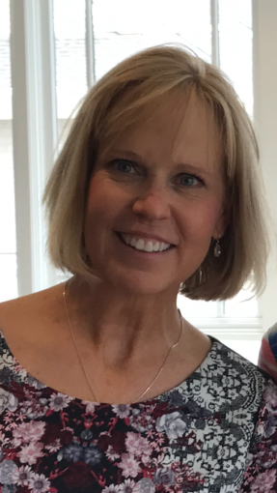
Contact Information
Chad Butt
Executive Director, MENTOR Vermont
chad@mentorvt.org (soon)
chad@mobiusmentors.org (now)
802-658-1888
Amy Johnston, MS
School Counselor & Mentor Coordinator
amy.johnston@mausd.org
802-453-2949

Slide 26
Questions?

