Slide 1
Welcome to the 2018 VTPBIS Leadership Forum!

Slide 2
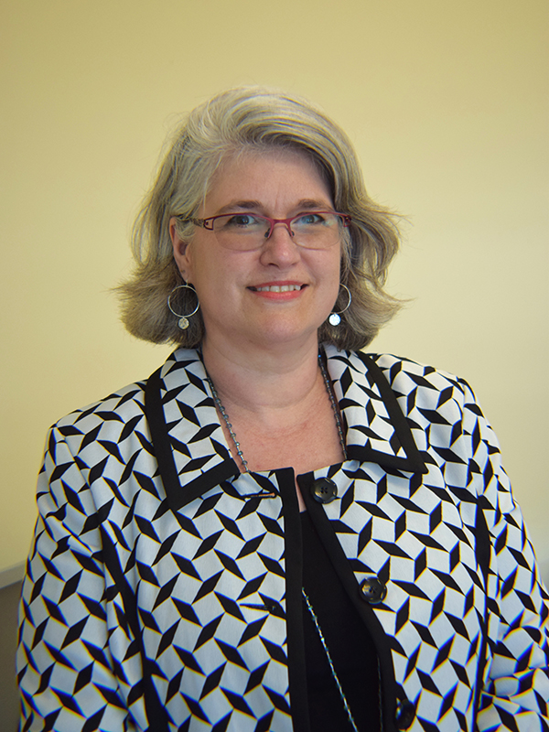
Welcome AOE Deputy Secretary Heather Bouchey
Notes:
So, who’s here?
We want to welcome teams from 2 VT schools that are here to explore PBIS. This is a large family we have here in VT and we welcome you to our table.
Last count we have individuals and teams from XX VTPBIS schools! That’s impressive. We designed this day around meeting your needs and we hope to hear from you afterwards whether this event meets this goal.
This event couldn’t happen without the extremely talented and experienced extended members of the STATE Team – our coaches and trainers. Can you please stand up so we can recognize you?
It’s also wonderful that we have several School/MH providers from our state designated agencies. Thanks to you for taking the time to come to this event today.
Thanks also to our VT AOE leaders that are here today. They support many of you to attend these events and they support the state team to make PBIS supports happen in VT.

Slide 3
Who’s Here?
2 Exploring Schools
85 VTPBIS Schools
VTPBIS State Team and Coaches
MH Providers
VT Agency of Education
Who else?
Notes:
So, who’s here?
We want to welcome teams from 2 VT schools that are here to explore PBIS. This is a large family we have here in VT and we welcome you to our table.
Last count we have individuals and teams from XX VTPBIS schools! That’s impressive. We designed this day around meeting your needs and we hope to hear from you afterwards whether this event meets this goal.
This event couldn’t happen without the extremely talented and experienced extended members of the STATE Team – our coaches and trainers. Can you please stand up so we can recognize you?
It’s also wonderful that we have several School/MH providers from our state designated agencies. Today’s keynote address and one of the sessions is about explicit partnerships between MH and PBIS which we are know is essential to serving our students and families most effectively! Thanks to you for taking the time to come to this event today.
Thanks also to our VT AOE leaders that are here today. They support many of you to attend these events and they support the state team to make PBIS supports happen in VT.

Slide 4
Why are we here?
To explore PBIS
To find out how VTPBIS is doing
To hear from keynote – Diane Myers
To learn and share NEW Ideas about PBIS Implementation and Sustainability; and
To celebrate!!!

Slide 5
What You Need to Know
WiFi Information:
Grandguest
Find all materials at:
www.pbisvermont.org

Slide 6
Maximizing Your Participation
Consider these questions:
Where are we in our implementation?
What do I hope to learn?
What did I learn?
What will I do with what I learned?
By when?
Use the Learning Reflection Sheet

Slide 7
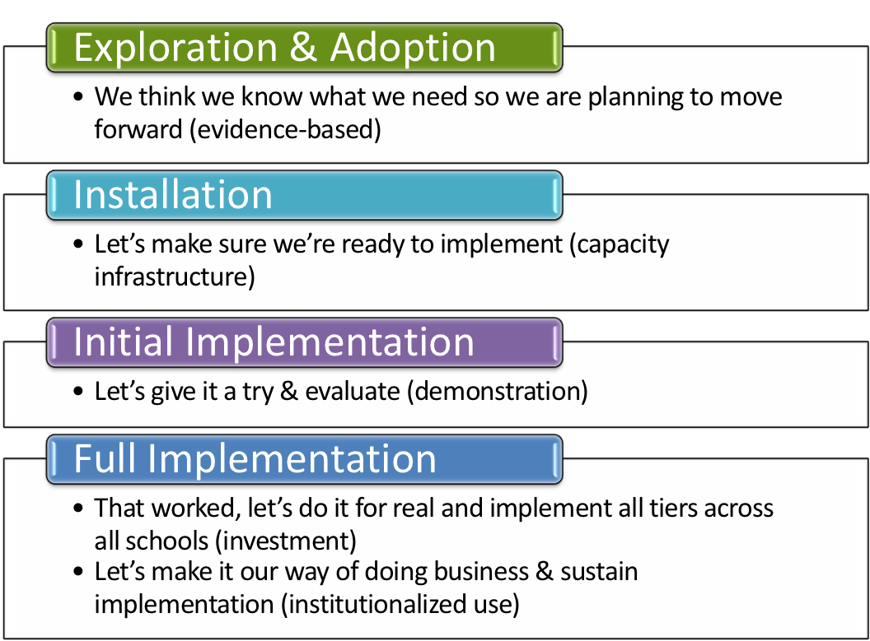
Where is your school in the implementation process?
Adapted from Fixsen & Blase, 2005
Notes:
Emphasis is that you have identified that you have a need. How did you identify it? Is it climate, behavioral challenges, both? Why do you want to explore an evidence based practice?

Slide 8
BEST Expectations
BEST Expectation | Forum Settings
Be Present | Be On Time Use agenda and map Silent cell phones
Engage | Network with peers Use training reflection form Attend an Ignite Session or Team Time
Strengths-based | Four positives to one negative Positively frame your questions and comments
Team Solutions | Agree to different sessions Attend Team Time using the Team Time template

Slide 9
How is VTPBIS Doing?

Slide 10
Number of VTPBIS Schools and SU/SDs

Slide 11
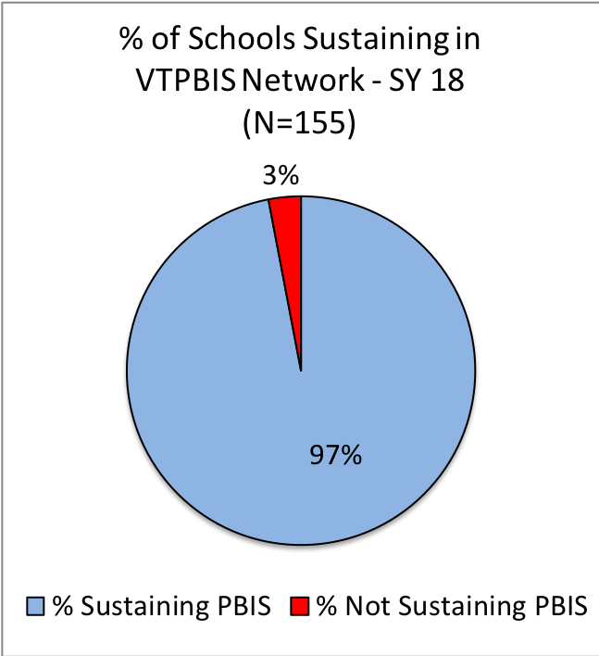

Slide 12
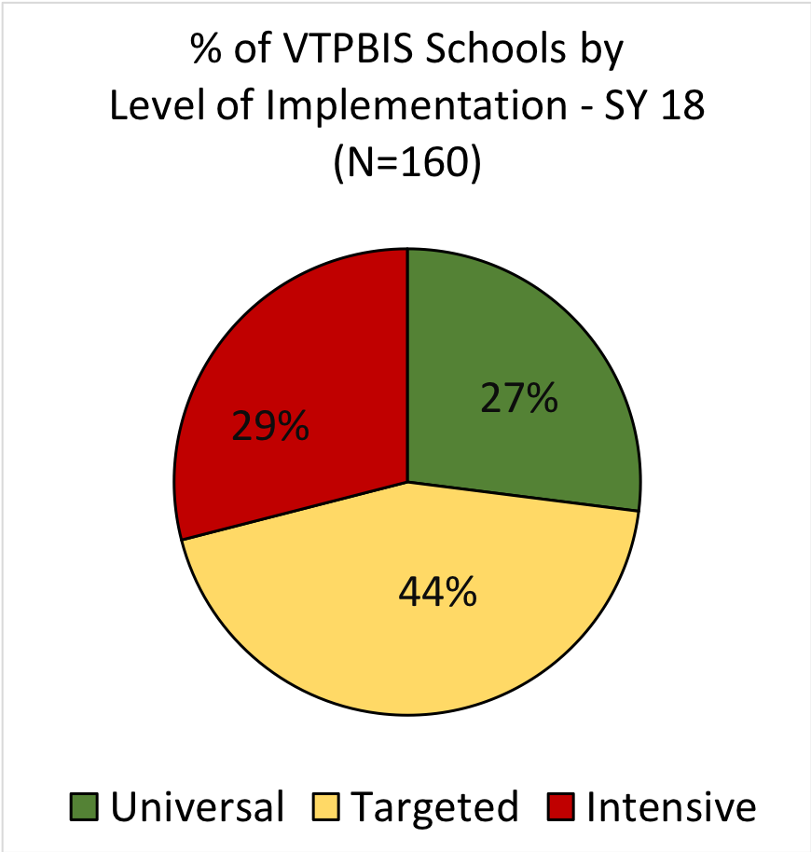

Slide 13
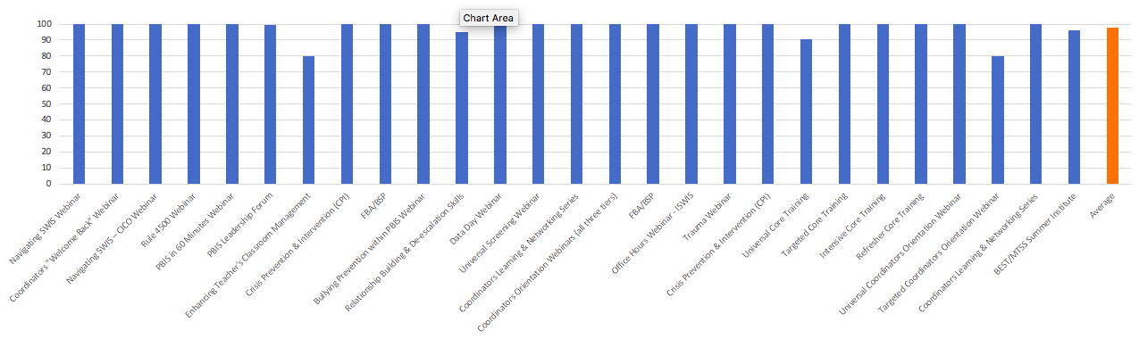
SY 18 Professional Learning Events:
% of Participants Highly Satisfied and Satisfied
Notes:
27 events
1,260 participants
98% highly satisfied/satisfied

Slide 14
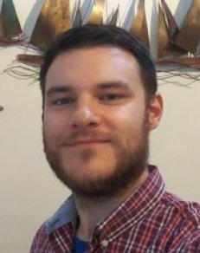
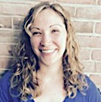
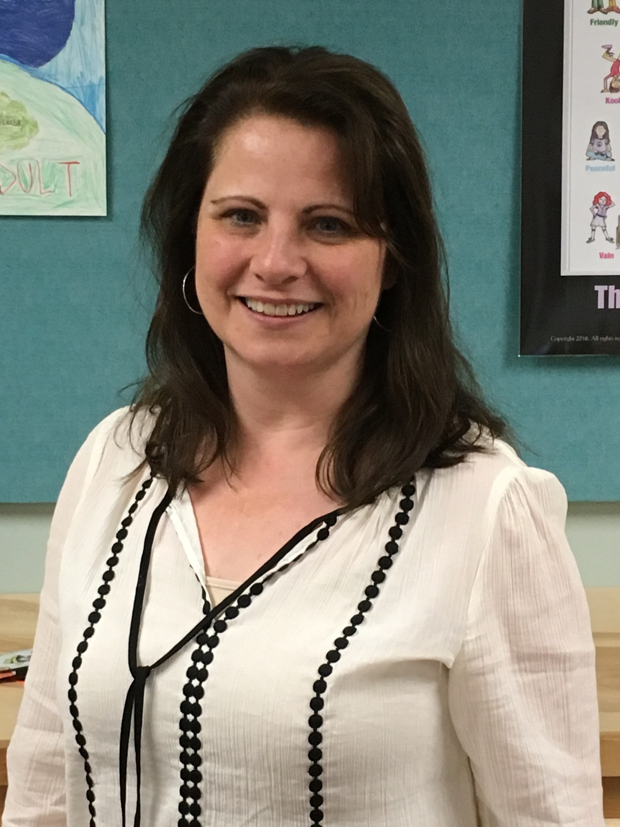
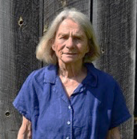
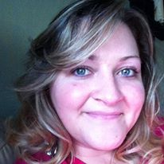
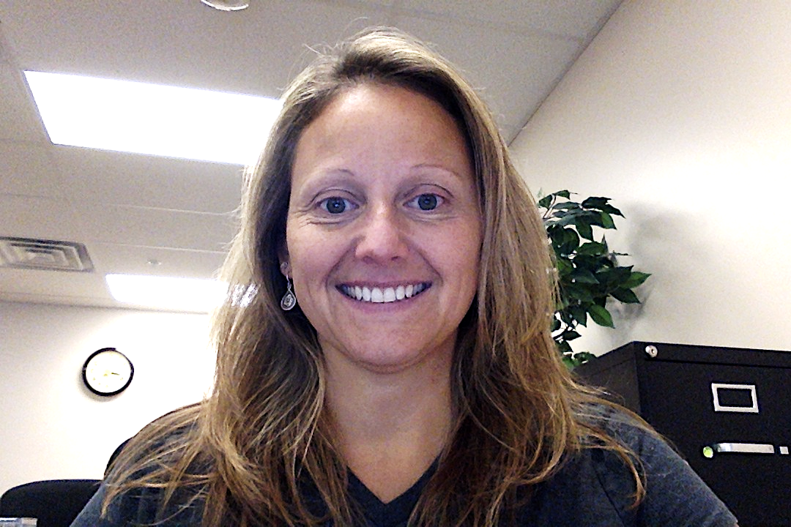
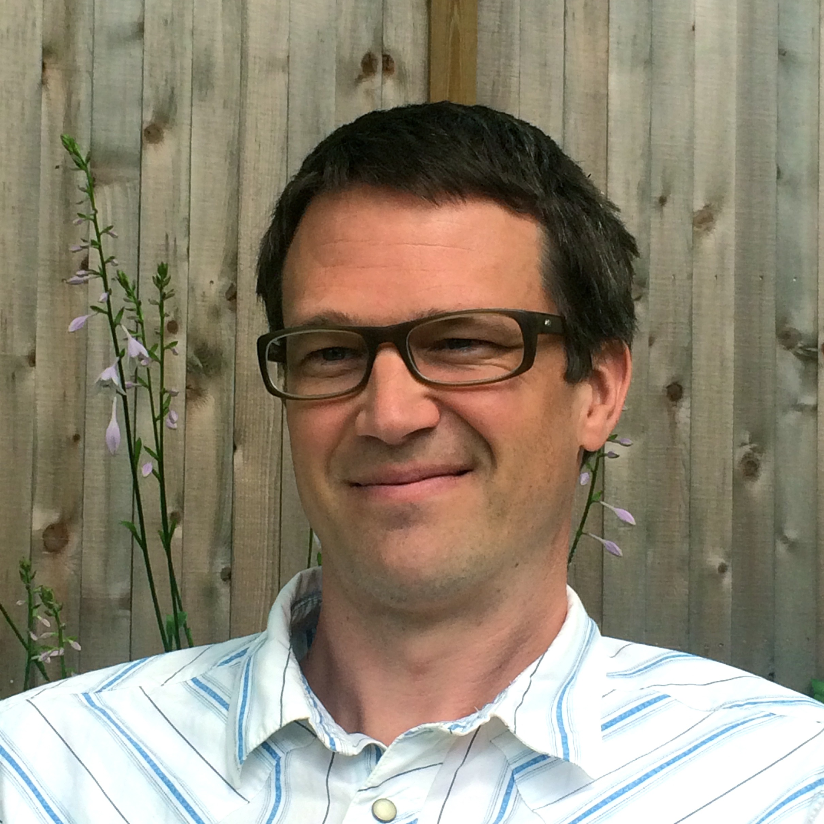
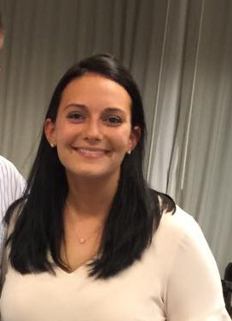
VTPBIS Coaching
“[Our coach] was huge asset to our school; she supported us where we needed it.”
47 VTPBIS Schools Received Support from VTPBIS Coaches
“[It was] very important to have a different set of eyes on the data and to provide some external feedback.”

Slide 15
Fidelity Assessments Completion Rates
79%
78%

Slide 19
Next Steps
Coaching
Alignment
Targeted/Intensive Level Supports
MH Partnerships
Strategic Plan
Classroom PBIS

Slide 20
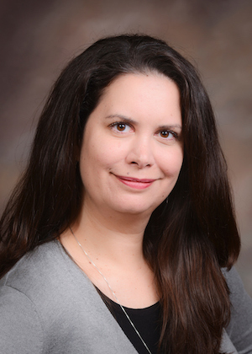
Welcome Diane Myers!
Notes:
Diane is an Associate Professor of Special Education at Texas Woman’s University in Denton, TX, where she also serves as the chair of the Department of Teacher Education and the coordinator for Special Education. Diane’s research and teaching interests include positive behavioral interventions and supports at the individual, classroom, and school-wide level. In addition,
Diane has been training teachers in classwide positive behavioral interventions and supports (CWPBIS) for over a decade and has learned a lot about what teachers know, what they want to know, and the kinds of questions they will ask. During this presentation, Diane will review the basic principles of CWPBIS and talk about the lessons she’s learned while working with teachers to implement evidence-based, proactive, culturally- and contextually-appropriate behavior supports in their classrooms."

