Slide 1
Integrating Social-Emotional Learning and PBIS
Rebecca Lallier, M.Ed.
VTPBIS Leadership Forum 2018

Slide 2
Maximizing Your Session Participation
Consider these questions:
Where are we in our implementation?
What do I hope to learn?
What did I learn?
What will I do with what I learned?
By when?
Use the Learning Reflection Sheet

Slide 3
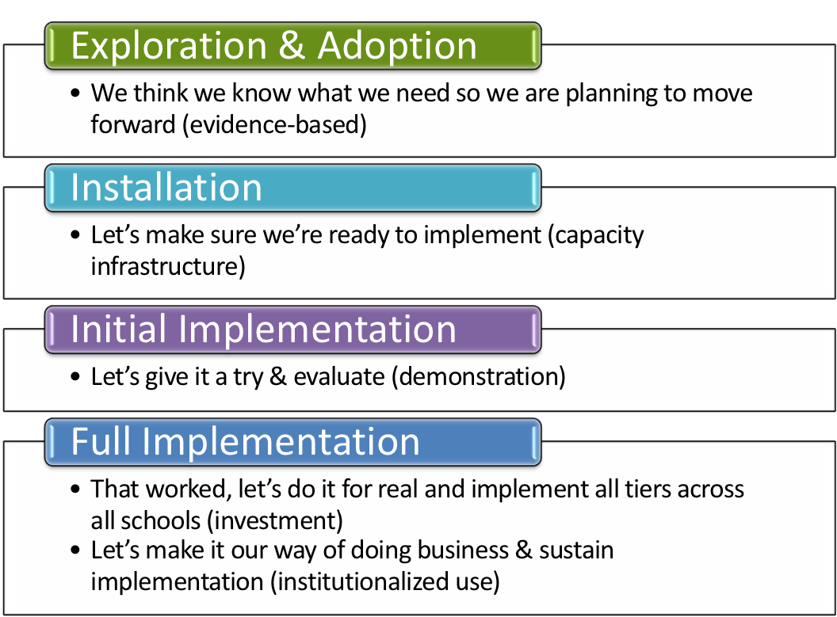
Where is your school in the implementation process?
Adapted from Fixsen & Blase, 2005

Slide 4
Upon completion of this workshop, you will have discovered answers to . . .
Why provide SEL?: Research findings
What is SEL?: Competencies, components, & approaches
Who do we start with?: Adult SEL
How do we deliver SEL?: Practices, standards, and curricula
Where do we go from here?: Getting started at your school
When are we going to do this?: Identifying next steps and long-range planning

Slide 5
Social Emotional Learning (SEL)
The process through which children and adults acquire and effectively apply the knowledge, attitudes, and skills necessary to:
understand and manage emotions
set and achieve positive goals
feel and show empathy for others
establish and maintain positive relationships
make responsible decisions
(CASEL, 2018)

Slide 6
Integrating SEL & PBIS
SEL
PBIS
Teaching students to develop:
positive attitudes, behaviors, & skills that will support their:
relationships and interactions
emotional well-being
school and lifelong success
Acknowledging, supporting, & reinforcing students demonstrating:
prosocial attitudes, behaviors, and skills so that:
they’re more likely to occur naturally
overall classroom and school culture flourishes

Slide 7
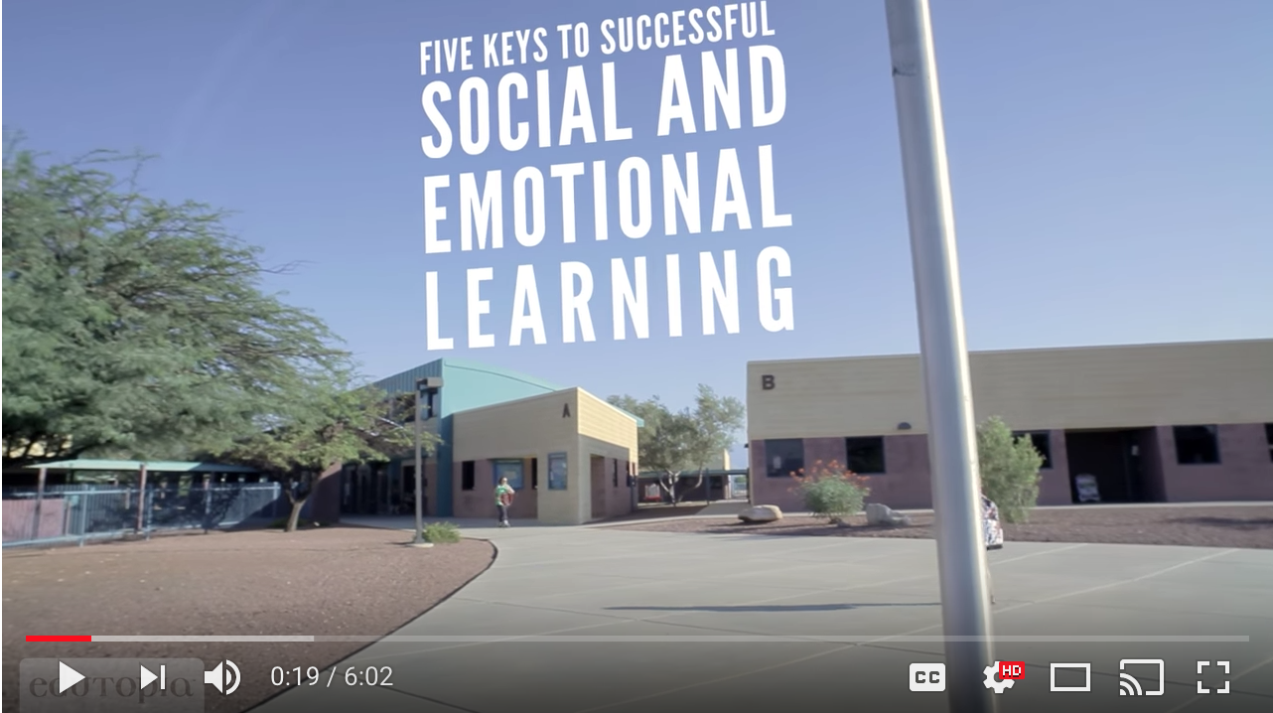
Notes:
LiveSlide Site
https://www.youtube.com/watch?v=DqNn9qWoO1M

Slide 8
Why?
SEL Research Findings

Slide 9
SEL Research Indicates:
Significantly improved academic performance on standardized tests
Significantly better school attendance
Improved positive attitudes toward self and others
Increased helping behaviors
Students like school more
Less disruptive classroom behavior
Reduced aggression, emotional distress, and substance abuse
Students less likely to be suspended or otherwise disciplined
(CASEL, 2018)

Slide 10
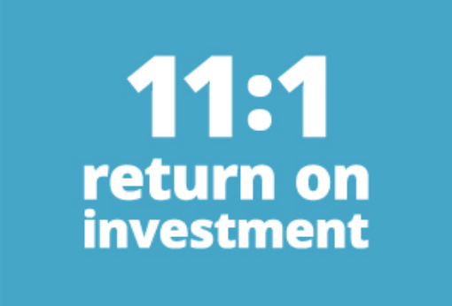
2015 Study: SEL Cost-Benefit Analysis
For every $1 spent implementing SEL programs, $11 is saved in resources that are not expended managing behavior problems and additional interventions for “at risk” youth.
(Belfield et al., 2015)

Slide 11
2017 Meta-Analysis: SEL Follow-Up Effects
3.5 years after the last intervention the academic performance of students exposed to SEL programs was an average 13 percentile points higher than their non-SEL peers
At other follow-up periods, conduct problems, emotional distress, and drug use were all significantly lower for students exposed to SEL programs
development of social and emotional skills and positive attitudes toward self, others, and school was higher
(Durlac et al., 2017)
Notes:
82 different interventions involving more than 97,000 students from kindergarten to high school, and the effects were assessed six months to 18 years after the programs ended.

Slide 12
2015 National Study: SEL Impact on Lifetime Outcomes
Statistically significant associations between SEL skills in kindergarten and key outcomes for young adults years later in:
Education
Employment
Substance use
Mental health
Incarceration & involvement with police
Need for public assistance & public housing
(Jones et al., 2015)

Slide 13
2016 World Economic Forum Report: The Future of Jobs
Top 10 job skills required for workers to thrive by 2020
Complex problem solving
Critical thinking
Creativity
People management
Coordinating with others
6. Emotional intelligence
7. Judgment and decision-making
8. Service orientation
9. Negotiation
10. Cognitive flexibility
(World Economic Forum, 2016)

Slide 14
Students with SEL Competencies:
Have more positive attitudes about and involvement with school
Participate more in the classroom
Are given more instruction & positive feedback by teachers
Are more accepted
by classmates
(Denham, 2017)

Slide 15
Turn and Talk Activity
What most resonates with you about these research findings?
How can you use this information to advocate for SEL at your school?
SEL Research Findings

Slide 16
What?
Competencies, Components,
& Approaches

Slide 17
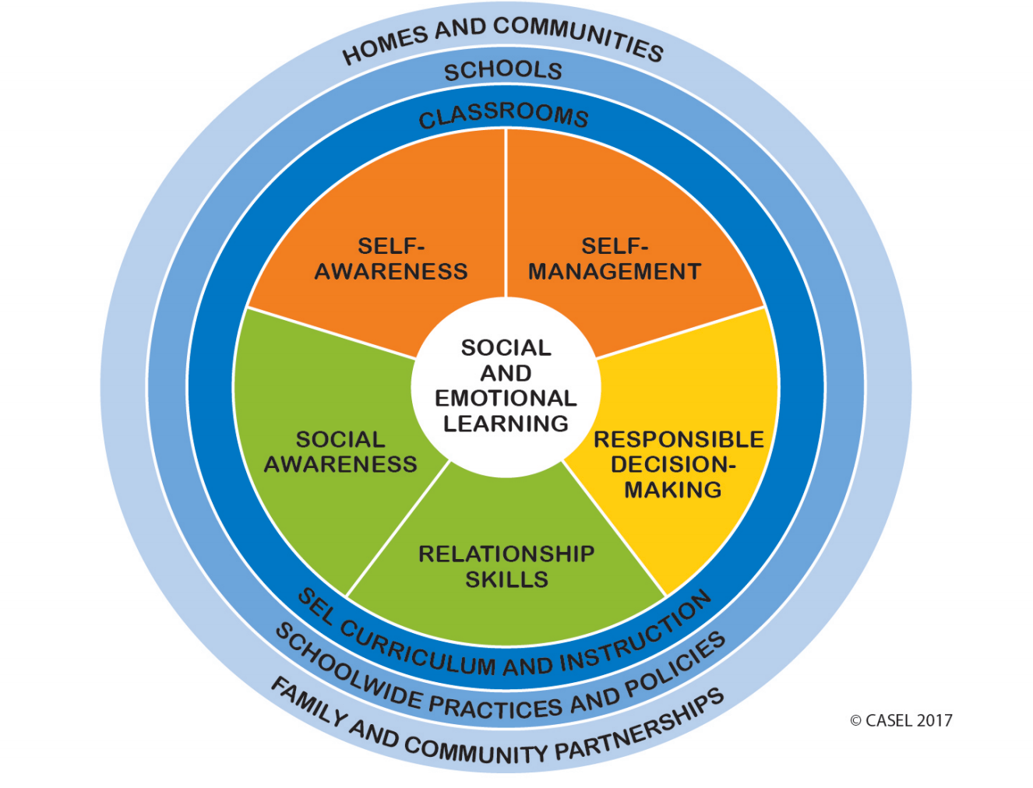
https://casel.org/wp-content/uploads/2017/01/Competencies.pdf

Slide 18
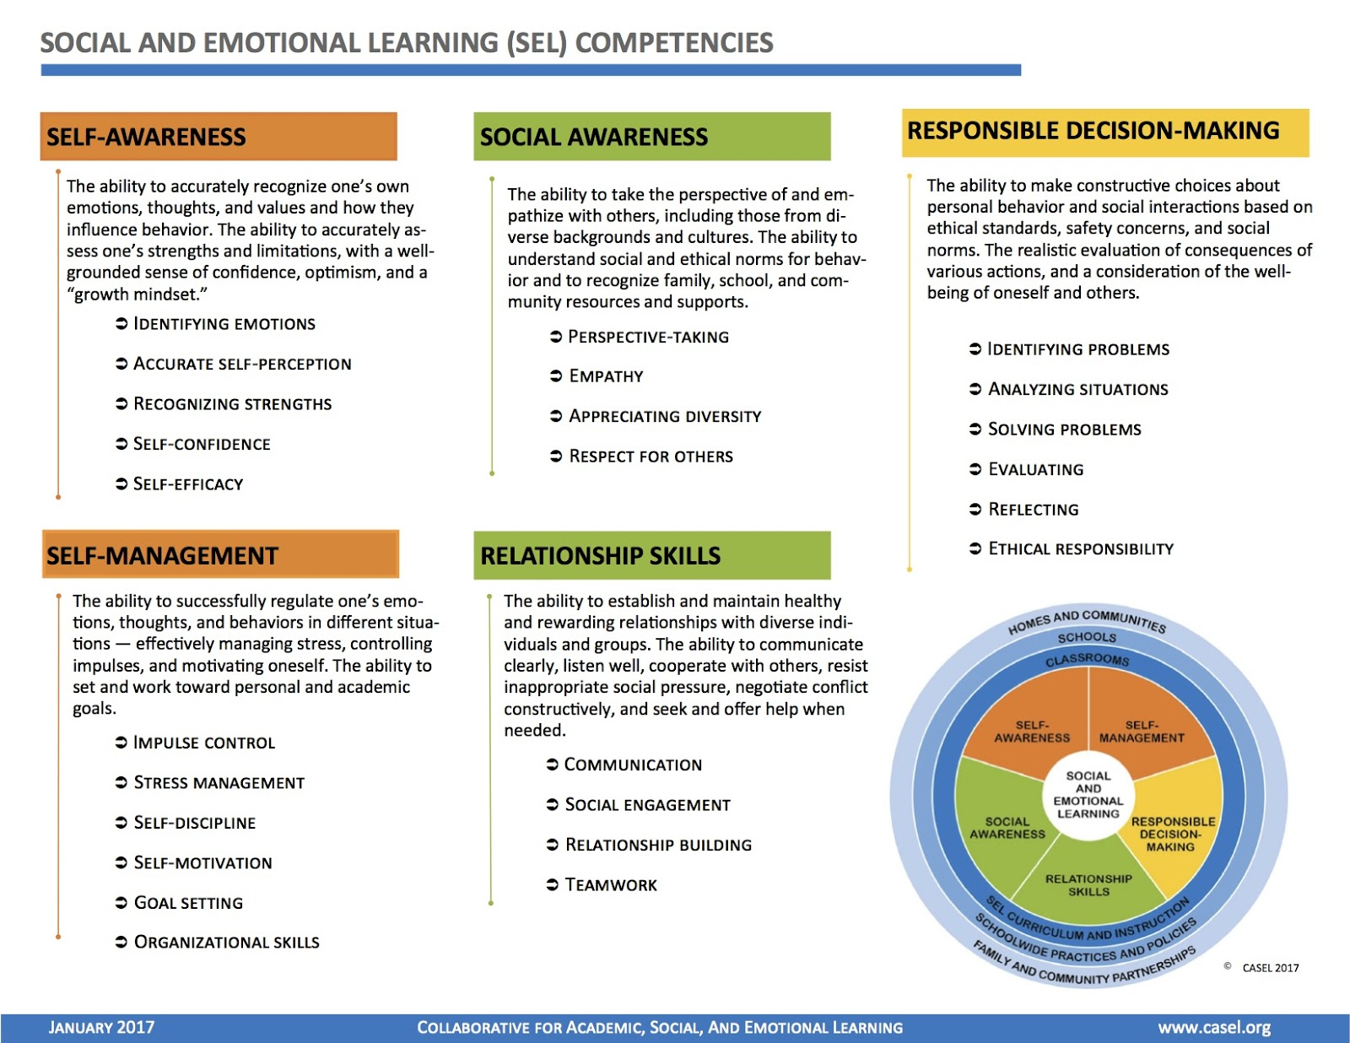
https://casel.org/wp-content/uploads/2017/01/Competencies.pdf

Slide 19
Components of SEL
Evidence-Based Practices & Programming
Adult SEL
School/District Framework
Organizational Strategies
Culture & Climate
Instruction & instructional practices
Opportunities to practice & apply skills
Systemic & sequential
Coordinated implementation
Behavior supports
Trust & respectful relationships
Professional development
Monitoring & evaluation

Slide 20
Approaches to SEL Instruction
Teaching practices
Culture & climate strategies & organizational support
Stand-alone SEL lessons
Academic integration
Notes:
Explicitly teach the skills; Facilitate & support SE development; Skill instruction & practice within academic context; Administrative & organizational support for SW SEL

Slide 21
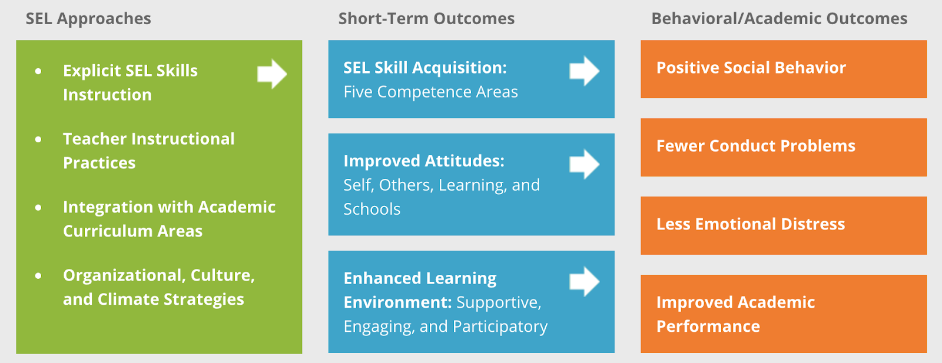
SEL Approaches & Outcomes
http://www.casel.org/what-is-sel/approaches/

Slide 22
Who?
Adult SEL

Slide 23
The Need for Adult SEL
46% of teachers report high daily stress, which compromises their health, sleep, quality of life, and teaching (Greenberg et. al, 2016)
93% of elementary school teachers report experiencing high levels of stress (Herman et. al, 2018)
61% of educators report that work is always or often stressful (American Federation of Teachers, 2017)
58% of educators described their mental health as “not good” for at least seven of the previous 30 days, increased from 34% in 2015 (American Federation of Teachers, 2017)
Notes:
Educator quality of life survey

Slide 24
Adult SEC Impact Student Outcomes
When teachers are highly stressed, students show lower levels of both social adjustment and academic performance.
Interventions on the organizational or individual level, or those that reach both, can help reduce teacher stress by changing the culture and approach to teaching.
Programs for mentoring, workplace wellness, social emotional learning, and mindfulness are all proven to improve teacher well-being and student outcomes.
(Greenberg et. al, 2016)

Slide 25
Effect of Educator Social Emotional Competencies (SEC)
Improve educator well-being
Decrease stress and likelihood of educator burnout
Increase educator satisfaction
Build & strengthen relationships with students & colleagues
Provide modeling of SEL skills for students
Create a positive learning environment
Notes:
Positive & more academically supportive environment

Slide 26
(Jennings & Frank, 2017)

Slide 27
Burnout Cascade
Teacher burnout
Teacher emotionally exhausted
Teacher performance deteriorates
Increased student misbehavior
Classroom climate deteriorates
(Jennings & Frank, 2017)
Notes:
Burnout teacher behaviors associated with harming school property, criticizing other students, talking back, higher levels of student anti-social& oppositional defiant behaviors

Slide 28
“
SEL is foundational for educators to build the skills to manage the tidal wave of changes and to be effective in their responses to changes.
Elena Aguilar
”
Notes:
Feelings exist. Change generates feelings. Feelings have consequences – helpful or obstacles

Slide 29
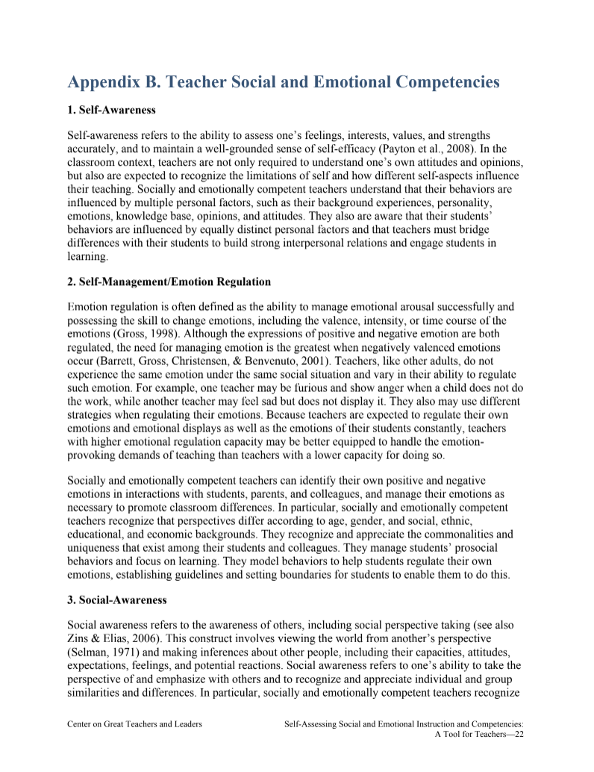
Small Group Activity
For each competency, discuss what it looks like in a teacher:
who has mastered that competency.
who has lagging skills in that competency.
Teacher Social and Emotional Competencies
(American Institutes for Research, 2018)

Slide 30
how?
Practices, Standards, & Curricula

Slide 31
Evidence-Based SEL Practices & Programming
Explicit Instruction:
Deliver
SEL curricular content
Generalize SEL concepts into instruction, relationships with students, and classroom management
Embedded Instruction:
Integrate SEL into academic content areas

Slide 32
School Culture
School Climate
the way teachers and other staff members work together and the set of beliefs, values, and assumptions they share
the school's effects on students, including teaching practices; diversity; and the relationships among administrators, teachers, parents, and students
(ASCD)

Slide 33
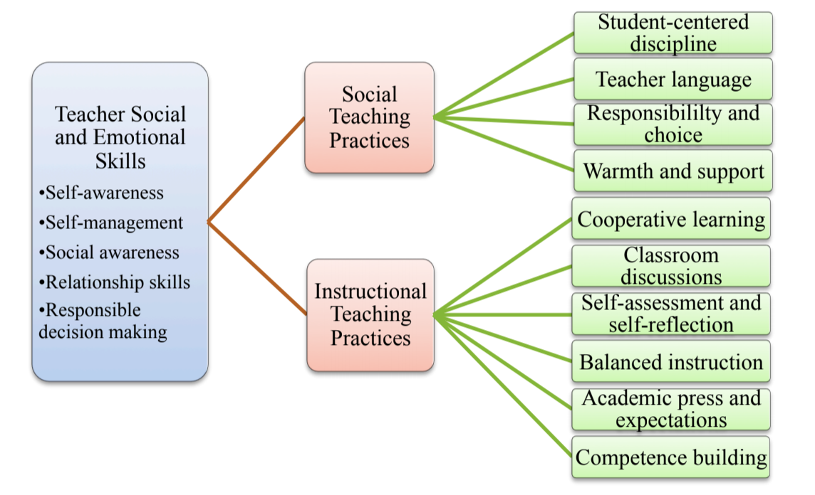
Teacher SEL Skills and Teaching Practices
(Yoder, 2014)

Slide 34
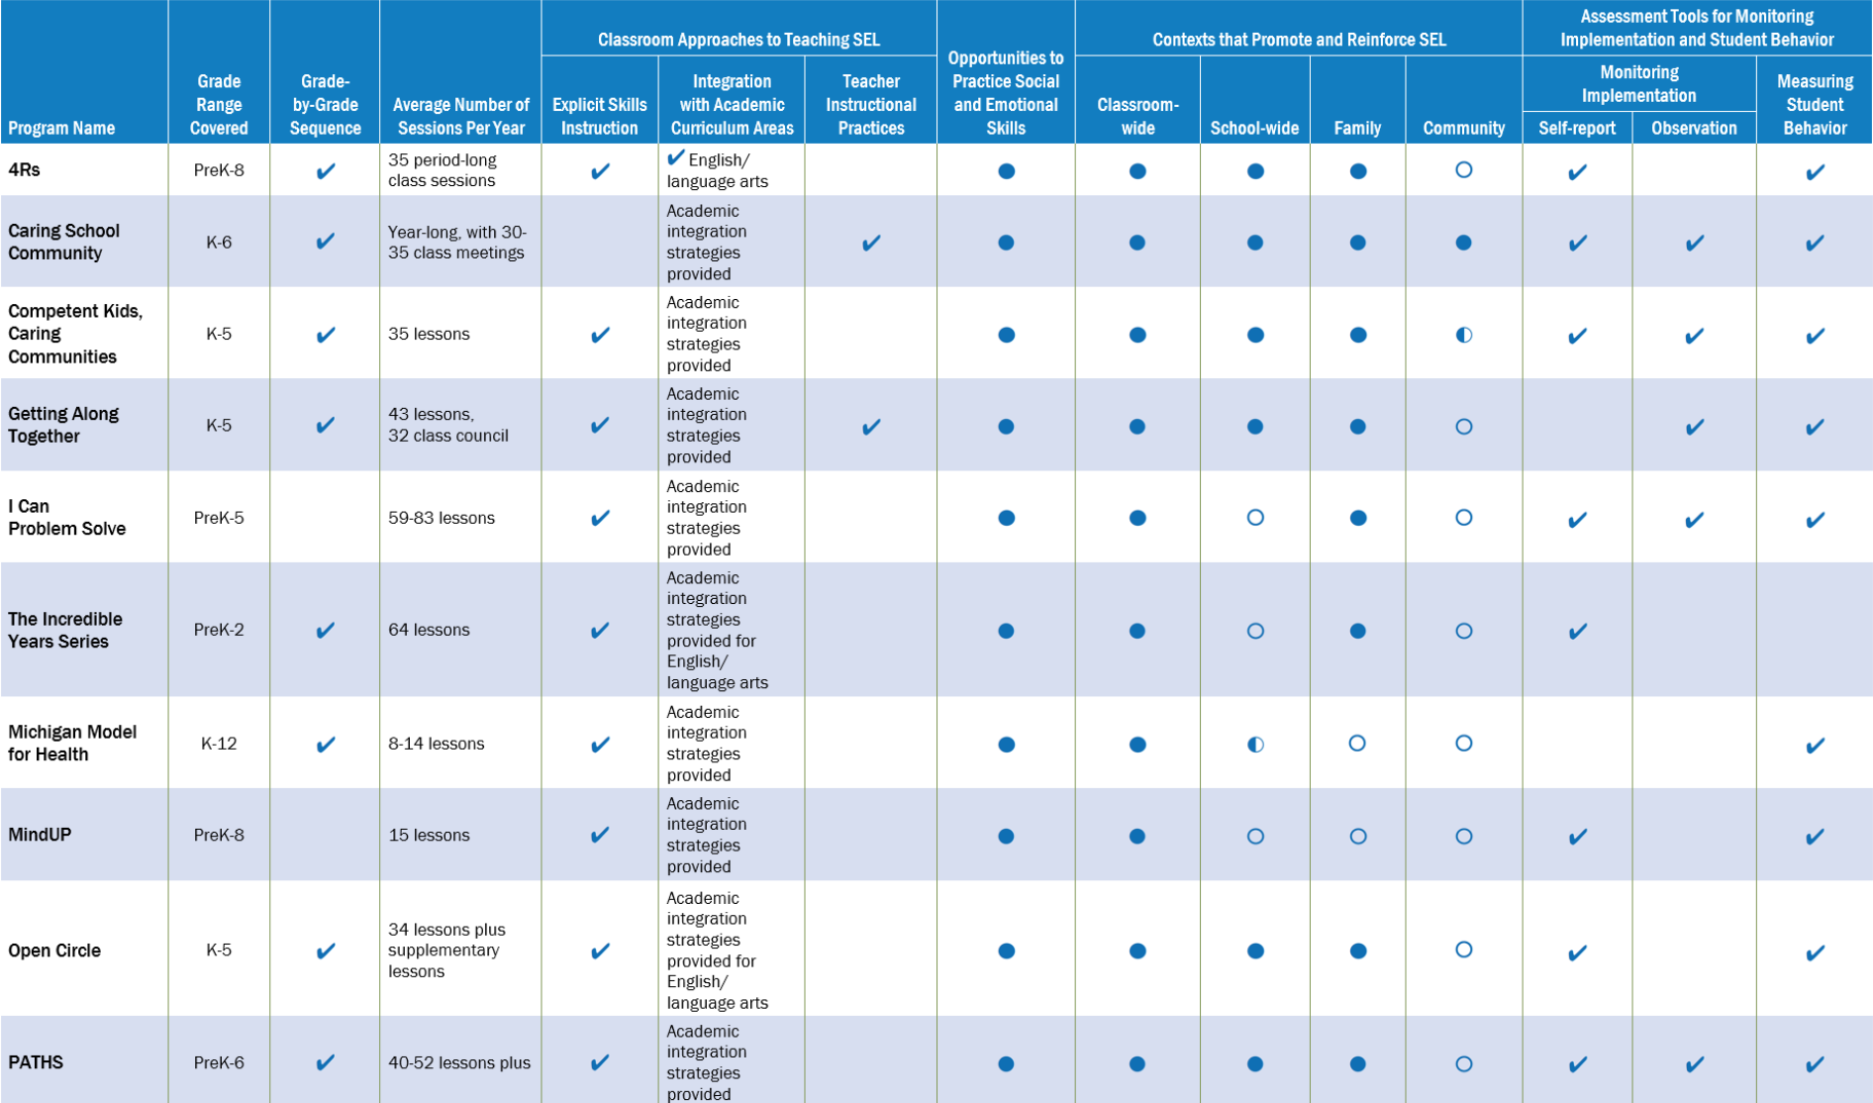
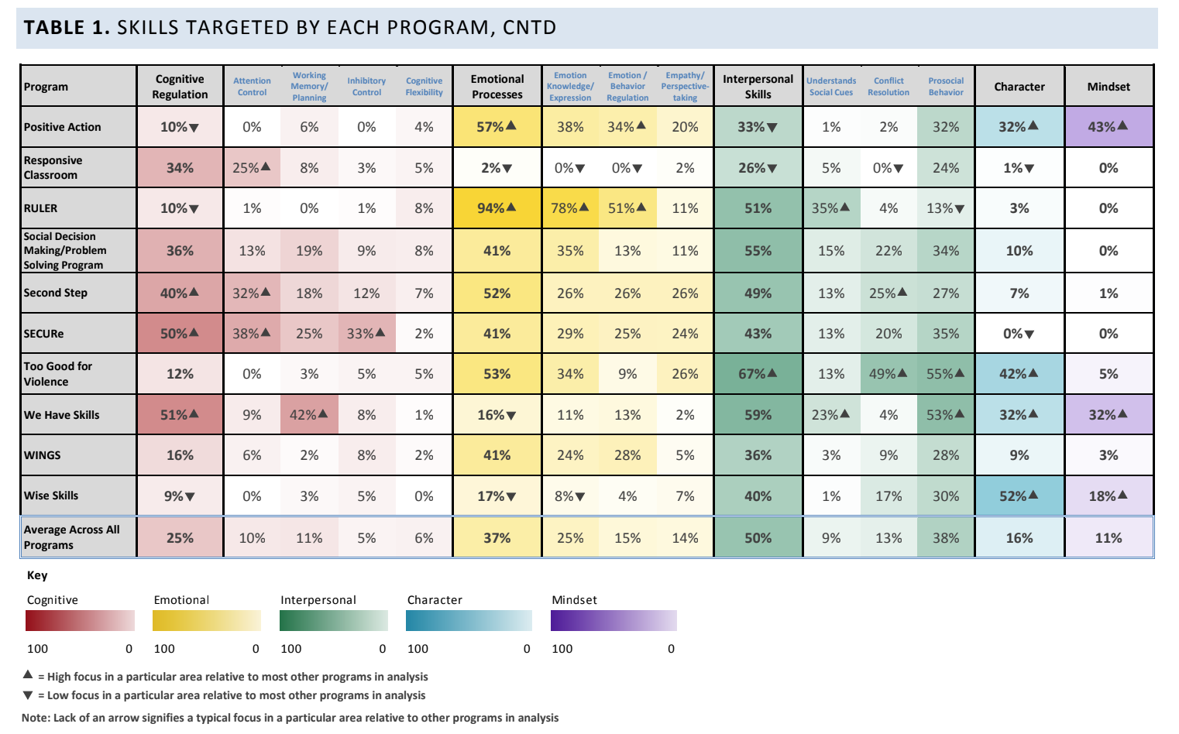
Identifying Evidence-Based SEL Curricula & Programs
CASEL Guides: Effective Social and Emotional Learning Programs (SELect)
Preschool & Elementary
Secondary
Navigating Social and Emotional Learning from Inside Out: Looking Inside and Across 25 Leading SEL Programs (elementary focus)

Slide 35
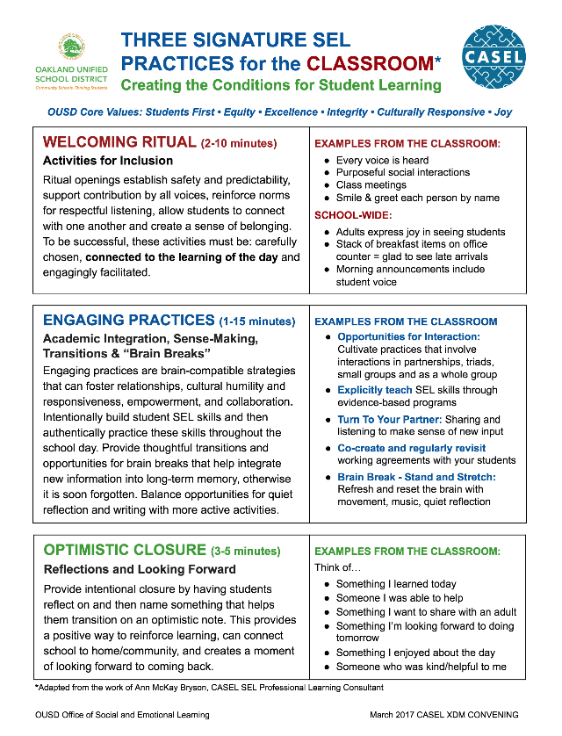
Signature SEL Practices
Welcoming Ritual
• Activities for inclusion
Engaging Practices
• Academic integration
• Sense-making
• Transitions
• Brain breaks
Optimistic Closure
• Reflections
Addresses all 5 SEL competencies
Creates collaborative classrooms
Builds upon/aligned to CCSS, Restorative Justice, & trauma-informed practices
https://www.washoeschools.net/cms/lib/NV01912265/Centricity/Domain/202/Washoe%203%20Signature%20SEL%20Practices%20for%20the%20Classroom.pdf
Notes:
Include specific SEL learning objectives in content area lessons

Slide 36
Teaching Skill Development
Monitor progress
Generalize
coaching
modeling
role play
behavioral rehearsal
feedback
apply in multiple settings
Practice
Do
Show
Tell

Slide 37
“
To develop the standards we simply asked ourselves:
What is it you wish your students could graduate with?
What are the skills you most depend on as an adult?
Those were all the standards we needed.
”
Anchorage School District

Slide 38
Examples of SEL Standards
Anchorage School District SEL Standards
Illinois SEL Standards
• Performance Descriptors grades 1-5
• Performance Descriptors grades 6-12
Minnesota SEL Competencies
Oakland Unified School District SEL Standards
Pennsylvania Standards for Interpersonal Skills
Vermont Early Learning Standards (birth-3rd grade)
Washoe County School District SEL Standards

Slide 39
Illinois SEL Standards
Goal 1: Develop self-awareness and self-management skills to achieve school and life success
Goal 2: Use social-awareness and interpersonal skills to establish and maintain positive relationships
Goal 3: Demonstrate decision-making skills and responsible behaviors in personal, school, and community contexts

Slide 40
SEL Measures
Students
Climate
Outcomes
Fidelity: Adult behavior

Slide 41
Where?
Getting Started

Slide 42
Key Questions
What are our primary SEL needs?
What are our desired outcomes?
What are our strengths in relation to SEL?
What are our challenges in relation to SEL?
What are our opportunities in relation to SEL?
What are the behaviors that “drive people crazy?”
What do students, parents, and staff complain about?

Slide 43
What SEL-promoting programs, activities, practices, strategies, and resources are already in place and working to address the desired outcomes?
Classroom SEL curriculum?
School counseling curriculum?
PBIS lesson plans?
Responsive Classroom?
Mindfulness?
Instructional practices (PBL, cooperative learning, etc.)?
Other?
Where are the gaps?

Slide 44
Universal SEL
Universal
Developing a common skill set, language, and framework for staff and students
School-wide SEL curriculum
Universal expectations (in all settings)
Re-teaching based on behavioral data
Shared language & concepts
School counseling curriculum

Slide 45
Targeted SEL
Targeted
Reinforcing the common skill set, language, and framework for students
Build upon universal SEL instruction
Small groups to target specific skills
Brief instruction during CICO & breaks
Zones/Feelings check
Goal and plan review
Strategies

Slide 46
Intensive SEL
Intensive
Teaching and reinforcing specific SEL competencies through an individualized approach
Social Thinking & hidden rules
Social stories
Problem solving models
Guided social skills practice
Generalization is the goal!

Slide 47
Possible Data Sources for SEL Needs Assessment
School climate survey
Universal screening
Behavioral data
Attendance
Report card (effort, work habits, social skills, etc.)
Nurse visits or other indicators of internalizing behaviors

Slide 48
SEL Professional Development Best Practice
Presented consistently over extended period of time
Clear participant learning goals
Involve active group participation
Deepen teachers’ content knowledge of key SEL concepts & theories as well as curriculum
Provide opportunities to actively apply this knowledge to practice
Understand how goals of SEL programs fit within broader context of other school & district goals
Include authoritative and proactive strategies for classroom management
(Jennings & Frank, 2017)
Notes:
Workshops, coaching, PLCs, study groups. Differentiated.

Slide 49
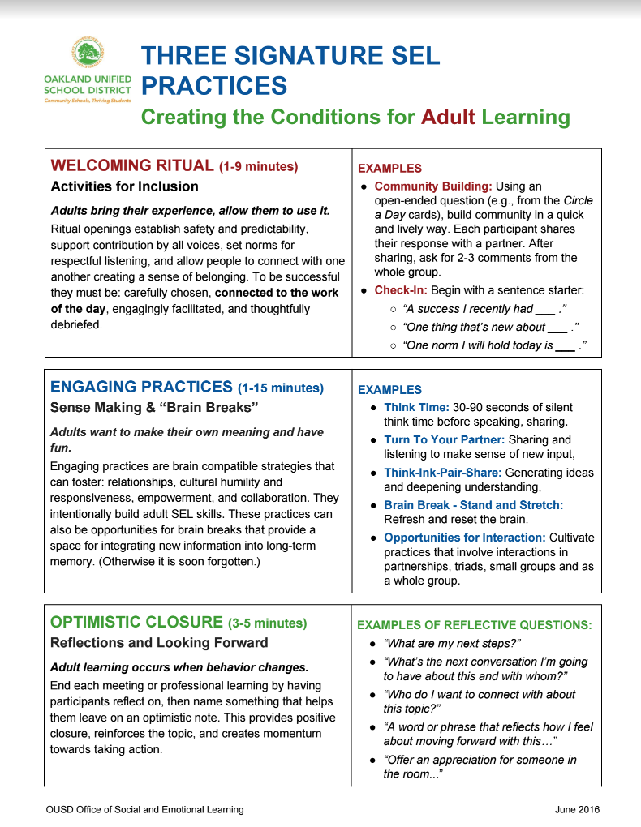
Building SEL Competencies Through Other Professional Development
Targeted reflection
Collaboration
Meaningful conversation
Deep inquiry work
https://casel.org/wp-content/uploads/2017/03/SELPractices-for-Adult-Learning-OUSD.pdf
Notes:
Deep inquiry work builds the competency of adults to learn with and from each other
SEL practices in Evaluation, Orientation, Hiring

Slide 50
When?
Next Steps &
Long-Range Planning

Slide 51
When SEL is Fully Implemented, We See:
Teachers promoting SEL in the classroom
Classroom concepts reinforced in all settings
Adults modeling SEL
Administrators managing school in a way that fosters adult SEL
(e.g., how meetings are run, the way decisions are made)
SEL implemented and aligned at all three tiers
All policies and practices at the school level supporting student SEL
(e.g., discipline guidelines)
Regular communication and engagement with families and community partners around SEL

Slide 52
Implementing SEL with Sustainability
Build infrastructure to support SEL
Assess current SEL programming and coordination
Assess school culture and climate
Articulate shared values and themes
Provide consistent, ongoing opportunities for students to practice SEL skills
Improve staff readiness to teach SEL
Connect to resources and other schools using SEL
(Elias et al., 2017)

Slide 53
Components of SEL
Evidence-Based Practices & Programming
Adult SEL
School/District Framework
Organizational Strategies
Culture & Climate
Instruction & instructional practices
Opportunities to practice & apply skills
Systemic & sequential
Coordinated implementation
Behavior supports
Trust & respectful relationships
Professional development
Monitoring & evaluation

Slide 54
Challenge Yourself
Forgive Yourself
Keep Going

Slide 55
References
Aguilar, E. (2014, May 20). It's time for social and emotional learning for all. Retrieved from https://www.edutopia.org/blog/social-emotional-learning-for-teachers-elena-aguilar
American Federation of Teachers. (2017). 2017 Educator quality of life survey(Rep.). Retrieved from https://www.aft.org/sites/default/files/2017_eqwl_survey_web.pdf
American Institutes for Research. (2018). Self-assessing social and emotional instruction and competencies: A tool for teachers. Retrieved from https://www.gtlcenter.org/products-resources/self-assessing-social-and-emotional-instruction-and-competencies-tool-teachers
ASCD. (n.d.). School culture and climate. Retrieved from http://www.ascd.org/research-a-topic/school-culture-and-climate-resources.aspx
Belfield, C., Bowden, B., Klapp, A., Levin, H., Shand, R., & Sander, S. (2015). The economic value of social and emotional learning (Rep.). Center for Benefit-Cost Studies in Education, Columbia University.
CASEL. (n.d.). Retrieved May 16, 2018, from https://casel.org/
Denham, S. A. (2017). Assessment of SEL in educational contexts. In Handbook of Social and Emotional Learning Research and Practice (pp. 285-300). New York, NY: The Guilford Press.
Durlak, J. A., Weissberg, R. P., Dymnicki, A. B., Taylor, R. D., & Schellinger, K. B. (2011). The impact of enhancing students’ social and emotional learning: A meta-analysis of school-based universal interventions. Child Development,82(1), 405-432. doi:10.1111/j.1467-8624.2010.01564.x

Slide 56
References
Elias, M. J., Leverett, L., Duffell, J. C., Humphrey, N., Stepney, C, & Ferrito, J. (2017). Integrating SEL with related prevention and youth development approaches. In Handbook of Social and Emotional Learning Research and Practice (pp. 33-49). New York, NY: The Guilford Press.
Greenberg, M. T., Brown, J. L., & Abenavoli, R. M. (2016). Teacher stress and health: Effects on teachers, students, and schools (Issue brief). State College: The Pennsylvania State University.
Herman, K. C., Hickmon-Rosa, J., & Reinke, W. M. (2018). Empirically derived profiles of teacher stress, burnout, self-efficacy, and coping and associated student outcomes. Journal of Positive Behavior Interventions,20(2), 90-100. doi:10.1177/1098300717732066
Jennings, P.A., & Frank, J.L. (2017). Inservice preparation for educators. In Handbook of Social and Emotional Learning Research and Practice(pp. 422-437). New York, NY: The Guilford Press.
Jones, D. E., Greenberg, M., & Crowley, M. (2015). Early social-emotional functioning and public health: The relationship between kindergarten social competence and future wellness. American Journal of Public Health, 105(11), 2283-2290. doi:10.2105/ajph.2015.302630
World Economic Forum. (n.d.). The future of jobs. Retrieved May 16, 2018, from http://reports.weforum.org/future-of-jobs-2016/
Yoder, N. (2014, February). Self-assessing social and emotional competencies: A tool for teachers. Retrieved from https://www.gtlcenter.org/products-resources/self-assessing-social-and-emotional-instruction-and-competencies-tool-teachers

Slide 57
Contact Info:
Rebecca Lallier
Dothan Brook School
White River Jct., Vermont
rebecca.lallier@gmail.com
lallierr@hartfordschools.net

