Slide 1
VTPBIS Coordinators January
Learning and Networking Meeting
Presented by the VTPBIS State Team
Notes:
Please make sure you have copies of the materials so you and your team can familiarize yourself with them.

Slide 2
Always Start with Data!
Attending the January North and South
Regional Coordinators Meetings
75
participants
57
schools
36
SU/SDs

Slide 3
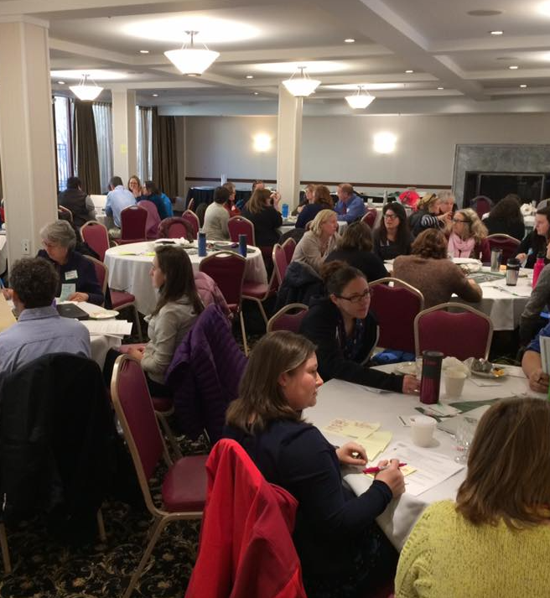
Agenda
Introductions & Acknowledgements
Anchoring Activity
Topic: Building Buy-in and Momentum through Understanding and Meaningful Engagement
Edcamp
Important VTPBIS Updates
Lunch on your own and optional additional Edcamp session or team time

Slide 4
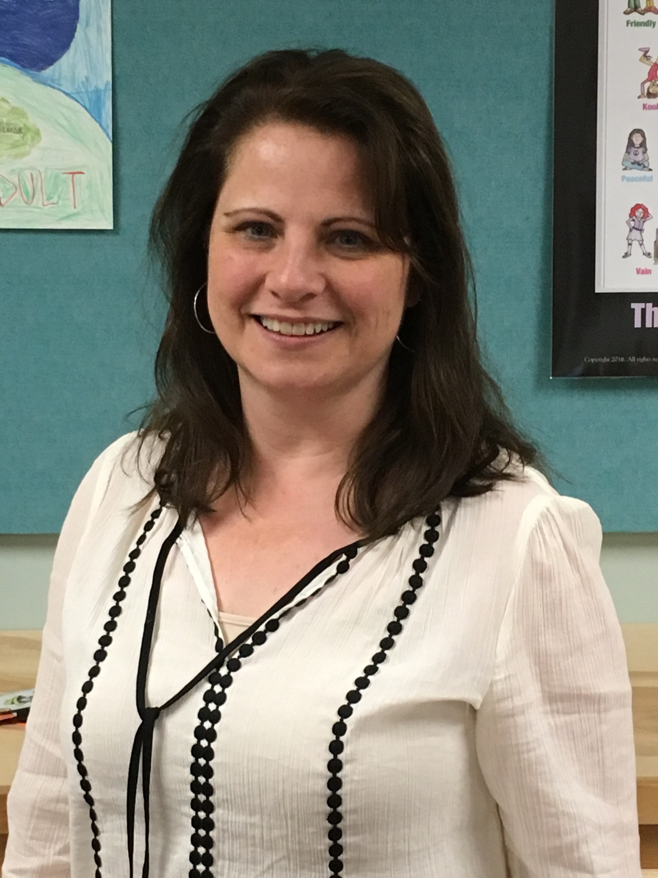
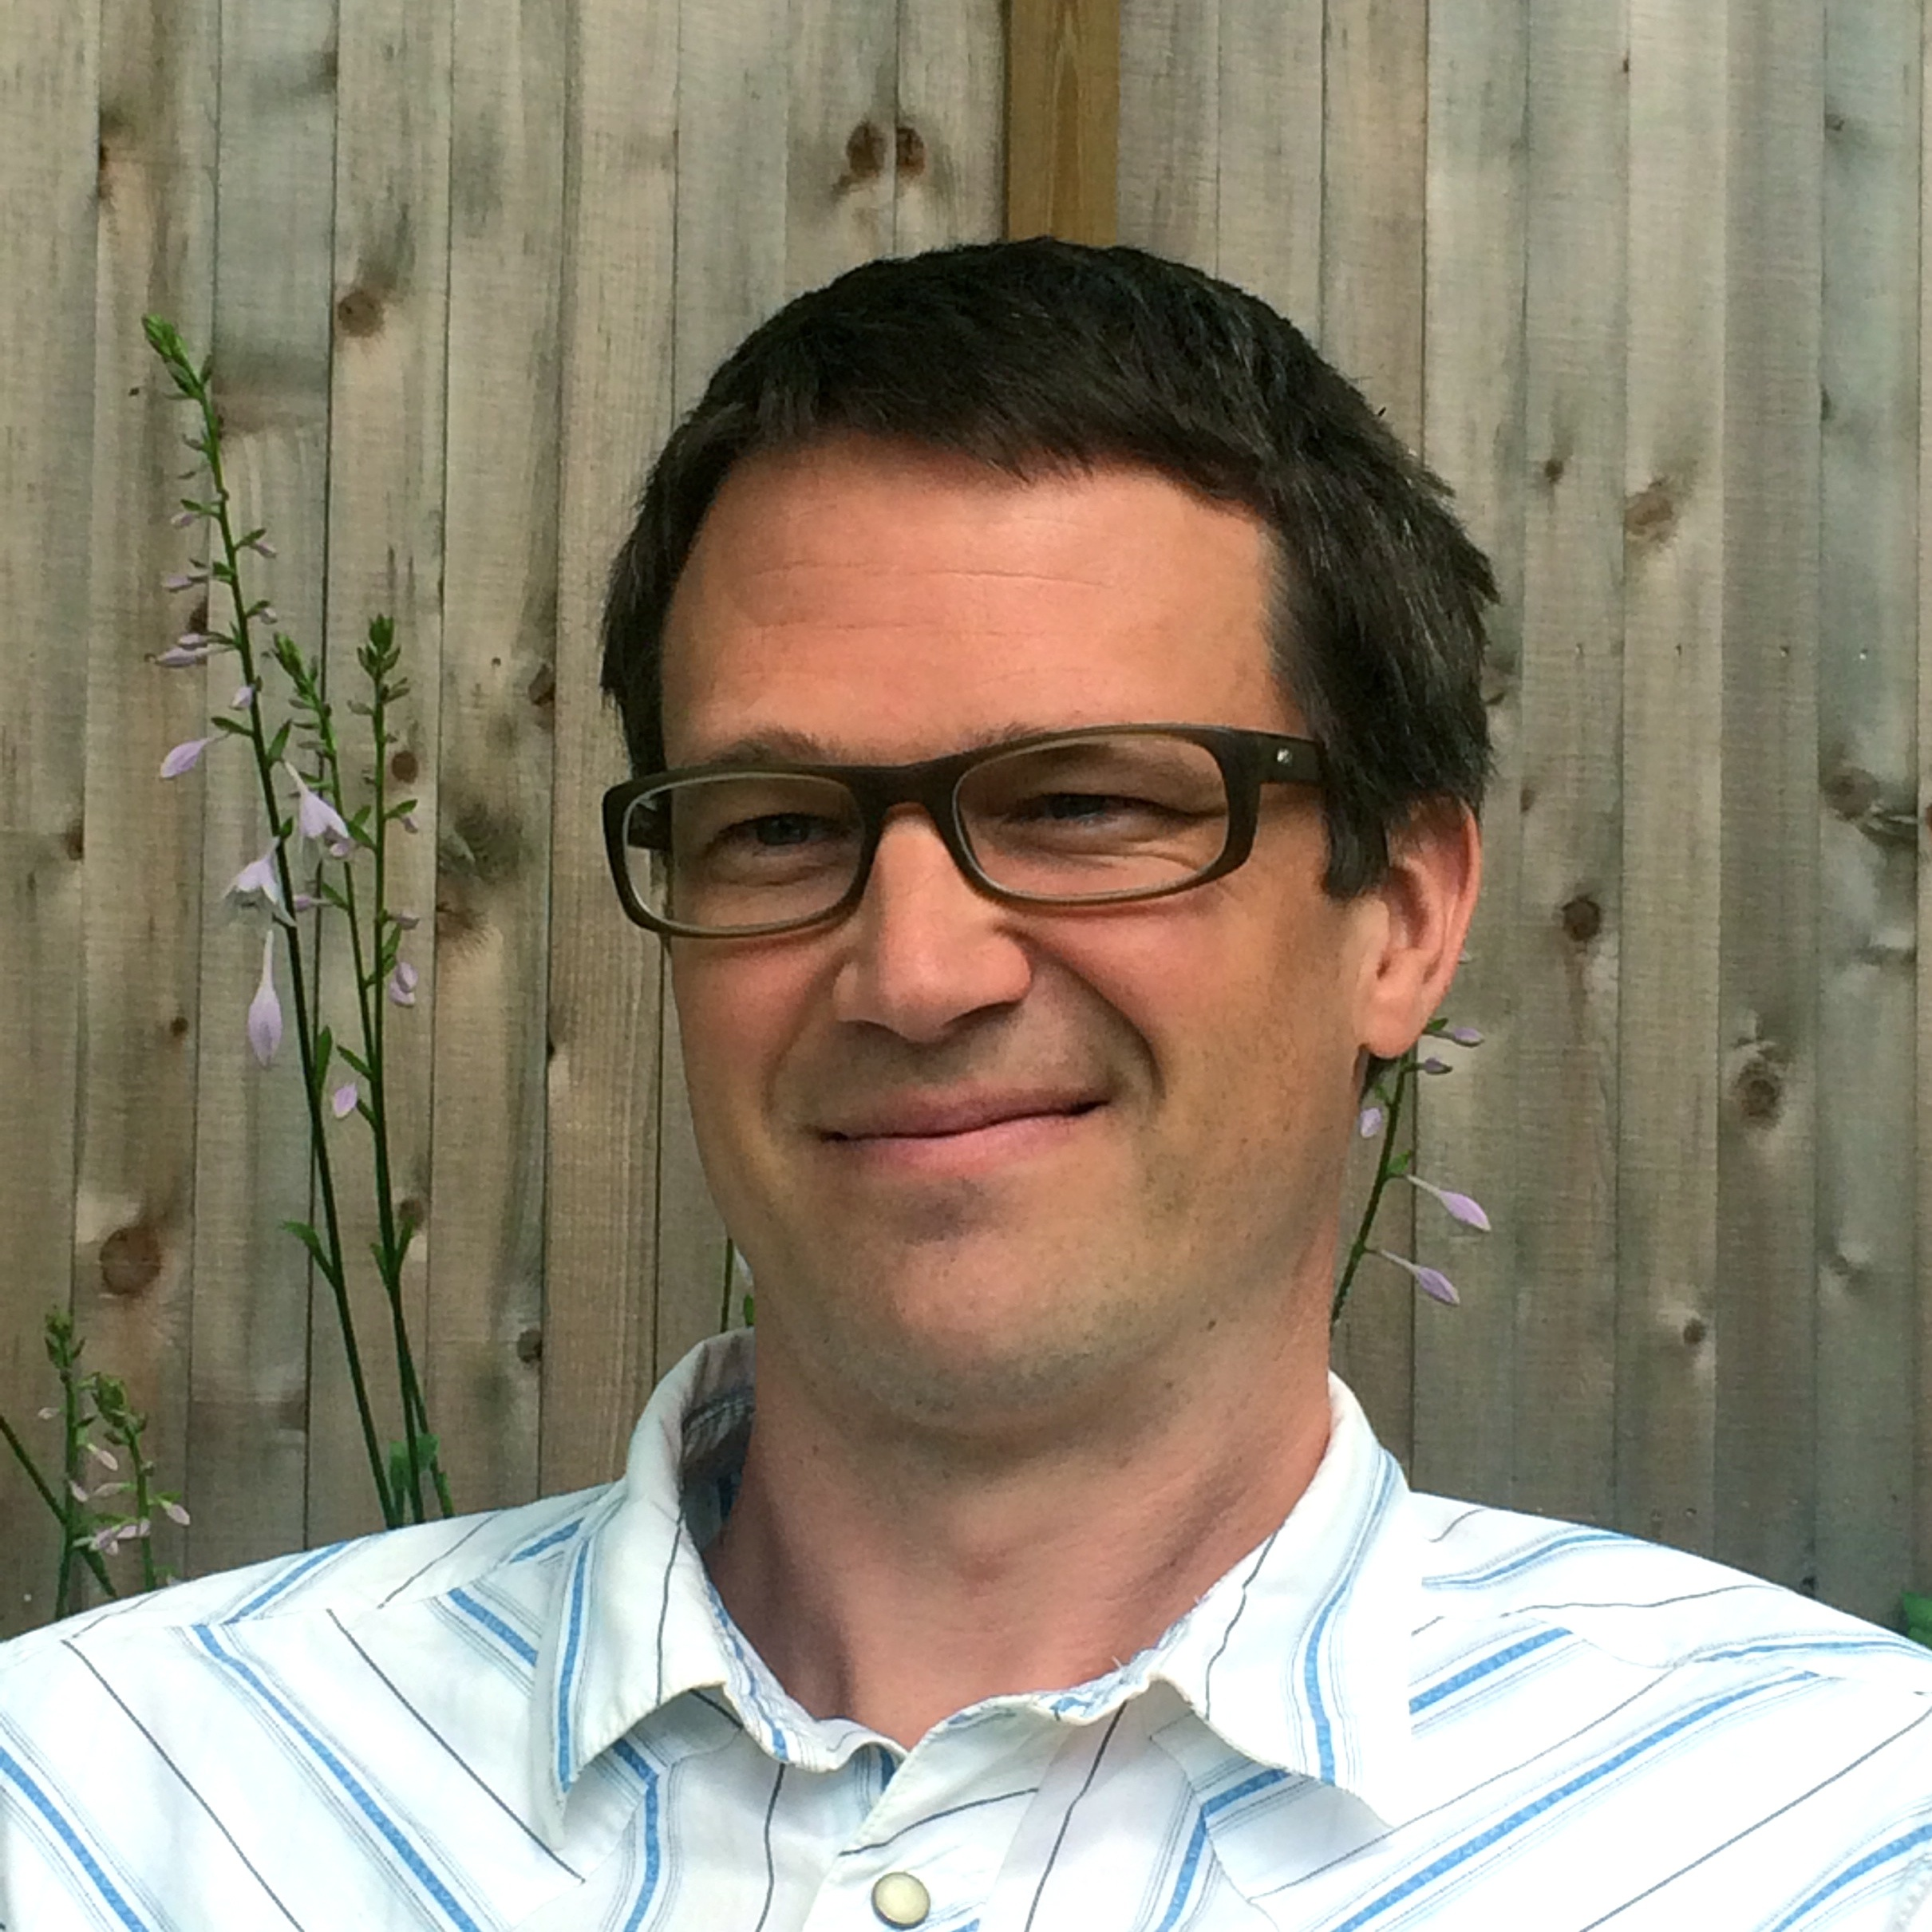
Acknowledgements

Slide 5
BEST Expectations
Be Respectful
Engage
Strengths-based
Team Solutions

Slide 6
Anchoring Activity: Maître’d
Table for Two:
Holiday break energizer
Celebrations throughout the year
Table for Four:
Strategies for obtaining ongoing feedback/input from all stakeholders
Problem-solving based on feedback
Table for Three:
Opportunities for different levels of involvement for stakeholders in implementation
Notes:
Table for two
What’s one thing you did on holiday break that energized you to come back to school?
What does your leadership team do to ensure celebrations for students and staff throughout the year?
Table for four
What strategies do you have in place for ongoing and predictable feedback/input from faculty, staff, students, family and communities?
What does your team do with input from students/staff/families/communities?
Table for three
What opportunities exist for different levels of engagement/participation/commitment for stakeholders in actual implementation?

Slide 7
Topic Presentation: Building Buy-In and Momentum Through Understanding and Meaningful Engagement

Slide 8
PBIS is all about…
Creating an environment where students can be socially and academically successful.
Can’t argue with that, right?
But, how do we create this environment so that it is most meaningful to students, staff, and others?
Turn to your neighbor.

Slide 9
Staff Buy-In
#1
factor in sustaining implementation
(Pinkelman et. al, 2015)
Notes:
Related - Lack of buy-in most commonly identified barrier.

Slide 10
How do you engage staff in PBIS implementation? The target is at least 80% teacher buy-in
Notes:
Buy-in: signifies the commitment of interested or affected parties to a decision ‐ to agree to give it support, often by having been involved in its formulation.
• Participate: to take or have a part or share
• Engage: become involved
• Involve: to engage, require, demand
You need:
All staff to buy‐in (or at least not sabotage)
• Majority of staff to participate – 80%
• Some staff to be engaged and ready to be involved
• Some staff to be active

Slide 11
What does 80% buy in mean?
Consensus means that I agree to:
provide input in determining what our school’s problems are and what our goals should be
make decisions about rules, expectations, and procedures in the commons areas of the school as a school community
Follow through with all school-wide decisions, regardless of my feelings for any particular decision
Commit to positive behavior support systems for a full year - allowing performance toward our goal to determine future plans

Slide 12
The Buy-In Continuum
Hard Core Believers
Participators
Wait-and-Seers
Hard Core Resistors

Slide 13
Read the list of reasons people resist (or are reluctant to) change. Which do you see most frequently?
Believe the change is unnecessary or will make things worse
Don’t trust the people leading the change effort
Don’t like the way the change was introduced
Are not confident the change will succeed
Did not have input or role in planning & implementation
Feel threatened that change will mean personal loss — security, status, relationships, competence
Believe in the status quo
Have already experienced a lot of change and can’t handle more disruption
Afraid they don’t have the skills to do the work in ways required by the change
(Hill, 2009)
Notes:
Activity

Slide 14
Read the list of reasons people support change. Which do you see most frequently?
Believe the change makes sense & it is the right course of action
Respect people leading the change effort
Anticipate new opportunities & challenges that come from the change
Were involved in planning & implementation
Believe the change will lead to personal gain – satisfaction, professional growth, relationships
Like and enjoy the excitement of change
(Hill, 2009)

Slide 15
Activity – Walkaround Survey
Check off 2-3 primary reasons adults in your school show reluctance to change
Why do you think they feel that way?
What are some resources, information, and opportunities to address this?

Slide 16
Consider a Restorative Approach to Gaining Buy-In/Support and Meaningful Engagement
What are Restorative Practices?
Proactively build healthy school climates by intentionally creating space for people to understand one another and develop relationships
Meaningful opportunities for social engagement that foster empathy and mutual responsibility for the well-being of individuals and community
When things go wrong, engaging those affected and creating space so that individuals and communities can identify, understand, and address harms and needs in order for all to heal
Something we are, not something we do
Whole School Restorative Approaches Resource Guide
Notes:
No singular universally agreed-upon definition for whole-school restorative approaches (Fronius et al., 2016)
Trust
Not new
Not a program

Slide 17
Big Idea:
Those who feel connected to their community are less likely to harm, more likely to want to
repair harm when it happens,
and more likely to accept consequences
All members of the community should feel that
their “presence is vital to their
learning community’s success”
Highgate's PBIS/RP Document
Whole School Restorative Approaches Resource Guide

Slide 18
Core Principles of RP
Voluntary participation
Exploring relationships
Meaningful engagement
Participatory decision-making (do “with” rather than “to” or “for”)
Identification of and addressing harms and needs (rather than focus on blame, rule violation, or punishment/exclusion)
Active responsibility (rather than passive and/or punitive accountability)
Restoration and repairing the harm
Whole School Restorative Approaches Resource Guide
Notes:
No singular universally agreed-upon definition for whole-school restorative approaches (Fronius et al., 2016)
What resonates with you in these core principles?
How might put these principles into action to help make PBIS more meaningful to staff?

Slide 19
Goals of PBIS and RP
To build a safe, respectful, and productive learning environment
To establish a positive school climate where students and adults have strong, positive relationships and students understand what is expected of them as learners at school
https://www.pbis.org/common/cms/files/pbisresources/TECBD_RJP%20in%20SWPBIS%20Eber,%20Swain-Bradway.pptx

Slide 20
Shifting Practices/Policies/Procedures
Reminder: this is a mindset shift for many

Slide 21
Core Features of Universal PBIS: What do these look like with RP lens?
Leadership team
Common purpose statement
3-5 positively-stated behavioral expectations
Systems for teaching behavioral expectations
Systems for acknowledging and rewarding behavioral expectations
Systems for discouraging problem behaviors
Data management systems
Notes:
Co-creation of norms/expectations
Engaging students in learning norms/expectations
Student voice and choice in recognition systems
Restorative approaches to responses to problem behavior

Slide 22
Activity
Review the core features of PBIS at the Universal Level
Where is your school’s implementation of these features along the continuum?
What can you do to move toward more meaningful engagement of staff, students, and others in implementation?

Slide 23
Communication is Essential!
Faculty know about the problem behaviors and can accurately contribute to solutions
Open communication will allow faculty to feel as though they are part of the change process
Faculty will begin to understand what is happening
Frequent communication opens dialogue for problem-solving across campus
Notes:
Communication is essential in order for school-wide positive behavior support to be successful and maintained across school years.
The more that faculty and staff are informed of the events and/or behavior patterns across campus on a consistent basis, the more they will feel as though they are part of the change process.
In addition, faculty will begin to understand what is happening across campus and in other classrooms.
This frequent communication opens the dialogue in problem solving across campus.

Slide 24
Welcome to VTPBIS Edcamp!
Collaborate with other VTPBIS educators and leaders in Vermont
Develop and strengthen shared leadership in PBIS implementation
Cultivate the understanding and implementation of PBIS Best Practices.
Promote equitable access to high levels of learning for all students.

Slide 25
Edcamp Tenants:
Participant Driven:
Topics created by the participants in advance and at the start of the session
Experience, not Expertise:
Conversations, not planned presentations
Participants facilitate sessions by sharing experiences
Rule of Two Feet:
Use dots to prioritize session topics
Find tables/topics that maximize learning needs
Notes:
Participants are encouraged to have discussions and hands-on materials to share
Built on principles of connected and participatory learning
Brings educators together to talk about the things that matter most to them: their interests, passions, and questions.

Slide 26
How it works:
Finalize list of topics as a large group
Everyone gets three dots to put next to topics of greatest interests
50-minute sessions
Guiding questions for sessions:
What is the topic? (create an operational definition)
What do you want to learn about?
What do you want to share?
What do you want to bring back to your school/SU/SD?
How will you know if you are successful?

Slide 27
Edcamp Session Directions:
Review list of topics
Put three stickers on the topics most important to you (you could put all your stickers on one topic!)
Finalize topics as large group
Go to designated table
Choose facilitator and note taker
Enjoy your discussion for 30 minutes
Switch to next topic

Slide 28
VTPBIS Updates
Update contact info
Quarterly Report info
TFI/SAS
RFP?
Upcoming events

Slide 29
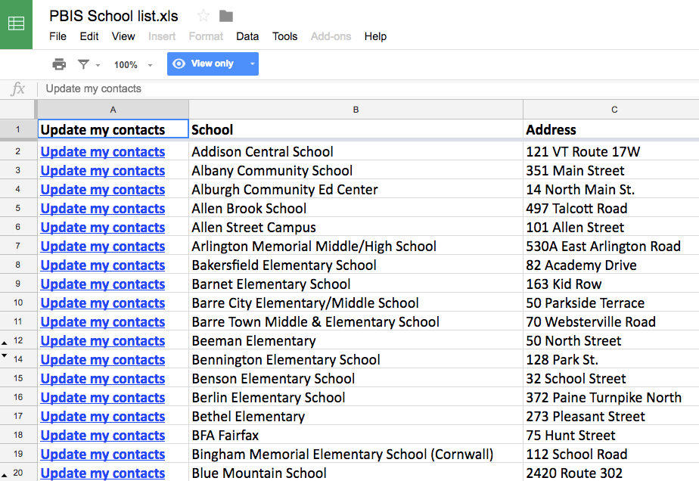
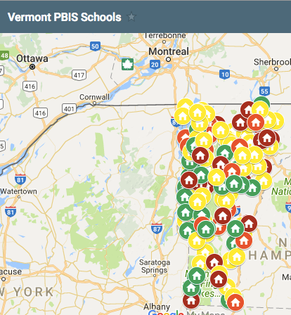
Contacts & Map
Update Contacts
Map

Slide 30
Professional Learning Fall, 2018
15
Learning Events
506
participants

Slide 31
Participant Comment:
“I always bring my knitting to training for when things get slow, and I didn't even think about pulling it out. Loved every minute. Thank you.”

Slide 32
Annual Report: Status of Action Steps
ACTION STEPS | STATUS
Classroom Management | 3rd CBPC Cohort started; ongoing support for Cohorts 1 & 2
Tier II/III | FBA/BSP Training
VTPBIS Coaching | 30 schools connected to coaches
PBIS/RP Alignment | Universal almost complete; PD
MH Partnerships | MH rep on state team; PD
Data-based Decision-Making | Data Days
PBIS/Academic Alignment | MTSS Field Guide
Notes:
CBPC possible activity for afternoon

Slide 34
Self Assessment Survey (SAS) and Tiered Fidelity Inventory (TFI) Reminder!
SAS Window: January 3rd - March 31st
ALL VTPBIS Schools
TFI Window: January 3rd - March 31st
ALL VTPBIS Schools
Complete each tier you are currently implementing
For more information, see: http://www.pbisvermont.org/resources/evaluation-tools/

Slide 35
Tools & Resources
www.pbisapps.org
Notes:
Sherry
Raise your hand if you’ve been to this website? This is the portal to access SWIS and PBIS Assessments – BoQ, BAT, SAS, SET

Slide 36
Upcoming Events
Upcoming Trainings:
VTPBIS Universal Orientation Webinar – 1/15
VTPBIS Targeted Orientation Webinar – 1/16
VTPBIS Intensive Orientation Webinar– 1/17
FBA/BSP – 2/1 and 2/8 at VTC, Randolph
Office Hours – 2/7
Trauma Webinar – 2/11
CPI – 2/14 – Hampton Inn, Colchester
March PBIS – 3/28 – 3/29 in Lake Morey
Next Coordinators’ Meetings:
NORTH: MAY 9th – Holiday Inn, S. Burlington
SOUTH: MAY 10th – Franklin Center, Rutland
2019 Summer Institute – 6/24-27, Killington

Slide 37
Resources
Hill, L. A. (2009). Managing change: Pocket mentor. Boston, MA: Harvard Business School Publishing
Flannery, K. B., Hershfeldt, P., & Freeman J. (2018). Lessons Learned on Implementation of PBIS in High Schools: Current Trends and Future Directions. Center for Positive Behavioral Interventions and Supports (funded by the Office of Special Education Programs, U.S. Department of Education). Eugene, Oregon: University of Oregon Press.
Whole School Restorative Approaches Resource Guide: https://education.vermont.gov/documents/whole-school-restorative-approach-resource-guide
Highgate's PBIS/RP Document: https://docs.google.com/document/d/1KHaWUzpipofy5D7iqfGdOGb6zxehwlfHlAvQ5p9xg0w/edit
https://www.pbis.org/common/cms/files/pbisresources/TECBD_RJP%20in%20SWPBIS%20Eber,%20Swain-Bradway.pptx

Slide 38
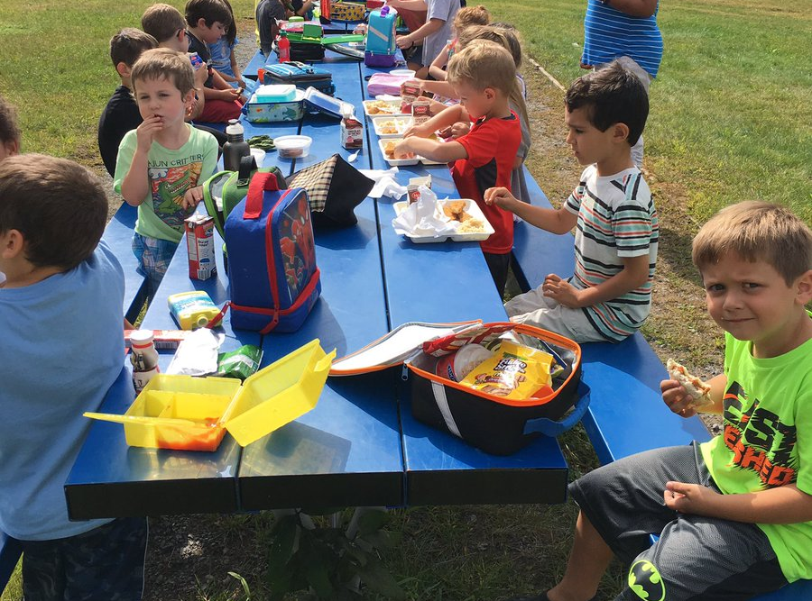
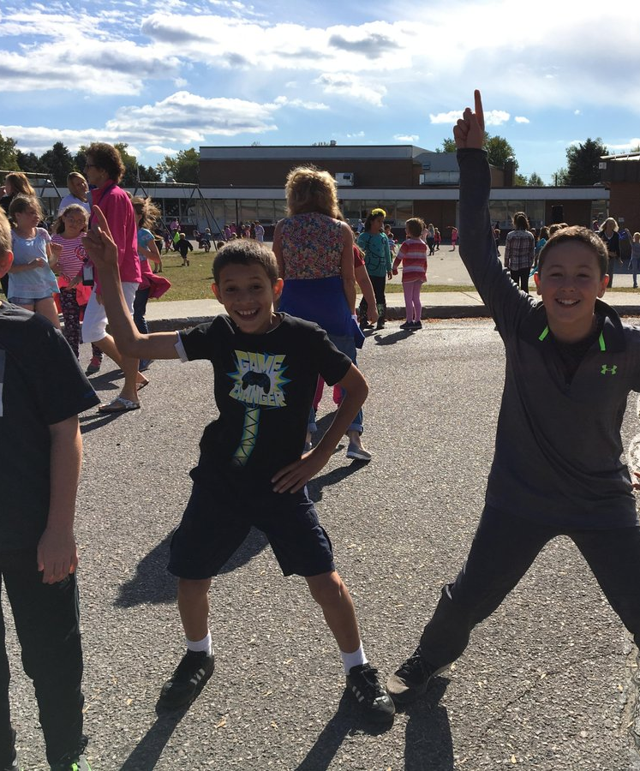
Lunch Break! After lunch: Optional additional Edcamp session or Team Time
Notes:
Sherry

