Slide 1
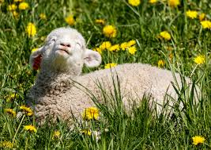
VTPBIS Coordinators as Coaches Learning & Networking Meeting May 2018
Notes:
Sherry

Slide 2
Always Start with Data
Attending the May North and South Regional Coordinators Meetings:
participants
schools
SU/SDs
Notes:
Sherry

Slide 3
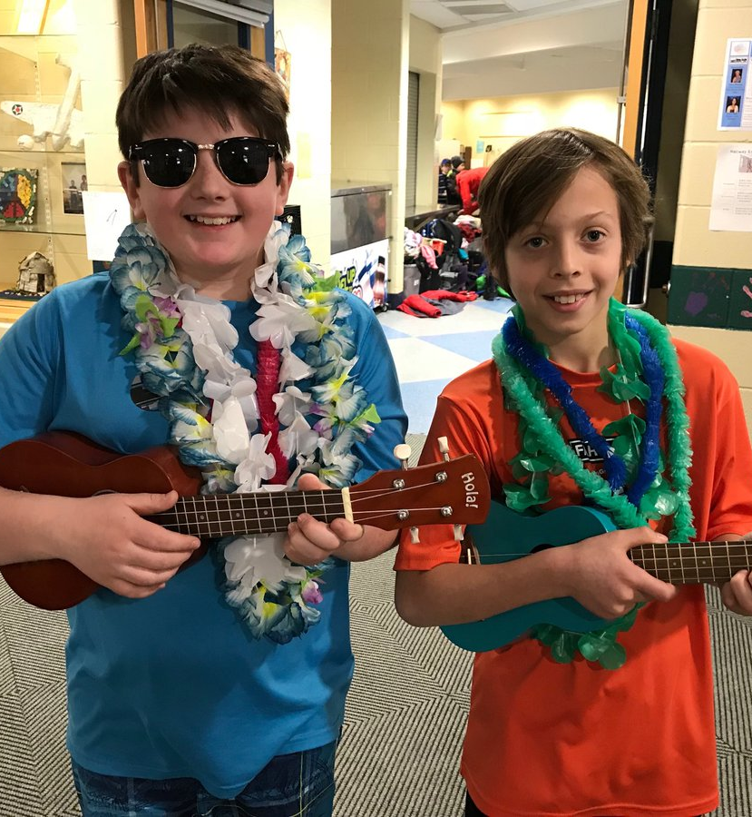
Agenda
Introductory Warm-up
VTPBIS Quarterly Report Highlights
TFI Action Planning
Topic: Supporting Staff as a Key to PBIS Sustainability
Networking Sessions
VTPBIS Updates and Important Information
Notes:
Sherry

Slide 4
BEST Expectations
Be present
Engage with others
Strengths-based
Team solutions
Notes:
Sherry
Remind of our expectations –
Be present – cell phones off, throw out task list, etc.
Engage – show respect by listening and using effect team skills
Use rule of brainstorming= no idea is a bad idea
Team solutions – work together toward consensus

Slide 5
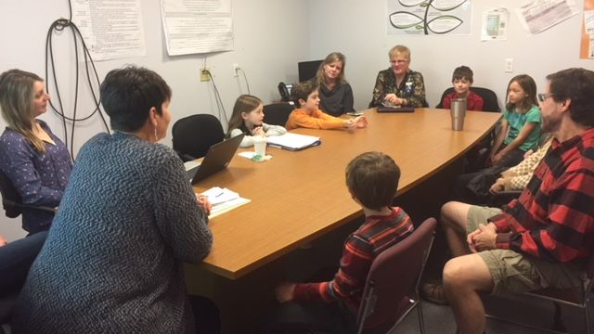
Maitre’d
Table for 3!
Introduce yourself.
Take turns answering this question:
Describe your teaming structure as it relates to PBIS. What are some strengths and challenges?
Notes:
Sherry

Slide 6
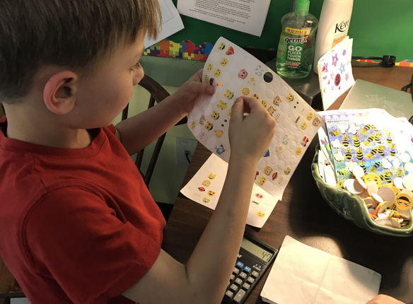
Maitre’d
Table for 2!
Introduce yourself.
Answer this question:
Describe the strengths and challenges of 1-2 of the following core practices at your school:
Teaching expectations
Acknowledgements - student, class, school-wide, staff
Consistent responses to problem behavior
Check-in/Check-out
Other Targeted Interventions
Supporting students with FBA/BSP
Notes:
Sherry

Slide 7
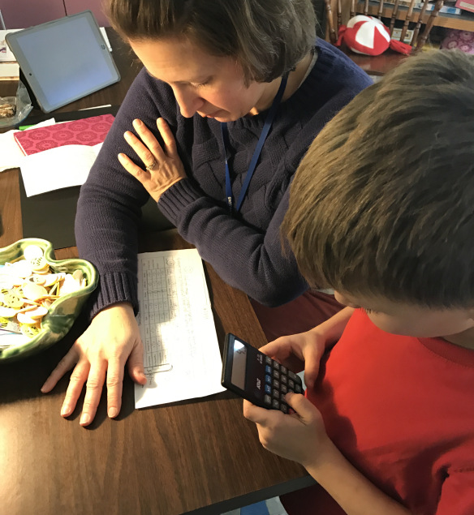
Maitre’d
Table for 3!
Introduce yourself.
Answer this question:
Describe your use of student outcome data and PBIS fidelity data. What are some strengths and challenges?
Notes:
Sherry

Slide 8
Maitre’d
Table for 4!
Introduce yourself.
Answer this question:
What are some ways you provide yourself with a meaningful reward?
Notes:
Sherry

Slide 9
TFI and SAS
State Results, Your Results,
and Now What?
Notes:
Amy

Slide 10
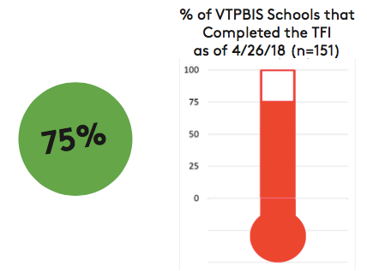
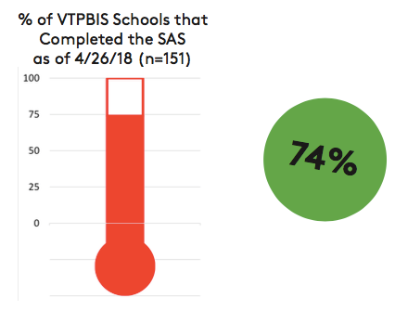
Notes:
Amy

Slide 11
Fidelity of Implementation - TFI
113 Schools Completed the TFI
Average Fidelity of Tier I Implementation = 76%
Notes:
Amy

Slide 12
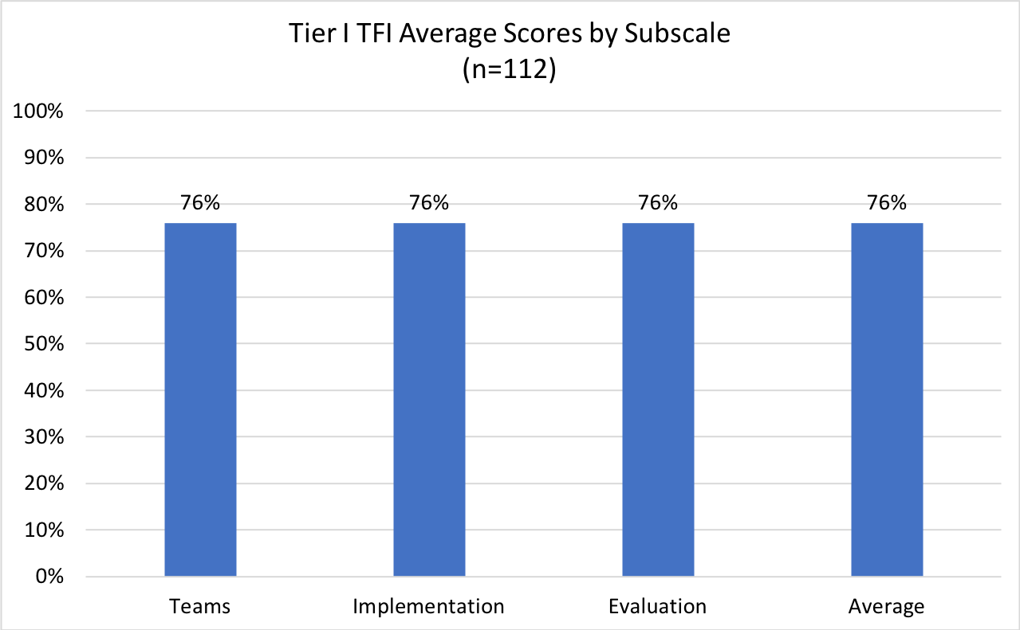
Fidelity of Implementation - TFI
Notes:
Amy

Slide 13
If I had a magic wand, and PBIS were implemented with 100% fidelity, my school would look like ___________________. This could be measured by ___________________.
Notes:
Amy

Slide 14
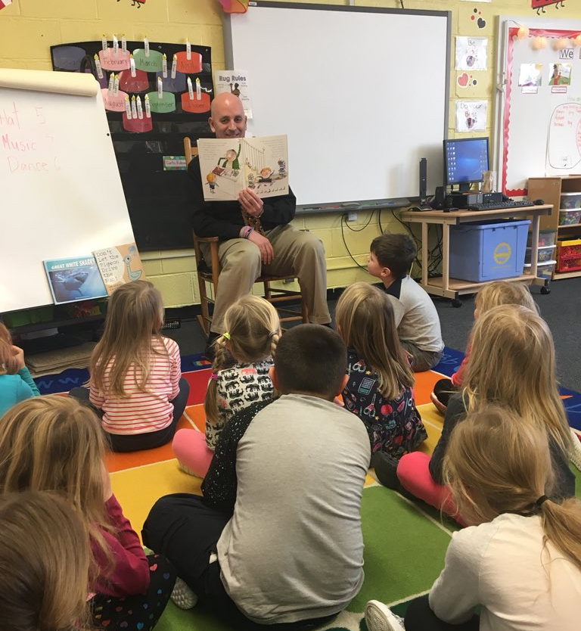
Sample Achievable Outcomes:
Improve overall school climate
Reduce ODRs
Reduce bullying
Increase attendance
Decrease referrals for Special Education
Improve academic scores
Notes:
Amy

Slide 15
Using the Tiered Fidelity Inventory (TFI) to Reach your Outcomes
Notes:
Amy

Slide 16
TFI
What? An efficient and effective validated measure to assess fidelity of core PBIS features at all 3 tiers – Teams, Implementation, and Evaluation
Why? To guide and sustain effective implementation of PBIS
Notes:
Amy

Slide 17
When?
Expectation is once a year for all schools
Window open January - March (for TFI and SAS)
Consider completing TFI more than once to monitor/assess progress
Contact Anne Dubie if you would like your window opened
Teams should anticipate 30 minutes to complete each tier’s assessment the first time
Notes:
Amy

Slide 18
After Assessment
Analyze data:
Total score report
Subscale report (broken down by tier)
Sub-sub scale report (broken down by components)
Individual items report
Celebrate your 2’s, examine your 0’s and 1’s
Notes:
Amy

Slide 19
TFI Action Planning Tips
Select a small number of items (1-3)
Ask: “What are the smallest changes we can put in place next year to improve implementation?”
After a few months, use the TFI again to monitor progress
Share results with stakeholders
Notes:
Amy

Slide 20
TFI Activity
Choose which tier you want to work on
Go to one of the assigned tables
Use the guiding questions to generate great ideas
Problem solve any challenges
Record the strategies you like on TFI Action Plan template
Notes:
Amy

Slide 21
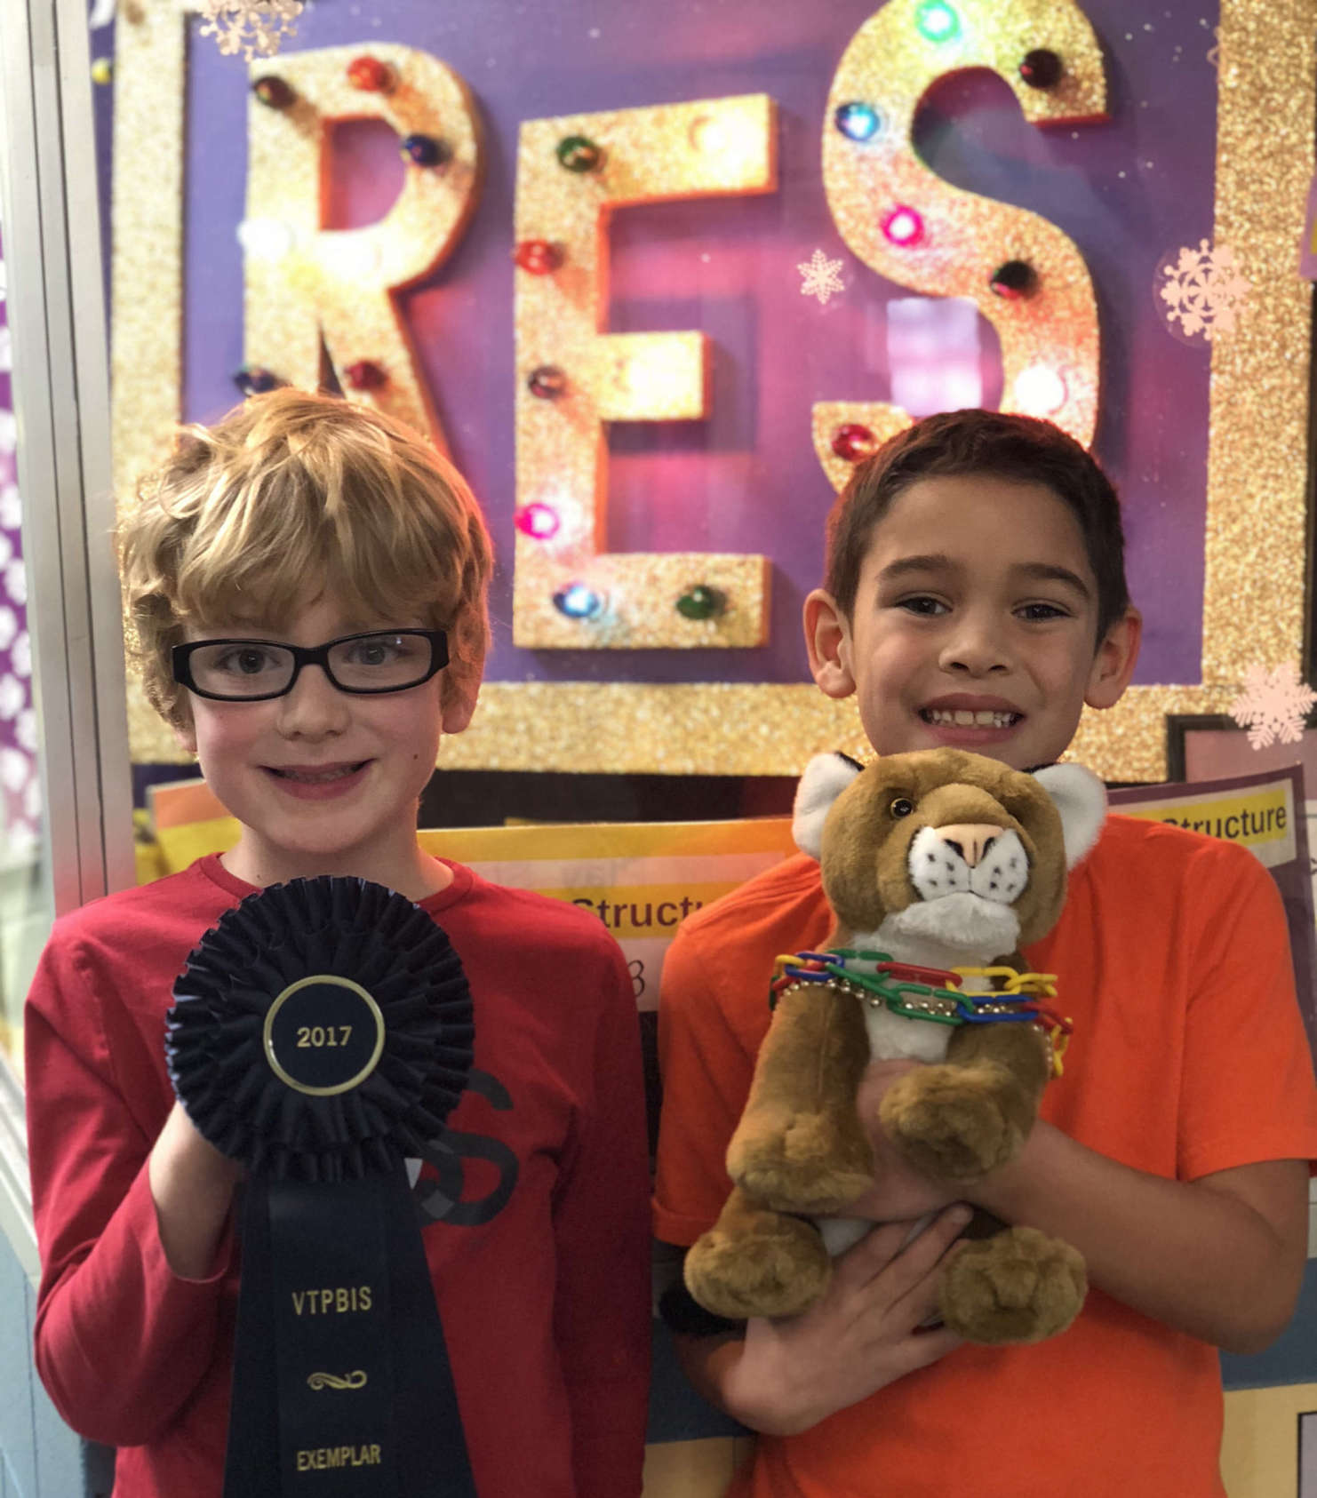
Exploring PBIS Sustainability
Adapted from Laura A. Riffel, Ph.D.
Notes:
Sherry

Slide 22
Sustaining PBIS in Schools
“Just Like Me”
Challenges:
Change in administrator
Never really had a team process & the “PBIS person” left
No support or coaching after March/Summer PBIS training, so we never really implemented PBIS with fidelity
“New school year snuck up on us” and we just didn’t get it started
Team shifted focus to prioritize new initiatives
Limited buy-in from staff
Staff don’t feel like their efforts are recognized
Notes:
Sherry

Slide 23
What Works for you?
“Just Like Me”
Full support of administrator
Build practice into policy
SU/SD-level supports
Commit to 3-5 years of implementation
PBIS as a top 3 priority in school action plan
Initiative alignment
What else?
Notes:
Sherry

Slide 24
Showing Positive Change Builds Momentum Toward Sustainability
University of Maryland
Notes:
Sherry

Slide 25
Key to Sustainability is Staff
Notes:
Sherry

Slide 26
Why Focus on Staff?
Teacher emotional exhaustion is associated with low level PBIS implementation in the classroom (Reinke, Herman, & Stormont, 2013)
Teachers who experience high levels of burnout or feel emotionally exhausted demonstrate lower quality teaching and impaired relationships (Maslach & Jackson, 1981)
Teacher stress contributes to teacher turnover (Johnson, et.al, 2005)
High stress and low coping of teachers is correlated with poor student behavior and academic outcomes (Herman, Hickmon-Rosa, Reinke, 2018)
Notes:
Sherry

Slide 27
Have you ever felt emotionally exhausted, burnt-out, or stressed (on the job)?
Turn to your partner and discuss:
When you have felt emotionally exhausted, burnt-out, or stressed,
What did you do to help yourself feel better?
What did other adults in the school do to help you feel better?
What could other adults in the school have done to help you feel better?
Notes:
Sherry

Slide 28
Support Staff Like You Support Students!
PREVENT
TEACH
REINFORCE
Notes:
Sherry

Slide 29
PREVENT
Keep something from happening or arising

Slide 30
Prevent
Get to know each other!
Culture of support - create social networks to minimize the sense of isolation experienced by many teachers
CLEAR expectations
Build a PBIS minute into all staff meetings
Seek feedback from all staff before finalizing decisions - process is important
Post PBIS progress data on a PBIS Bulletin Board in the staff room or send out in emails
System of staff acknowledgements
Notes:
Sherry
Conduct self-care/wellness activities
SAS

Slide 31
What are some prevention strategies that your leadership team can put in place to address issues of emotional exhaustion, high stress, and burnout?

Slide 32
TEACH
Manner of imparting information or skill so that others may learn (acquire skills or knowledge)

Slide 33
Teach
PBIS orientation for new staff
Have PBIS Staff Handbook
Time and resources for PD and reflection
In-Service trainings based on school priorities
Classroom Behavior Practices supports
Just like with students, don’t assume teachers know best practices in classroom behavior support
VTPBIS Professional Development calendar
Notes:
Sherry

Slide 34
What are some “teach” strategies that your leadership team can put in place to address issues of emotional exhaustion, high stress, and burnout?

Slide 35
REINFORCE
Anything stimulus which strengthens or increases the probability of a specific response

Slide 36
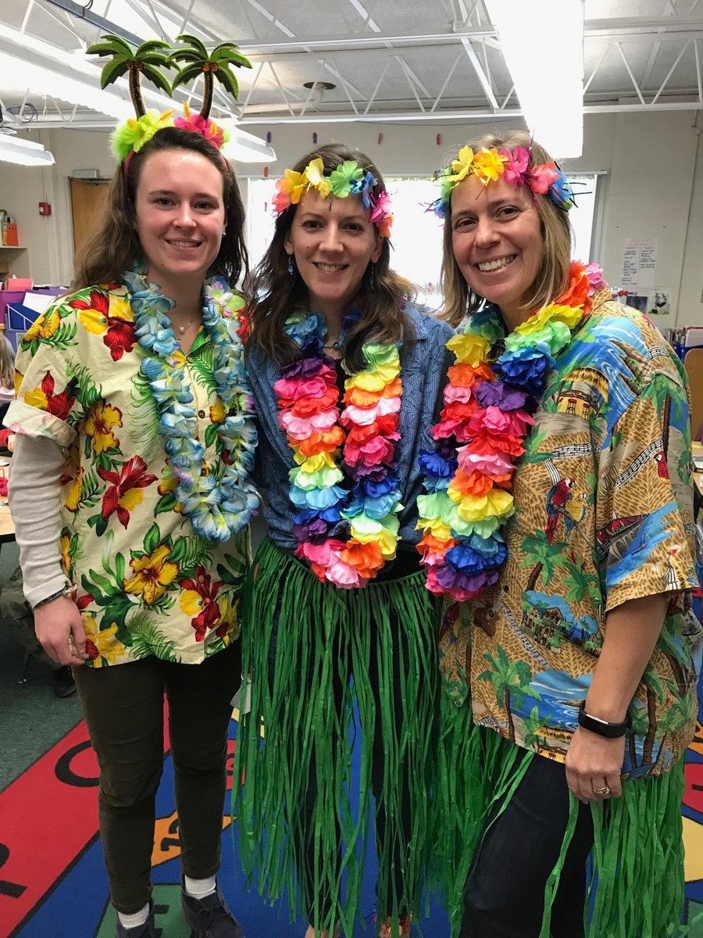
Reinforce
Catching students being good feels good!
Find ways for administrators, peers, and parents to provide high rates of positive to negative interactions with staff
Tie staff acknowledgements to their participation in PBIS
Staff acknowledgements can happen any time, for any reason
Best way to decide on acknowledgements? Ask!
Staff and students can give input about what is reinforcing for them!
Notes:
Sherry

Slide 37
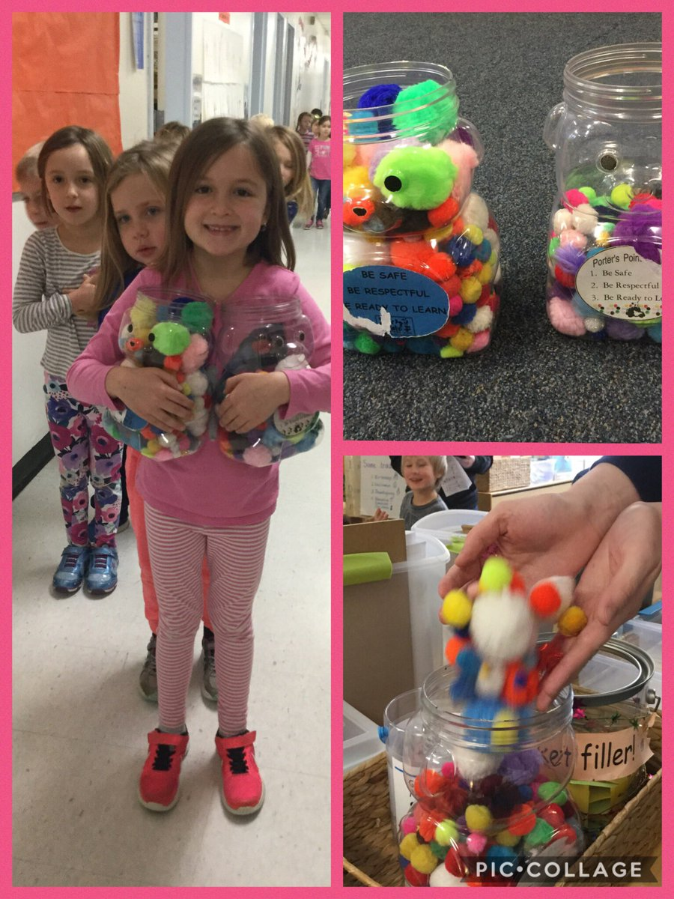
Reinforcements are effective when:
Tied to specific behaviors
Delivered soon after the behavior
Age appropriate (actually valued by student/staff)
Delivered frequently
Gradually faded away
Notes:
Sherry

Slide 38
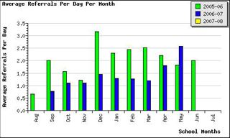
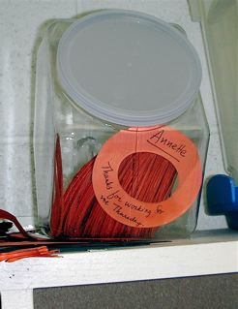
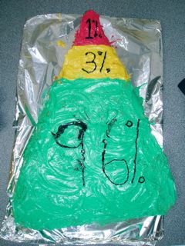
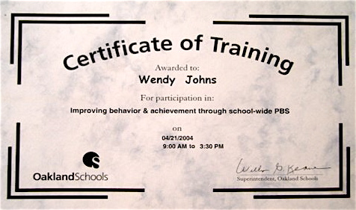
Ideas for Staff Acknowledgement
Share data with staff
Beach staff recognition lunch
Staff acknowledge each other
Staff celebration
Certificate of training
Notes:
Sherry
Highlight staff strengths in parent newsletter.
Ask the cafeteria staff to bake some special cookies. After a particularly difficult day, invite all the staff to come down for cookies in the cafeteria.
Ask parents to send in praise via email. At the end of the day, read the kudos that came in about staff members. Give kudos to the parent who shared by sending a hand written note.
Make a deal with the staff: “If we have 90% participation in the Self-Assessment Survey, then the PBIS team will wash everyone’s car on a non-rainy day.”
Invite staff members to the next board meeting and compliment their achievement to the board
Surprise the staff with a scavenger hunt that ends in a nice breakfast
Students contribute to staff acknowledgements

Slide 39
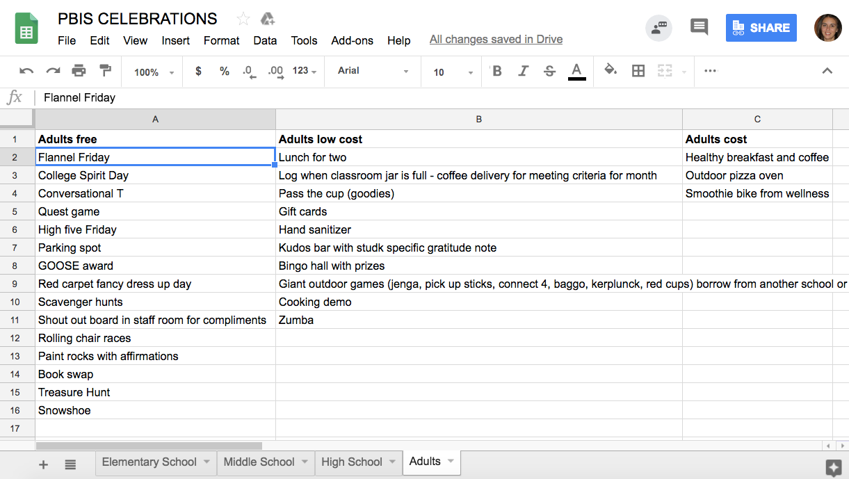
Where can you find more ideas?
Notes:
Sherry
https://docs.google.com/spreadsheets/d/1oVFyZtS401_HQwwAeK5-eLKgiFkNFO4i8BLUrk5hBUI/edit?usp=drive_web

Slide 40
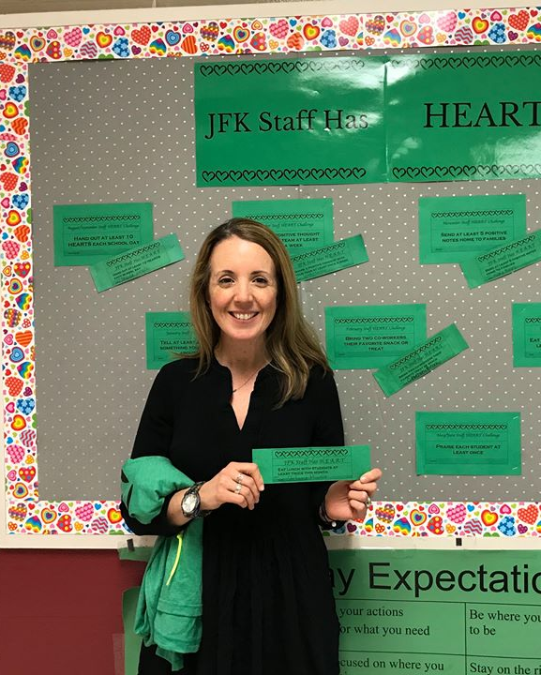
JFK Staff Shout Out
Notes:
Amanda B.

Slide 41
What are some “reinforce” strategies that your leadership team can put in place to address issues of emotional exhaustion, high stress, and burnout?

Slide 42
3, 2, 1 Reflection
Write down three ideas you heard for supporting staff.
Name two things that you are going to bring back to your team.
Name one thing you can do to support staff now.
Notes:
Sherry

Slide 43
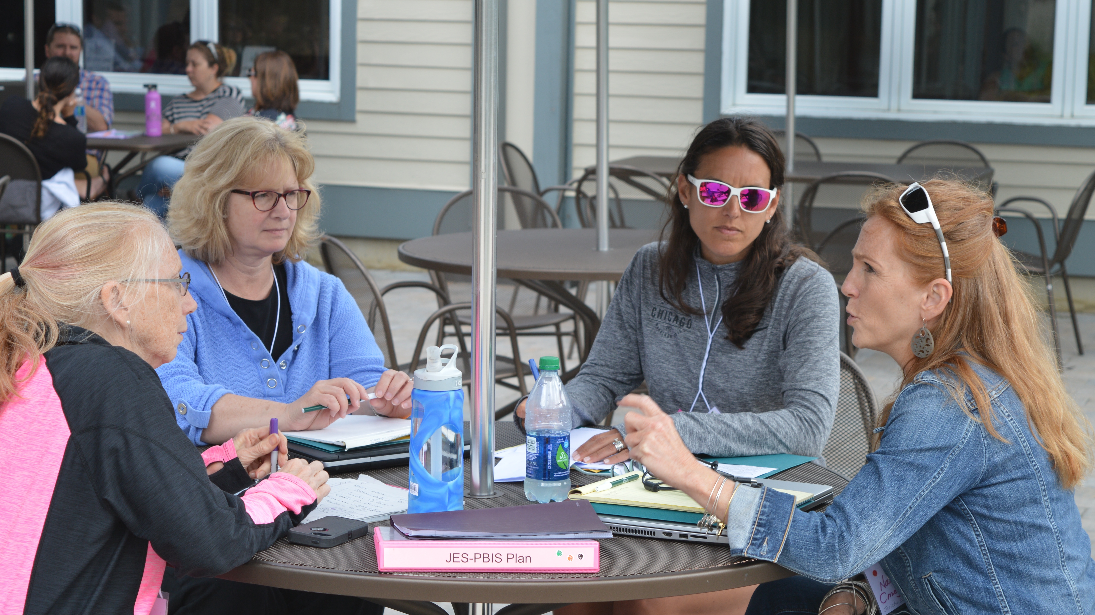
Networking Sessions
Notes:
Amy

Slide 44
Topical Networking Carousel:
Session 1:
1. Restorative Practices within MTSS
2. Classroom Strategies
3. Data for Decision-making
4. Presenting/Reporting Data
5. Sustainability Strategies
6. PBIS Coordinators
7. Staff Acknowledgements
Session 2:
1. Restorative Practices within MTSS
2. Classroom Strategies
3. Data for Decision-making
4. Presenting/Reporting Data
5. Sustainability Strategies
6. PBIS Coordinators
7. Staff Acknowledgements
OR TEAM TIME!
Notes:
Amy
15 minutes at each table – depends on time!

Slide 45
1. Restorative Practices within MTSS
“Restorative Justice is not another program to be imposed on schools. It is a philosophy, a way of being and relating. It does not replace current initiatives. Promising and evidence-based programs such as: Positive Behavior Intervention and Support (PBIS), Responsive Classroom, Second Step, Too Good for Violence, Too Good for Drugs, Tribes, and other initiatives assist in building a foundation and culture of caring. These kinds of programs and initiatives complement restorative practices.”
Spotlight Practice: Restorative Justice: A Working Guide for Our Schools
Notes:
Amy

Slide 46
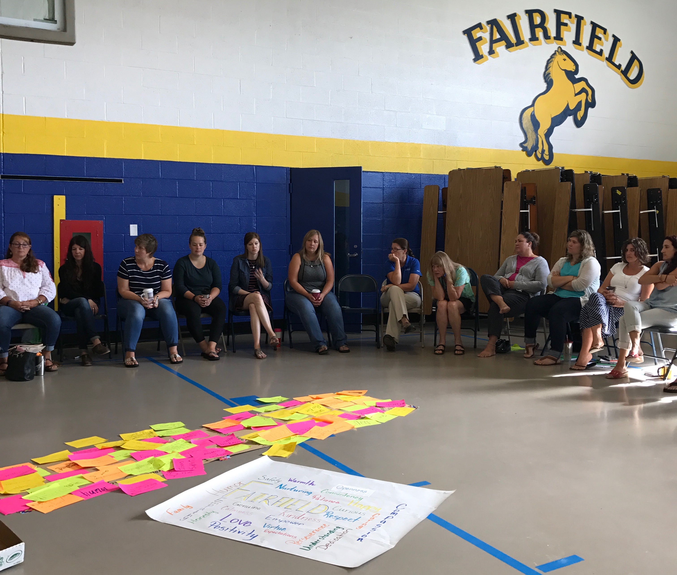
1. Restorative Practices within MTSS
Many schools decide to start their RP journey with their staff
Notes:
Amy

Slide 47
1. Restorative Practices within MTSS
Oakland Unified School District – Family, Schools, and Community Partnerships Department
Notes:
Amy

Slide 48
1. Whole School Restorative Justice Principles
(Jon Kidde, Advancing Restorative Justice in Schools, 2018)
Notes:
Amy

Slide 49
1. Restorative Practices within MTSS
Conversation Starters:
How do you define Restorative Practices?
Have you/your school been trained in Restorative Practices? Where?
How have you integrated Restorative Practices with PBIS/MTSS? If you haven’t, how do you see RP enhancing PBIS/MTSS?
What resources can you share?
Notes:
Amy

Slide 50
2. Classroom Strategies
6 Critical Features of Evidence-Based
Classroom Management:
Maximize structure in your classroom.
Establish and teach expectations.
Actively engage students in observable ways.
Establish a continuum of strategies to acknowledge expected behavior.
Establish a continuum of strategies to respond to unexpected behavior.
Use self reflection and behavior data to progress monitor and problem solve
Notes:
Amy

Slide 51
2. Classroom Strategies
Resource: https://www.pbis.org/common/cms/files/pbisresources/Supporting%20and%20Responding%20to%20Behavior.pdf
Notes:
Amy

Slide 52
2. Classroom Strategies
Conversation Starters:
Do you feel like PBIS exists in the classroom in your school?
What areas of classroom management are challenging for your teachers?
What strategies has your school used to improve PBIS in the classroom?
Do you have anyone who has been/is being trained as Classroom Behavior Practice Coach in your school? How are they being utilized?
What resources can you share?
Notes:
Amy

Slide 53
3. Student Data for Decision-Making: Common Issues
Problem | Solutions
We don’t have enough data - Our staff don’t document students’ behavior | Find out the reason behind staff reluctance (i.e. afraid it will be used against them; too time consuming; don’t see the purpose) and address it (i.e. explain how it will be used; share data back with them; use the data to change students’ behavior)
We don’t think our data is accurate | Determine data decision rules that will enable you to have a “just right” amount of data
We are wasting too much paper | Paperless referrals!
We don’t know how to utilize SWIS/PBIS Apps to its full capacity | Webinars (SWIS, SWIS-CICO, TFI); Videos on PBIS Apps website; possible session at BEST Summer Institute; time during networking session today!
We don’t know how to capture the data of students on Tier III plans | Determine data decision rules that will enable you to have the data you need for these students/school-wide without overwhelming those responsible
Notes:
Amy

Slide 54
3. Student Data for Decision-Making
Conversation Starters:
Do you have too much, too little, or just the right amount of data?
How do you encourage staff to document behavior?
What data decision rules do you have? What data decision rules are you in need of?
Are you using paperless referrals? Have you looked into it?
How do you document behaviors of students on Tier III plans?
Do you have a way of tracking positive behaviors?
What resources can you share?
Notes:
Amy

Slide 55
4. Presenting/Reporting Data
Who are your stakeholders?
What data should you share?
Fidelity Data
TFI
SAS
Outcome Data
ODRs
Climate
Family Engagement
Academics
Graduation rates
Attendance
Staff Retention
When should you share the data?
Where/how should you share it?
Why should you share data with stakeholders?
Notes:
Amy

Slide 56
4. Presenting/Reporting Data
Conversation Starters:
Who do you share data with currently? What stakeholders are you missing?
What methods have you used to share your data?
What outcome data to you have access to? How can you utilize it?
Time to create staff presentations to share fidelity data (template provided)
Acknowledgements for completing SAS + TFI, Summary of Results, Strengths, and Challenges
Three goals
Notes:
Amy

Slide 57
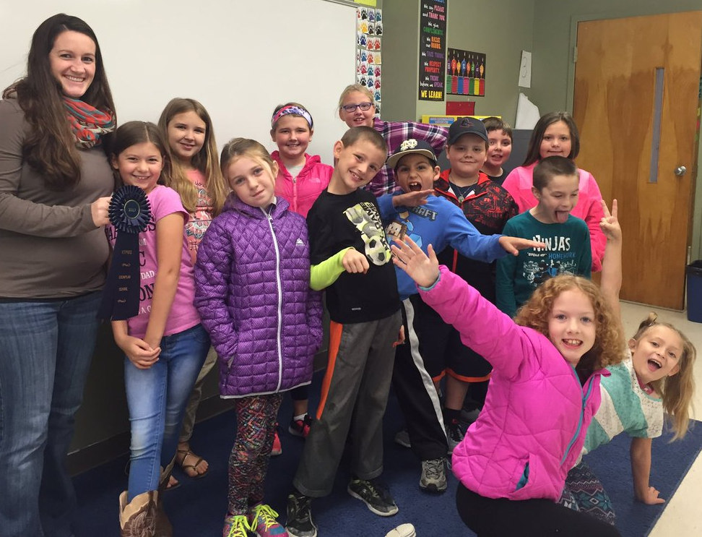
5. Sustainability Strategies
Administrator support
Staff support, buy-in, acknowledgement
Strong Team
Use of data
Coaching
Notes:
Sherry

Slide 58
5. Sustainability Strategies
Conversation Starters:
How does your administrator show support of PBIS?
How do you encourage staff buy-in?
What are the strengths of your team?
How does your team use/report data?
Have you utilized coaching? What has your coach helped your school with?
What have you done to “spice up” PBIS in your school in order to help it sustain?
Notes:
Sherry

Slide 59
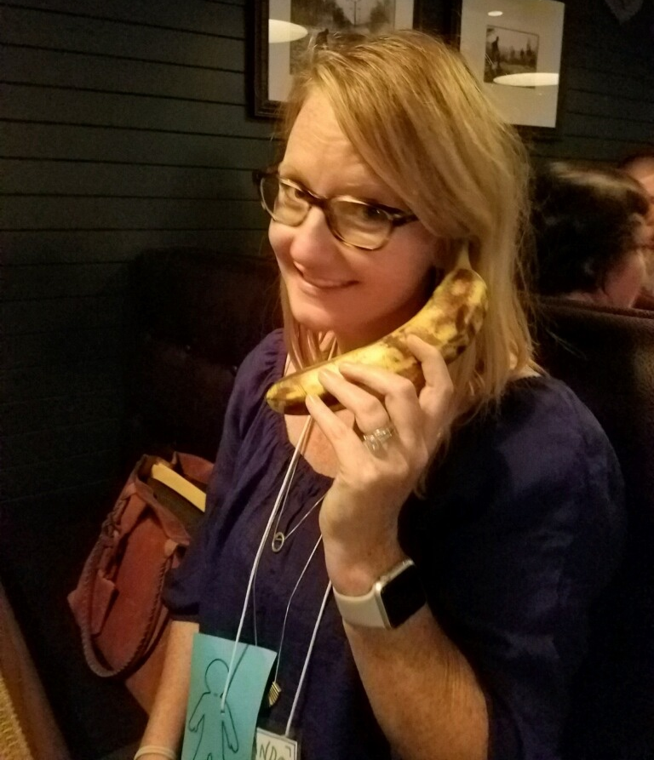
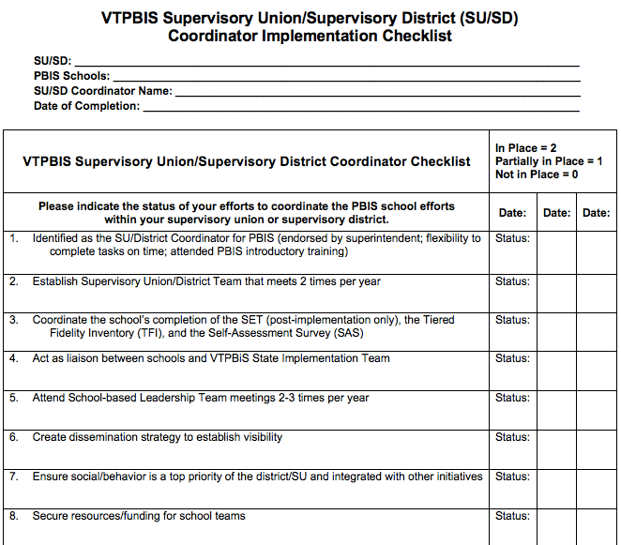
6. SU/SD and School Coordinators
System-wide support for PBIS at the school and SU/SD level is key to sustainability
Coordinator Checklists
Notes:
Sherry
https://www.pbisvermont.org/support-roles/supervisory-union-coordinators/

Slide 60
6. SU/SD and School Coordinators
Conversation Starters:
What is your full-time role in your school/district?
How much time do you have to devote to PBIS?
What is challenging about balancing your roles?
How do you manage your responsibilities as School or SU/SD Coordinator?
What is your favorite part of being a Coordinator?
Notes:
Sherry

Slide 61
7. Staff Acknowledgements
Finding the time is important
Know your context
Staff voice/choice
Importance of relationships
Tie to PBIS
Google PBIS Staff Rewards. Here’s one: https://www.pbisrewards.com/teacher-incentives/
Notes:
Sherry

Slide 62
7. Staff Acknowledgements
Conversation Starters:
What unique challenges have you experienced with staff acknowledgements?
What staff acknowledgements have you tried and how did they work?
How can you connect staff acknowledgements with burn-out prevention?
How can you connect staff acknowledgements with PBIS sustainability?
Notes:
Sherry

Slide 63
Networking Guidelines
7 Topics, 7 Tables, 7 Unique Conversations…
Select a topic and find corresponding table
Facilitator guides the conversation
Allow everyone a turn to speak
Reflect on the following:
Operationally define the topic.
Use the conversation starters as guidelines
Record ideas in your own notes
1. Restorative Practices within MTSS
2. Classroom Strategies
3. Data for Decision-making
4. Presenting/Reporting Data
5. Sustainability Strategies
6. PBIS Coordinators
7. Staff Acknowledgements
Notes:
Sherry

Slide 64
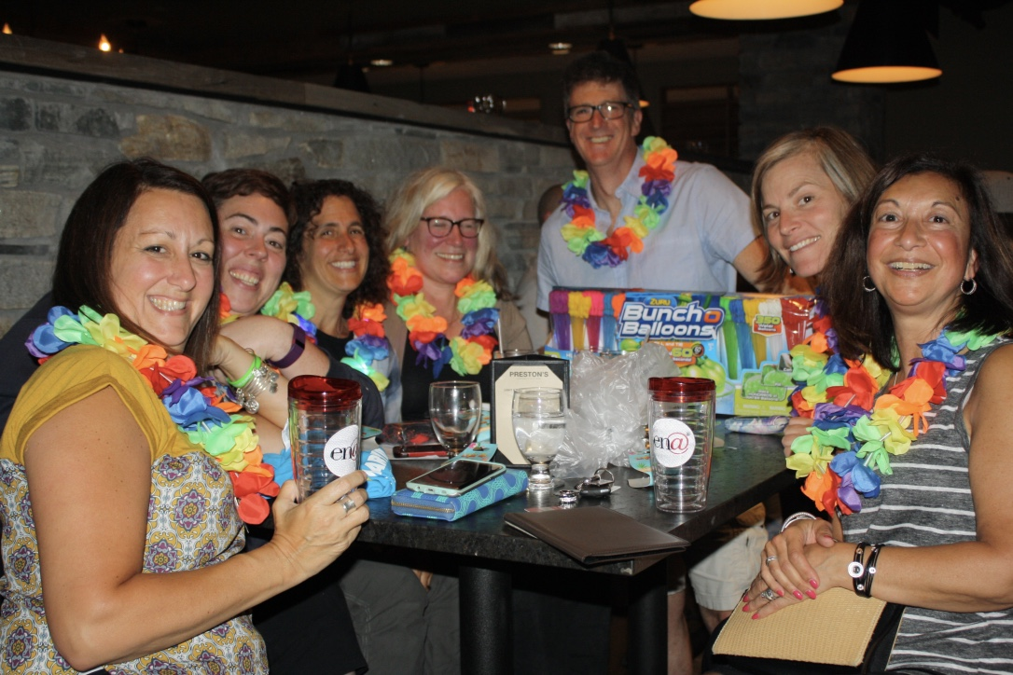
Important VTPBIS Matters
VTPBIS Acknowledgements
Summer Institute
Next Year’s PD Calendar
What else?
Notes:
Sherry

Slide 65
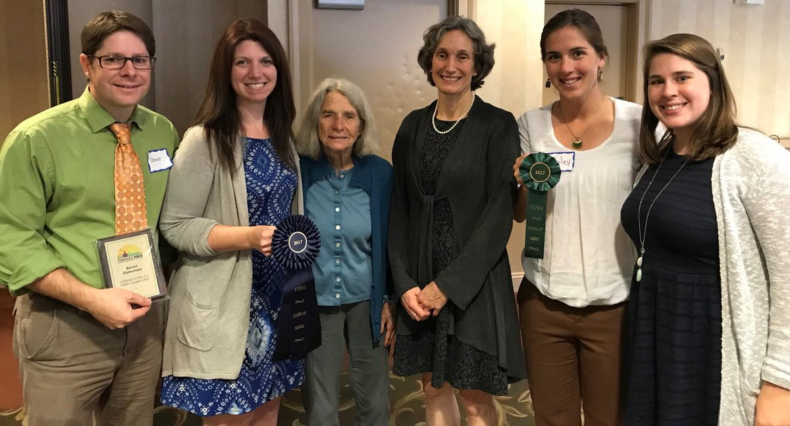
VTPBIS Acknowledgements
Merit:
No application - All schools that:
Implement Universal PBIS with fidelity (measured as 70% on the Tiered Fidelity Inventory (TFI) or 80/80 on the School-wide Evaluation Tool (SET))
Use behavior data (Big 7 data) within a problem-solving framework to improve student outcomes
Complete the annual Self-Assessment Survey (SAS) to help plan/revise implementation
Exemplar:
Application will be emailed to all eligible schools
Show evidence of the above plus:
Sustained fidelity of implementation of Universal PBIS as demonstrated by two consecutive years of Tiered Fidelity Inventory (TFI) at 70% or 80% on School-wide Evaluation Tool (SET)
Sustained implementation has had positive effects on academic, behavioral, and social/climate data
Acknowledgements will be presented at the VTPBIS Leadership Forum in October
Notes:
Sherry

Slide 66
Thanks for always being someone we can count on!
Notes:
Sherry

Slide 67
We hope all of your PBIS wishes come true!
Notes:
Sherry

Slide 68
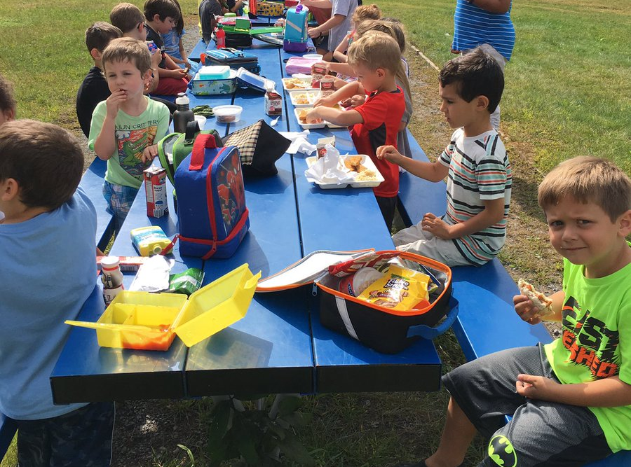
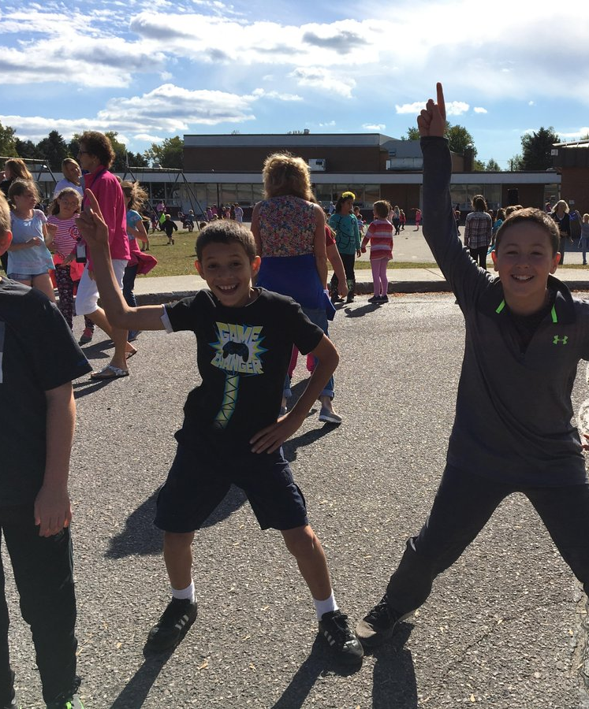
Lunch Break!
Notes:
Sherry

Slide 69
Networking Instructions
Call out a VTPBIS Topic you want to discuss
After all topics are listed, narrow number of topics based on size of group
Post topics around the room
The person who brought up the topic will facilitate
Self-select two topics
Small group discussions center around the following questions and posted on newsprint; take notes:
Define the topic (so everyone is talking about the same thing).
What are your challenges?
What will it look like when things are going well?
How might you get there?
Switch to a different topic
At the end of the session, each group will report out
Notes:
Amy

Slide 70
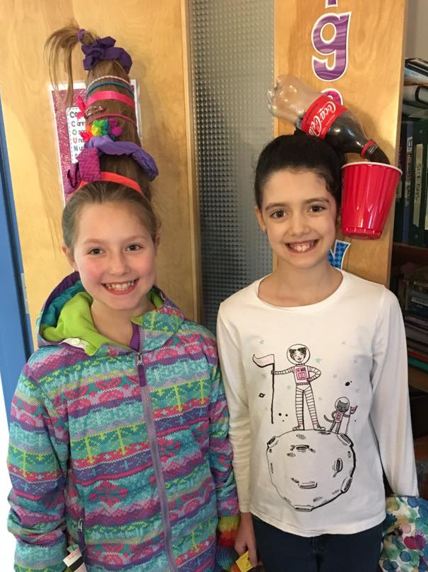
Topics to Consider:
Alignment/Integration
Implementation Dips
Collecting, Analyzing, and Using Data
Building Inventory of Targeted Supports
Strengthening Leadership Teams
Interagency Partnerships
What Else?
Notes:
Amy

