Slide 1
VTPBIS Regional Coordinators Learning and Networking
Meeting
May 2019

Slide 2
Always Start with Data!
Attending the May North and South
Regional Coordinators Meetings
53
participants
40
schools
25
SU/SDs

Slide 3
BEST Expectations
Be Respectful
Engage
Strengths-based
Team Solutions

Slide 4
Agenda
Introductory Warm-up
Topic: Using PBIS Data and Reflection to Make Effective Decisions
VTPBIS Spring Report Highlights
Networking Sessions and Action Planning
Important VTPBIS Updates
Lunch on your own
(Optional) Additional networking session or team time
Notes:
Sherry

Slide 5
Acknowledgements
Notes:
https://www.pbisapps.org/community/Pages/The-Best-Decisions-Take-Guts-and-Data.aspx

Slide 6
Opening Activity
Using the emotions chart as a reference, what emotion/s describe/s how you were feeling the first few days of school? How are you feeling about school now? Share with a partner.
Think back to the first days/weeks of school and how you felt to be starting with PBIS and share with a partner.
What were your hopes for PBIS?
How did those hopes change over the course of the year?
Notes:
Print out emotions chart.

Slide 8
Poll Everywhere
In one word, describe how you feel about the fidelity of your school’s PBIS implementation this year.
In one word, describe how you feel about your students’ behavior this year.
As a table group, talk about the difference between your gut feelings around fidelity and student outcomes compared to what your fidelity/outcome data is telling you.

Slide 9
Notes:
In one word, describe how you feel about the fidelity of your school's PBIS implementation this year.
https://www.polleverywhere.com/free_text_polls/s5Sp5fPWBYHW18jargUbO

Slide 10
Notes:
In one word, describe how you feel about your students' behavior this year.
https://www.polleverywhere.com/free_text_polls/5XCTsoNwosCM48Nmp9zxd

Slide 11
Notes:
How do you make decisions at school?
https://www.polleverywhere.com/multiple_choice_polls/QLG6A84KTlRAGi6SYg2JY

Slide 12
How do educators make decisions? Recent research study found that:
40% of teachers used systematic data to make their decisions
Just as many teachers only used their intuition or gut feelings when they made decisions
15% used a combination of data and intuition
Notes:
By looking at data, we find details about something we’d otherwise miss if we relied solely on our own experiences. We break down a problem to its smallest parts to know every in and out of the situation. That’s just one step of several in a decision-making process.
Example of student you know needs targeted supports but doesn’t have 3-5 office discipline referrals.
Data do a great job of breaking a problem apart, and a lousy job of telling us what to do next. Our brains are good at that. It’s our experience, the intangible ways we relate to the data, that lead us to solutions better suited to our specific contexts.

Slide 13
Data Points and Gut Checks
Wherever there are data, there are gut reactions to it

Slide 14
At the end of the school year, there is a mountain of data available to create a plan for next year.
You could take the pieces needing improvement and just slide them over to your action plan verbatim...
Or, you could use those pieces, alongside your own experiences, to inform the solutions you come up with as a team.
“Here comes the really hard part!”
Notes:
Disconnect major challenge. We will ask you to think of ways to connect students at Tier 3 with 1 & 2,
Counter intuitive then to emphasize the tip.
ASK THEM: So why the heck are we doing it?
My belief is that principles and values of wraparound are not just an effective basis for team planning around a small number of students in your school, but when you introduce the wraparound process into a school’s PBIS system there’s the opportunity for the values to improve the supports that ALL students receive.

Slide 15
t
Notes:
Using Data
https://www.polleverywhere.com/surveys/bM42NFzSvq3cRoBWhPNYC

Slide 16
Create an Action Planning Agenda
Review the big picture including national, statewide, or district-level data
Revisit your team’s annual action plan
Review the end-of-year data for your school
Discussion time!
Select and prioritize items for next year’s action plan
Assign items to team members and set deadlines
Plan how to share decisions with stakeholders after the meeting

Slide 17
Fidelity – TFI
The Big Picture Review
State Results
How do they compare nationally?
Notes:
Amy

Slide 19
National TFI Completion Frequency

Slide 20
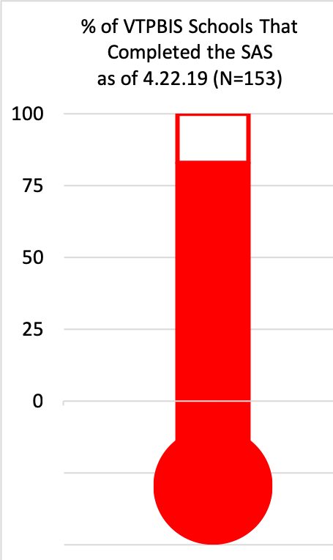
83%
80%
Notes:
Amy

Slide 21
Fidelity of Implementation - TFI
123 Schools Completed the TFI
% of schools implementing with fidelity = 79%
Notes:
Amy

Slide 22
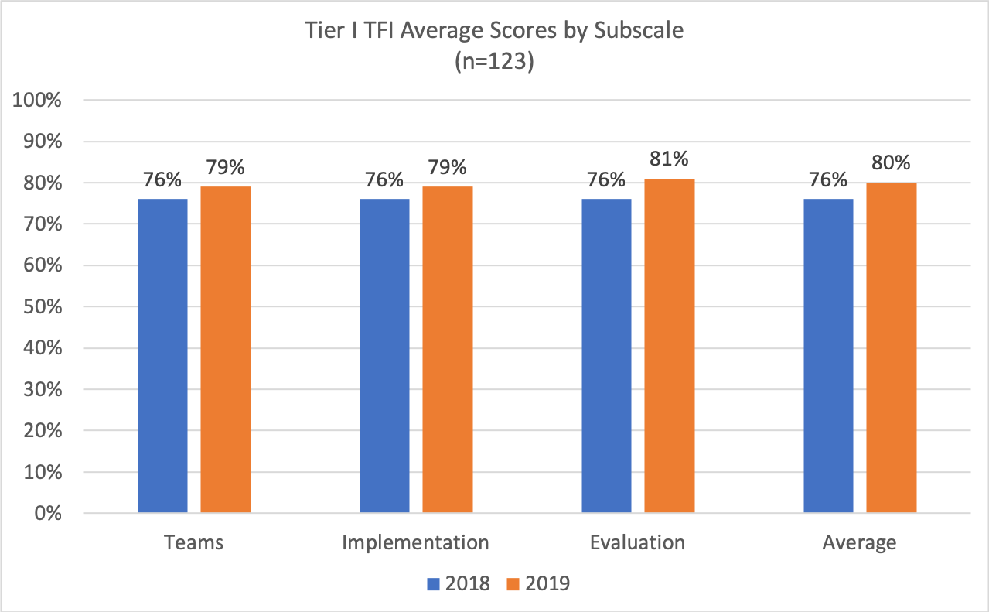
Notes:
Amy

Slide 23
Comparisons
Working with a partner:
Go to your TFI Scale and Subscale Report in PBIS Assessment. Compare your school’s Tier I average to the national + state average.
What do you notice? What do you wonder?
If you have time, compare your TFI and SAS scores from this year to last year.
What do you notice? What do you wonder?

Slide 25
Student Outcomes – ODRs
The Big Picture Review
State Results
How do they compare nationally?
Notes:
Amy

Slide 26
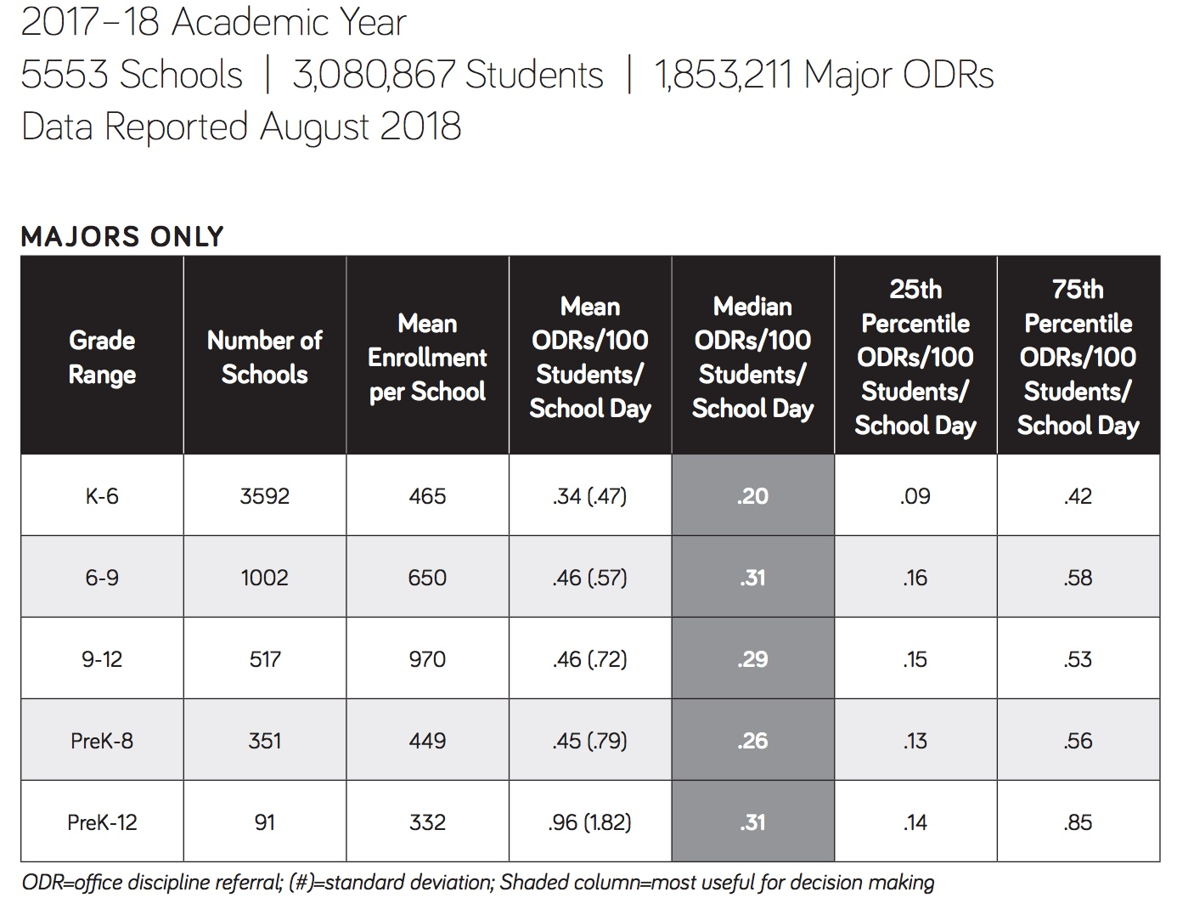
Vermont 2017-18
113 Schools in SWIS
Mean = .59
Average = .81

Slide 27
Comparing your School’s ODRs to National Rates/Trends
1. Using SWIS:
Go to your End of Year Report
Look at Rate of ODRs (major)
Compare to national rate by school level (at pbisapps.org);
OR
2. Using SWIS:
Compare ODRs/Day/Month (Majors Only) to the national trend line
Demo: https://www.pbisapps.org/applications/Pages/Application-Demos.aspx
What do you think might be different about your school compared to the national percentile?

Slide 28
Compare your school’s data summary to your lived experience
What connections can you make between the TFI results and ODRs?
Do they align?
What are your thoughts about any differences?
What setting in the school felt most challenging this year – Playground? Halls? Cafeteria?
Is this supported by your data?
Why or why not?

Slide 29
Action Planning Activity
Complete the VTPBIS Action Planning Self-Assessment
Talk with a partner about what’s in place, what’s not, and generate ideas for making your action planning a great and effective experience!

Slide 30
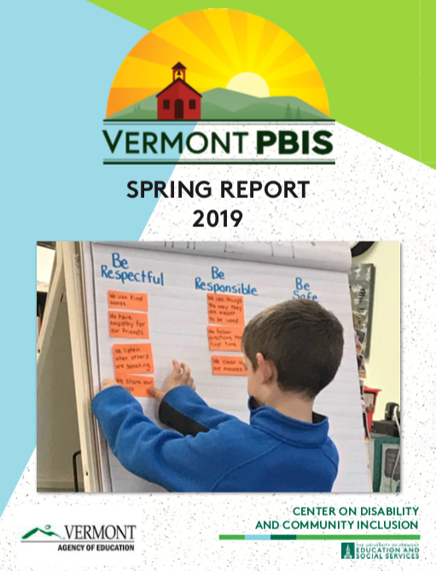

Slide 31
Input
892
participants
30 learning events
98.79% highly satisfied/ satisfied
”I enjoy hearing what other schools are doing and gathering information about how to tweak our program to make it the best it can be.”

Slide 32
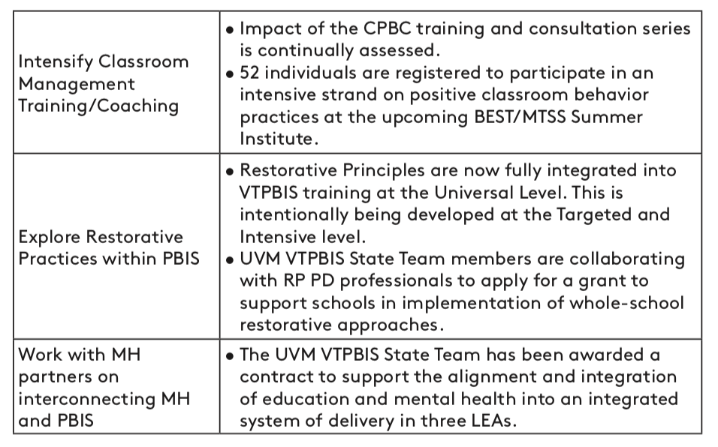
Sustainability

Slide 33
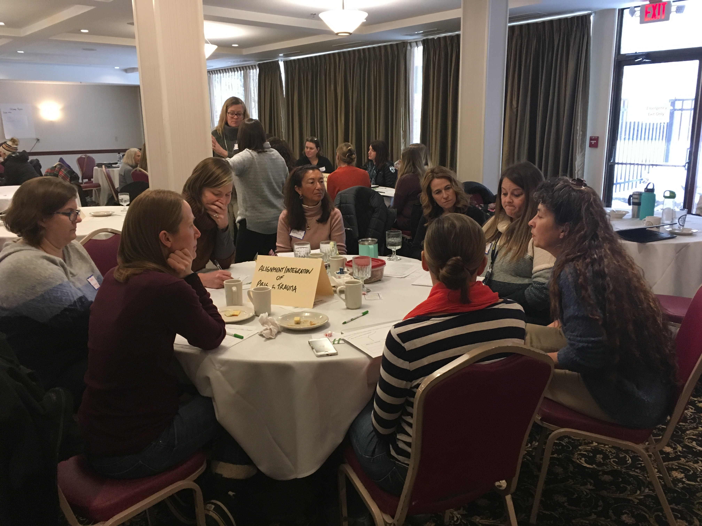
Networking Sessions
Networking Sessions
Notes:
Amy

Slide 34
Topical Networking Carousel:
Session 1:
Alignment (SEL, Restorative Practices, etc.)
Analyzing, Utilizing, and Reporting Fidelity + Outcome Data
Family Engagement
Tiers II + III
Utilizing Student Voice
SWIS Q&A
Session 2:
Alignment (SEL, Restorative Practices, etc.)
Analyzing, Utilizing, and Reporting Fidelity + Outcome Data
Family Engagement
Tiers II + III
Utilizing Student Voice
SWIS Q&A
OR TEAM TIME!
Notes:
Amy
20 minutes at each table – depends on time!

Slide 35
1. Alignment
Trauma-Informed Schools
PBIS
Classroom Behavior Practice Coaching
SEL – Second Step
Pyramid Model
Mental Health Partnerships
Restorative Practices
Responsive Classroom
What social/emotional/behavioral innovations are you implementing?
How many are being put in place at the same time?

Slide 36
1. Alignment
“It is not the pace of change that is the culprit,
it is the piecemealness
and fragmentation
that wears us down.”
Fullen, 2003

Slide 37
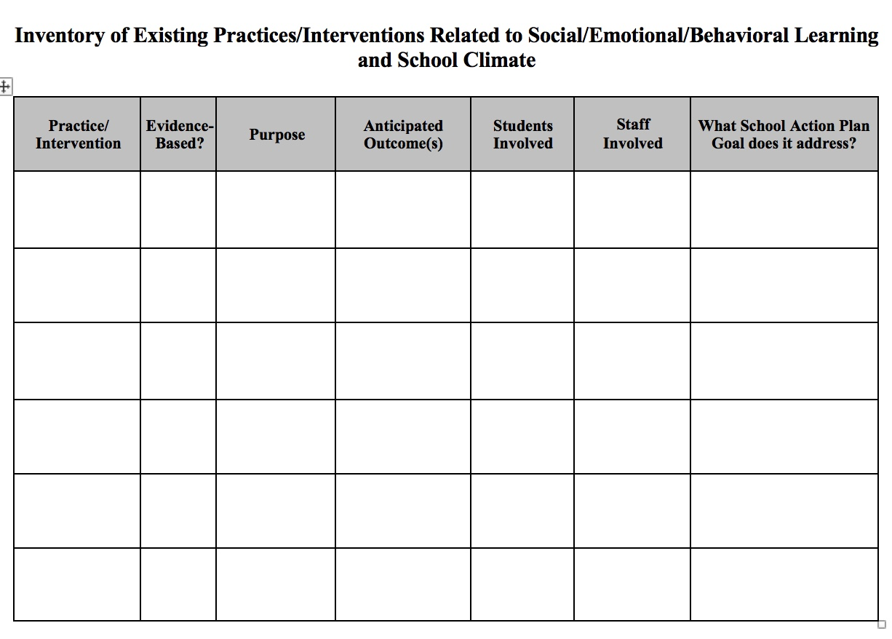
1. Alignment: Create Inventory of Related Initiatives
Notes:
https://www.pbisvermont.org/wp-content/uploads/2017/12/Inventory-of-Existing-Practices-Related-to-SEBL-and-School-Climate.docx

Slide 38
1. Alignment
Conversation Starters:
What social/emotional/behavioral innovations are you implementing? How many are being put in place at the same time?
Do staff receive a consistent message about the priorities of the district/school?
What challenges are you experiencing with alignment?
How can you help promote the message that many initiatives/programs can be aligned under the PBIS framework (and will be more likely to sustain this way)?
Take time to complete Inventory of Related Initiatives (optional)
Notes:
Amy

Slide 39
2. Analyzing, Utilizing, and Reporting Fidelity + Outcome Data
TFI
Review your Scale and Subscale Reports. Find which scales and subscales scored best and which ones scored lowest.
Look at the Items Report. For the subscales with the best scores, write down the top three items you think your team should commit to sustaining next year. For the subscales with the lowest scores, write down the three items you’ll want to be sure the team discusses further on how to improve them next year. Add these to your action plan.
SAS
Using SAS summary form, list strengths and weaknesses.
Circle priorities and add to your action plan.

Slide 40
2. Analyzing, Utilizing, and Reporting Fidelity + Outcome Data
Who are your stakeholders?
What data should you share?
Fidelity Data
TFI
SAS
Outcome Data
ODRs
Climate
Family Engagement
Academics
Graduation rates
Attendance
Staff Retention
When should you share the data?
Where/how should you share it?
Why should you share data with stakeholders?
Notes:
Amy

Slide 41
2. Analyzing, Utilizing, and Reporting Fidelity + Outcome Data
Conversation Starters:
Who do you share data with currently? What stakeholders are you missing?
What methods have you used to share your data?
What outcome data to you have access to? How can you utilize it?
Time to create presentations to share data (template provided for staff presentation on fidelity data)
Notes:
Amy

Slide 42
3. Family Engagement
When equal partnerships are in place among children, youth, families, and youth-serving staff and leaders, positive educational, health, mental health, social and occupational outcomes for youth are promoted
https://www.pbis.org/Common/Cms/files/pbisresources/Family%20Engagement%20in%20PBIS.pdf

Slide 43
3. Family Engagement
Family engagement focuses on supporting and empowering family members to engage as equal partners, and using culturally responsive strategies and multidirectional communication that facilitate equal access and opportunity (Mapp & Hong, 2010).
How is this definition different from family involvement?
Notes:
family involvement, which emphasized family participation and one-directional (school to home)

Slide 44
3. Family Engagement
Does this ever happen?
Negative spiraling occurs for families with students with challenging emotional and behavioral problems, which contributes to reduced family engagement, and worsening emotional and behavioral challenges (and reduced family engagement and so on).

Slide 45
3. Family Engagement
PBIS families, students, and educators should work together to develop Tier I systems and link school and home practices.
When concerns arise for individual students, the foundation in terms of relationship-building and use of positive behavior support can be used as a foundation to build individual support systems

Slide 46
3. Family Engagement
Consider the four A’s:
The manner in which educators approach families;
The attitudes educators hold regarding family involvement;
The atmosphere created by educators, and
Actions and practices with families that are collaborative, partnership-oriented, and focused on relationships between families and schools

Slide 47
3. Family Engagement
Schools need active engagement of families, students, and faculty to be effective. This includes:
Providing information about PBIS implementation
Having a documented process for obtaining feedback and providing response
A clear process known by all stakeholders for matching student needs to interventions
A clear process for requesting assistance known by all stakeholders
Notes:
Amy

Slide 48
3. Family Engagement
Conversation Starters:
In what ways does your school promote the four A’s: Attitudes, Approach, Atmosphere, and Actions?
How do you invite stakeholders to learn about PBIS?
What ongoing communication do you share with stakeholders about PBIS implementation?
How do you acknowledge the success of children and youth with stakeholders?
What do staff, students, families know about the process for referral about behavior supports at the school?
Family Engagement Resources: https://www.pbisvermont.org/training-resources/family-engagement/
Family Engagement Survey: https://www.pbisvermont.org/evaluations/family-engagement-survey/

Slide 49
4. Tiers II + III
Tier II Considerations and Conversation Starters:
Timely selection of students for Tier II supports improves the effectiveness of Tier II implementation
A robust inventory of targeted interventions increases likelihood that students’ needs are effectively addresses
Tier II and Tier III interventions need to be layered upon Tier I
All stakeholders should be aware of interventions and their role in implementation
Interventions need to be evaluated for effectiveness at least annually

Slide 50
4. Tiers II + III
Tier III Considerations and Conversation Starters:
Students receiving Tier III supports should have an individualized team with an identified facilitator
External supports from mental health, DCF, other family members may need to be accessed
Plans for students should be strengths-based
Tier III interventions should be layered upon Tiers I and II
FBA/BSP capacity is needed at the school
Student plans and interventions should be evaluated regularly

Slide 51
4. Tiers II + III
Conversation Starters:
Review handouts in packet for this group to discuss answers to the considerations for Tier II and Tier III

Slide 52
5. Utilizing Student Voice
Continuum of youth leadership from youth expression/surveying to shared decision making with adults
Examples:
Students vote on school mascot, acknowledgments, playground equipment, etc.
Students help create and deliver roll-out (i.e. lesson plans, creating videos, visuals)
Peer-to-peer acknowledgments/student-to-teacher acknowledgments
Have youth serve as CICO mentors
Utilize SET/TFI walkthrough to get additional input from students
Have students color map – safe and unsafe areas of the school
Share data with youth and having them develop action steps
More ideas here: https://docs.google.com/document/d/1R0xNcr3L3IC5iDXh45yu-GpkdThDm9ucOK0h_o5U4AM/edit
Notes:
Amy

Slide 53
5. Utilizing Student Voice
Conversation Starters:
What ways have you included student voice in PBIS?
What are the barriers to including student voice?
Are students just surveyed or have you engaged in true youth-adult partnerships where decision making is shared?
How can you ensure diverse youth voice that is representative of the entire student body?
Notes:
Amy

Slide 54
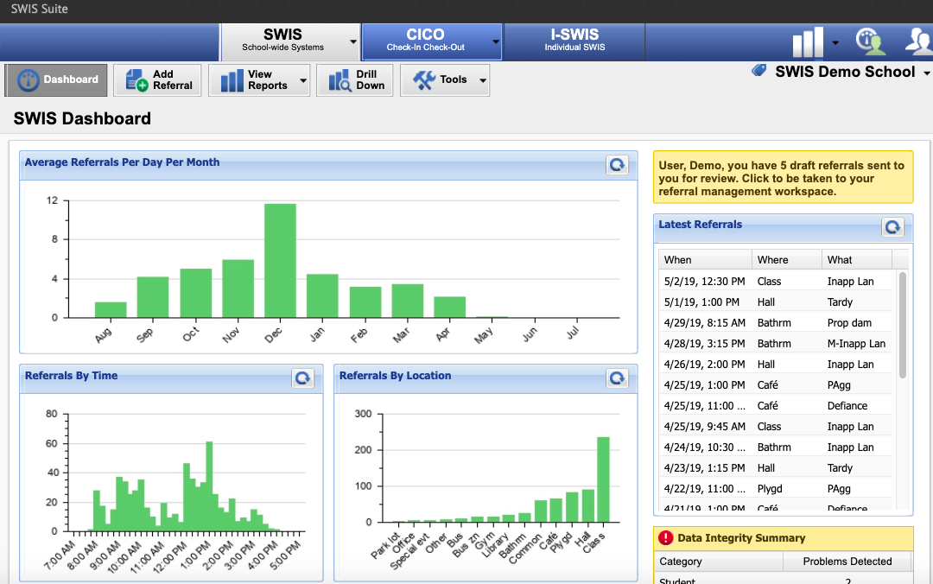
6. SWIS Q&A
Get all of your burning SWIS questions answered!

Slide 55
Networking Guidelines
6 Topics, 6 Tables, 6 Unique Conversations…
Select a topic and find corresponding table
Facilitator guides the conversation
Allow everyone a turn to speak
Reflect on the following:
Operationally define the topic.
Use the conversation starters as guidelines
Record ideas in your own notes
Alignment (SEL, Restorative Practices, etc.)
Analyzing, Utilizing, and Reporting Fidelity + Outcome Data
Family Engagement
Tiers II + III
Utilizing Student Voice
SWIS Q&A
Notes:
Amy

Slide 56
Important VTPBIS Matters
Summer Institute
Next Year’s PD Calendar
VTPBIS Acknowledgements
Celebrations!!!
Notes:
Sherry

Slide 57
VTPBIS Acknowledgements
Merit:
No application - All schools that:
Implement Universal PBIS with fidelity (measured as 70% on the Tiered Fidelity Inventory (TFI) or 80/80 on the School-wide Evaluation Tool (SET))
Use behavior data (Big 7 data) within a problem-solving framework to improve student outcomes
Complete the annual Self-Assessment Survey (SAS) to help plan/revise implementation
Exemplar:
Application will be emailed to all eligible schools
Show evidence of the above plus:
Sustained fidelity of implementation of Universal PBIS as demonstrated by two consecutive years of Tiered Fidelity Inventory (TFI) at 70% or 80% on School-wide Evaluation Tool (SET)
Sustained implementation has had positive effects on academic, behavioral, and social/climate data
Acknowledgements will be presented at the VTPBIS Leadership Forum in October
Notes:
Sherry

Slide 58
Recognizing Shari Carr

Slide 59
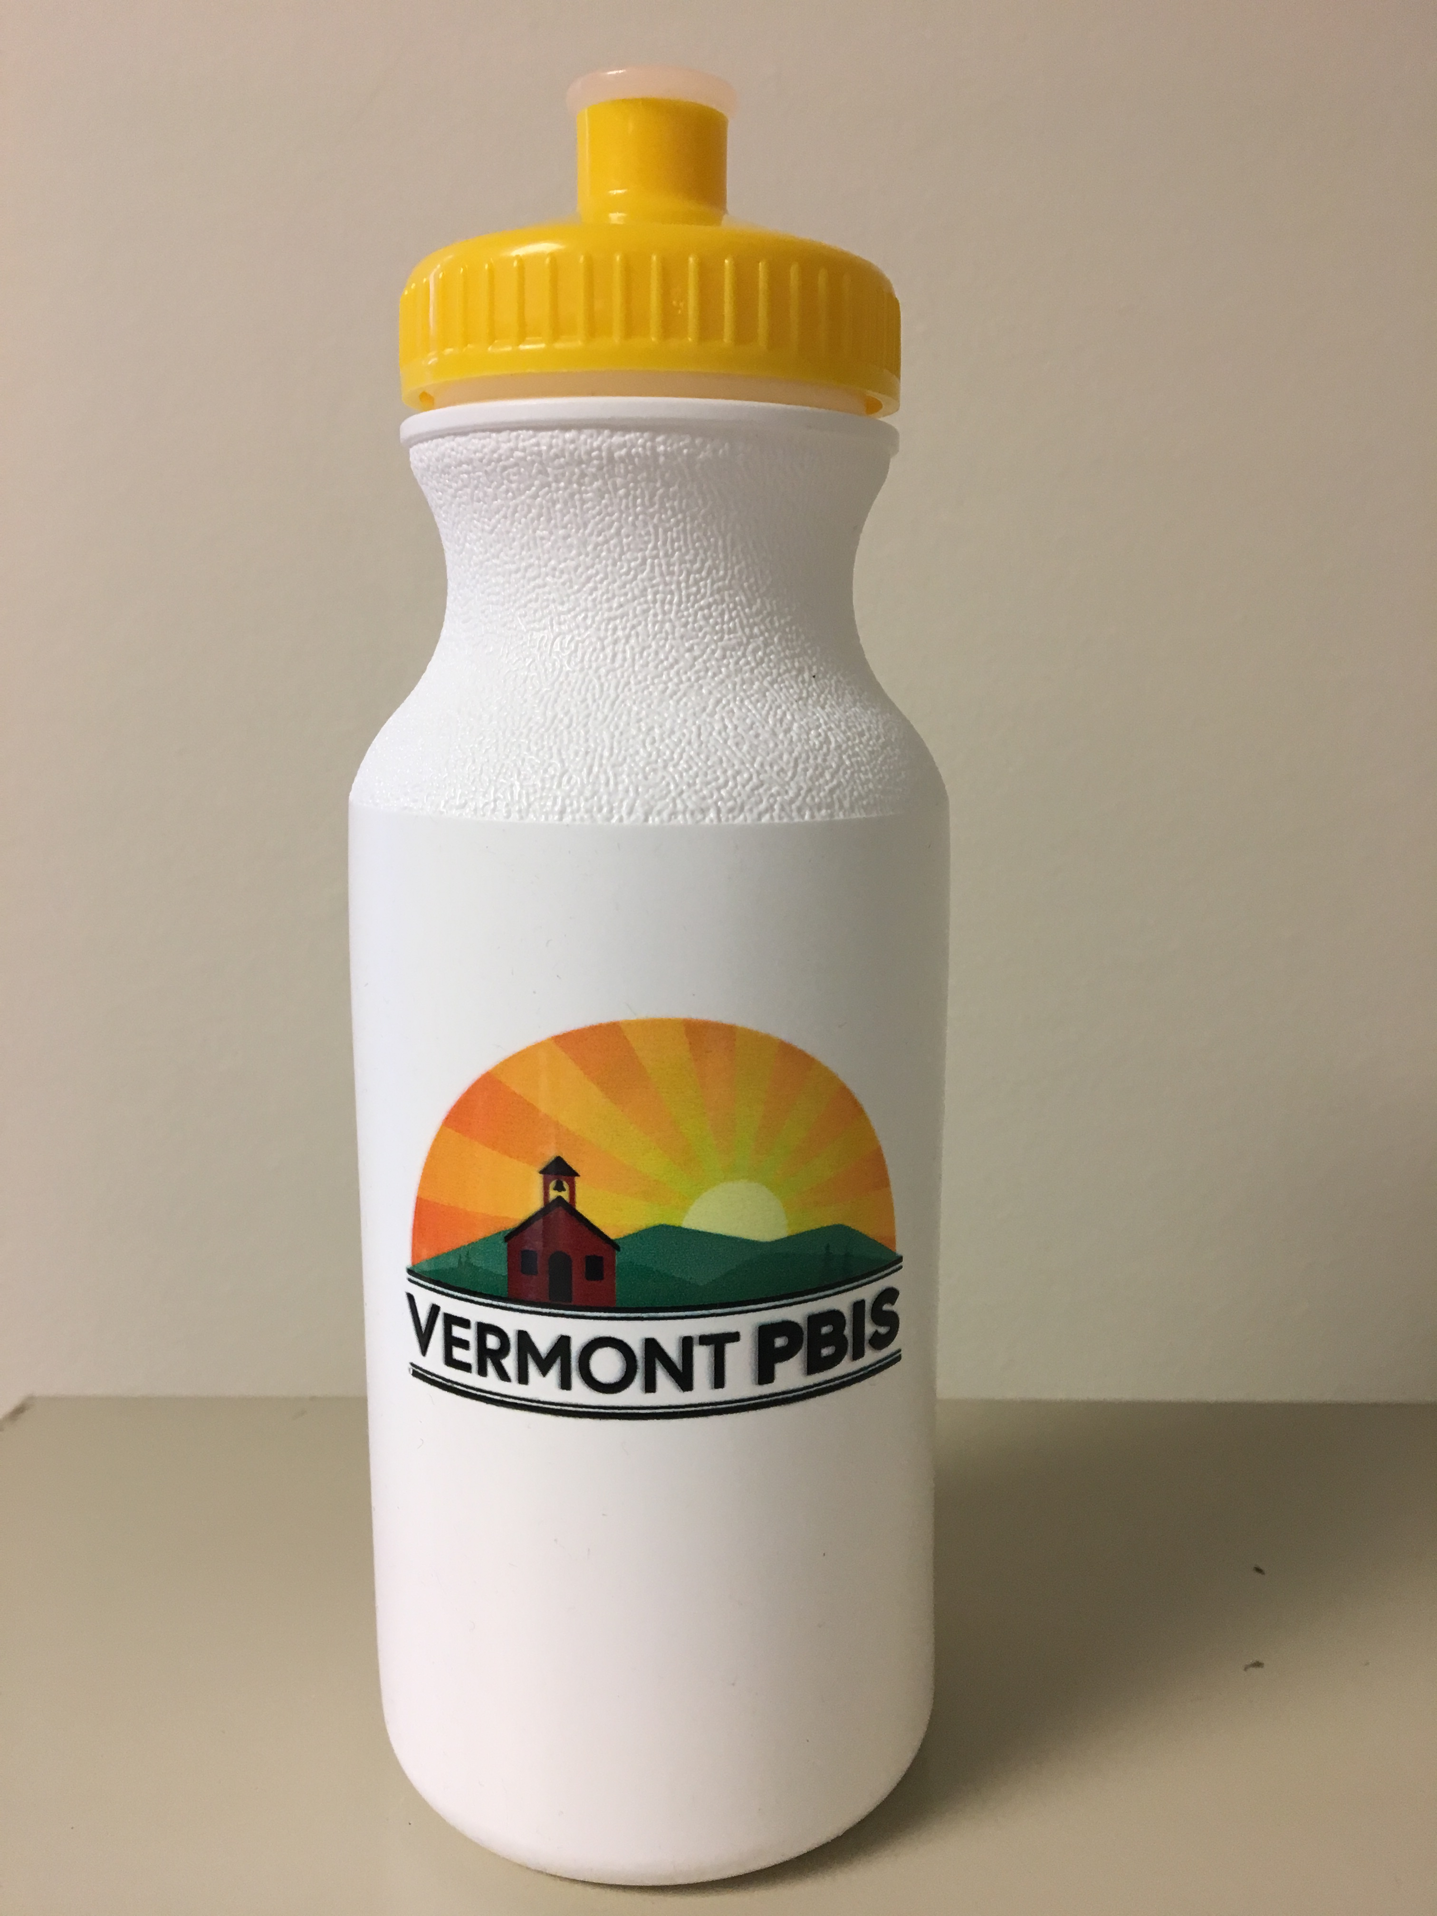
Wherever you may drink your water this summer, think of VTPBIS and our appreciation for you!

Slide 60
Lunch On Your Own (Optional) Additional Networking Session (determine topic) and/or Team Time

