Slide 1
From Chaos to Cosmos: Building an Interconnected Framework that Integrates Mental Health and PBIS
Sherry Schoenberg
Kym Asam, LICSW
Notes:
Talk about grant in intro.
Mention the materials on the website: ISF page of Midwest site; ISF briefs

Slide 2


Acknowledgements

Slide 3
Agenda
Participants will:
Consider the rational for ISF
Understand how ISF enhances MTSS core features
Explore what an Interconnected Systems Framework can look like in a school
Expand concepts of data sources
Explore tools and strategies for building an integrated systems framework in your schools and community

Slide 4
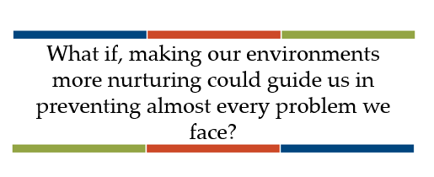
What if…?
Roles and functions clearly defined across the tiers of implementation.
Blended funding to enable providers to serve on teams across tiers.
Professional development, training, and coaching required to ensure staff are skilled to deliver interventions and clinicians can support teachers in their classrooms.
Community providers invited to participate in district trainings and team meetings and learn about how the education system operates.

Slide 5
ISF Benefits
Uncovers students with mental health needs earlier
Links students with needs to evidence-based interventions
Uses a data tracking system to ensure youth receiving interventions are showing improvement
Expands roles for clinicians to support adults as well as students across all tiers of support.
Creates a Healthier school environment
Notes:
the ISF applies the core features of MTSS to deliberately integrate mental health, community, school, and family partners through a single system of support. The MTSS framework guides state, district, and community leaders to blend funding and modify policies and procedures to help systems work more efficiently.

Slide 6

Why Now More Than Ever?
Notes:
In the United States, over 40% of students will have experienced a mental health problem, such as anxiety or depression, by the time they reach seventh grade (SAMHSA, 2016). Suicide is the second leading cause of death among 10-34 year olds (NIMH, 2018) and according to the National Survey of Children’s Health (2016), 46% of children have experienced at least one Adverse Childhood Experience (ACE). The newest statistics on suicide from the Centers for Disease Control (CDC), along with current rates of substance use, opioid abuse, and electronic aggression are alarming. This public health crisis requires a whole population response

Slide 7
Implementation Challenge
Risk Factors
Protective Factors
Antisocial behavior
Substance Use
Disability
Mental illness
Self-management skills
Interpersonal skills
Healthy habits
Academic competence
Notes:
Every day we are working with students, families and colleagues who come into our schools with precipitating factors that we may or may not know about – such as mental illness, substance abuse, or disability. These risk factors can be balanced by such things as being successful at learning, being physically active and having strong social or daily living skills.
Schools that engage students in rigorous and relevant academic opportunities while promoting the development of healthy social, emotional, and behavioral routines and habits can help balance out these risk factors to overcome struggles.

Slide 8
Implementation Challenge
INEFFECTIVE RESPONSE
Reactive management
Exclusion, segregation, isolation
Train & hope
Non-evidence-based practices
Subjective decision making
Low quality implementation of evidence-based practices
Risk Enhancers
Trauma
Negative modelling
Family, school, community disruption
Discrimination
Protective Factors
Academic competence
Healthy habits
Interpersonal skills
Self-management skills
Notes:
However, balancing the boat becomes harder when risk factors are heavier than the protective factors due to trauma, outside influences such as negative peer modeling, family disruption, bullying, and explicit and implicit bias.
Keeping our boat afloat requires a balancing of the effects of life’s challenges with supports
As educators, we need to explicitly focus on both learning about these risk factors and the things that influence them while avoiding some of the responses that WE KNOW DO NOT WORK!

Slide 9
Implementation Challenge
EFFECTIVE RESPONSE
Trauma-informed decision making
Prevention-based behavioral sciences
Tiered support systems
Data-based decision-making teaming
Continuous coached professional development
High fidelity implementation
Proactive, competent, informed leadership
Risk Enhancers
Trauma
Negative modelling
Family, school, community disruption
Discrimination
INEFFECTIVE RESPONSE
Reactive management
Exclusion, segregation, isolation
Train & hope
Non-evidence-based practices
Subjective decision making
Low quality implementation of evidence-based practices
Protective Factors
Academic competence
Healthy habits
Interpersonal skills
Self-management skills
Notes:
We can play a DELIBERATE role in promoting protective factors for so many of our students through carefully selecting effective responses.
This institute provide some of the gems for your treasure chest that can help you even the keel for our learners and our schools;
Offerings have a focus on charting a course of prevention within a system that provides access to learning for students.
Several strands delve into how to use data to make the most effective and efficient decisions to help navigate the waters.
There are many topic-based consultants here that can help you take your team’s learning to a higher level beyond just training with the goal of high fidelity implementation.
It is hero’s work, daunting, exhilarating and rewarding.

Slide 10
The Interconnected
Systems Framework (ISF)
Deliberate application of the multi-tiered PBIS Framework for all social-emotional-behavioral (SEB) interventions & supports (e.g. Mental Health, Social Emotional Instruction,
Trauma-Informed Practices, Bully Prevention, etc.)
Aligning all SEB related initiatives through one system at the state/regional, district and school level
Active participation of Family and Youth is a central feature of the ISF
Notes:
ISF is what prevents chaos from occurring do to all the various elements that need to be coordinated. Framework is ISF.
State level, regional level, district level and school level

Slide 11
ISF Enhances Multi-Tiered Systems of
Support (MTSS) Core Features
  Effective teams that include community mental health providers
  Data-based decision making that include school data beyond ODRs and community data
  Formal processes for the selection & implementation of evidence-based practices (EBP) across tiers with team decision making
  Early access through use of comprehensive screening, which includes internalizing and externalizing needs
  Rigorous progress-monitoring for both fidelity & effectiveness of all interventions regardless of who delivers
  Ongoing coaching at both the systems & practices level for both school and community employed professionals

Slide 12
1.
Single System of Delivery
One Set of Teams
4.
MTSS essential to install SMH
2.
Access is NOT enough
Key Messages
Success defined
by Outcomes
3.
Mental Health is
for ALL
Notes:
One set of teams that is the single system of delivery for services. Working smarter not harder. Differentiate roles and discussions. Don’t need EST, CST, Universal, Targeted, Climate, etc.
Access is not enough – success is defined by outcomes. More than they can access services and show up – how do we know if it is working. Define success by outcomes.
Mental health/wellness access to everyone and is for all. Mental health is everyone’s job. Mental health and wellness for staff and communities as well.
MTSS approach for continuous process of improvement.

Slide 13
Traditional
An Interconnected Systems Framework
MH counselor “sees” student at appointments
MH person on teams at all tiers. Interventions are defined (core features, dosage, frequency, outcomes)
Clinicians only do “mental health”
MH is everyone’s job. Clinicians contribute to integrated plan
Case management notes
Fidelity AND outcome data determined before delivery; data monitored continuously by teams
Notes:
ISF enables teams to move from traditional methods to more effective and efficient methods.
What if we can do less but serve more students?
Break-out groups – consider your current model for delivering mental heatlh services to students. What would you need to do to adopt the ISF model?

Slide 14
The Role of the School-Based Clinician at All Three Tiers
Coaching/Facilitation
Coaching/Coordination
Coaching/Consultation

Slide 15
Staff Utilization Review
Assess current workforce capacity
Identify changes needed for integration and efficiency
Review roles, responsibilities, time allocation of both school and community-employed clinicians working in schools
Consider a time-study
Notes:
The goal is to move from discussion to action planning around systems change to better support the social/emotional/behavioral needs of all youth.
How do students access services?
How do staff refer students for services?
Where is the clinician located?
Demystify mental health from a intensive intervention to a universal intervention

Slide 16
Break-out Groups
Consider your current model of delivering mental health services/supports to students.
What would you need to do to adopt an Interconnected Systems Framework (ISF)?

Slide 17
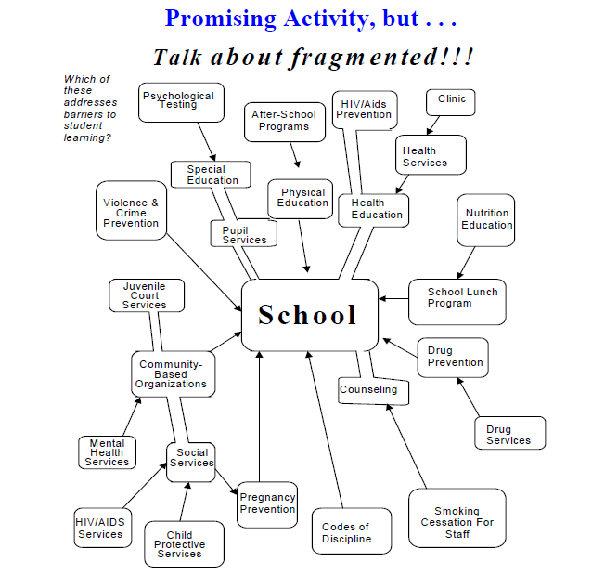
How Do we turn this…

Slide 18
INTO THIS?
Trauma Informed Strategies
Discipline and Safety
School Mental Health
Wraparound
Check & Connect
Function-based Support
Classroom Management
One Social Emotional Academic Framework
Restorative Practices
Wellness & Self-Regulation
Cognitive Behavior Counseling
Check In Check Out
Social Emotional Learning
Dropout Prevention
Bullying Prevention
School Climate
Literacy Instruction
Cultural Responsiveness
Social Skills Programming
Notes:
Safety, emotional safety
Look for opportunities to expand or merge existing teams with similar goals. For example, if there is a school climate and safety team, mental health team, and PBIS team, leadership can combine these efforts into one standing team at Tier 1. The following questions can help the DCLT examine the effectiveness of their current teaming structure
How are we currently supporting our students, staff and families? Is our response adequate? Timely? Effective? Efficient?
• How would our teams work more effectively if we had one set of teams to address social-emotional-behavioral and academic needs of our students?
• What is currently working and what are the barriers to improving an integrated effort?

Slide 19
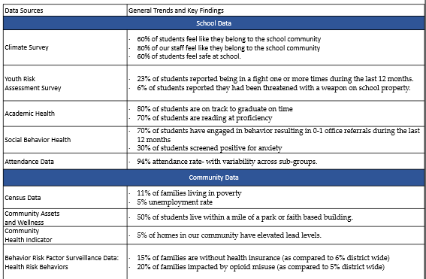
2d. Review Existing School and Community Data
Whole population Needs
  Community Data
  School Data
  Youth/Family Perspective Data
  Local ‘events’ impacting families
  Data related to remote learning
Notes:
See data questions hand out

Slide 20
Structure and process for education and mental health systems to interact in most effective and efficient way.
Guided by key stakeholders
in education and mental health/community systems.
Key stakeholders have the authority to reallocate resources, change role and function of staff, and change policy.
ISF Defined (at full implementation)

Slide 21
District Community Leadership Team
Executive Functions: Provide the stakeholder engagement, funding & alignment, workforce capacity, and policy needed to allow school teams to travel through the full sequence of implementation stages. Adopting an integrated framework is a process that will challenge the assumptions and traditional practices of most school faculty and mental health systems.
Implementation Functions: Provide the training, coaching, and feedback & evaluation systems needed to establish personnel with both the specific technical skills needed to deliver integration and the organizational vision to deliver those skills within a unified framework.
Notes:
Again, reflecting the DCLT graphic, the team has the authority to provide funding (flex funding for MH providers to get paid beyond fee for service model and serve on systems planning teams), promote visibility and political support and understand that this is a process that takes time to install, implement- taking place in stages and changing current structures
The team will also provide ongoing access to training (PD is delivered to school/community teams with admin support, use of data and assigned a coach to support implementation )
An integrated approach starts with a District Community Leadership Team (DCLT) who develops a strategy for training and supporting school level implementers. School-level systems teams are organized around tiers and have time to establish common language, working agreements, shared vision, and common understanding of MTSS. Community partners, including family and student representatives, with clearly defined roles, are active participants and leaders.
The development of an interconnected system of behavioral/mental health in schools should be initiated and led by executive-level leadership from education, mental health, and other partnering agencies. Adopting a truly integrated way of working involves organizational change, requiring active leadership from those with authority to change policy, blend or braid funding streams, and re-position personnel and procedures at the school level.

Slide 22
Stages of Implementation
and Operational Descriptions
During this stage, a team is assessing the needs of the district and community and selecting evidence based practice(s) to meet the identified needs while also assessing the readiness to implement (e.g. financial, political, resources).
The installation stage is about acquiring or repurposing resources to support the implementation of new practice or program. Resources include staffing, training, funding, evaluation systems, and coaching.
This is referred to as the ‘fragile’ or ‘awkward’ stage of implementation when staff are beginning to implement changes. District continues to shift resources to support staff.
When practices become the norm, and are integrated into policy and procedure. Practitioners are implementing with proficiency, leadership is supporting implementation needs, and stakeholders have adapted to innovation.
Installation
Initial Implementation
Full Implementation
Exploration/Adoption
Notes:
Installation is about repurposing resources to be sure you have what you need to do the work.

Slide 23

Examples of ISF tools…

Slide 24
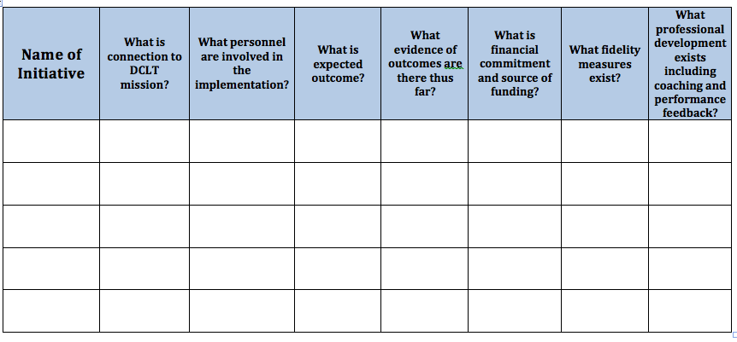
ISF Initiative Inventory
ISF V2 Ch4: State/District Level Installation Guide (in press) - Step 2b: Conduct a Review of Current Initiatives
Purpose of this tool is to (a) provide an overall picture of existing social emotional behavioral related initiatives or programs available to the larger community, (b) determine the effectiveness, relevance, and fidelity for each, (c) determine funding and resource allocation, and (d) determine areas of redundancy. This process is led by the District Community Leadership Team with representation from both education and community stakeholders.
Adapted from NIRN Initiative Inventory
Notes:
Examine what you have, where are the gaps, what is the fidelity measures, how is it funded, etc.

Slide 25
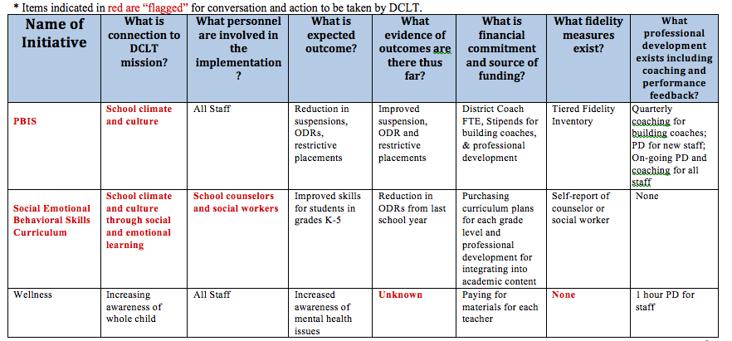
ISF Initiative Inventory
ISF V2 Ch4: State/District Level Installation Guide (in press) - Step 2b: Conduct a Review of Current Initiatives
District Example

Slide 26
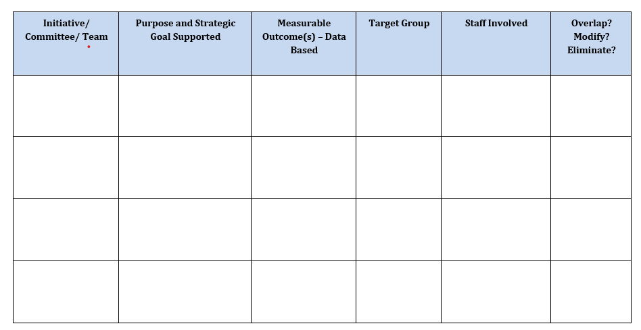
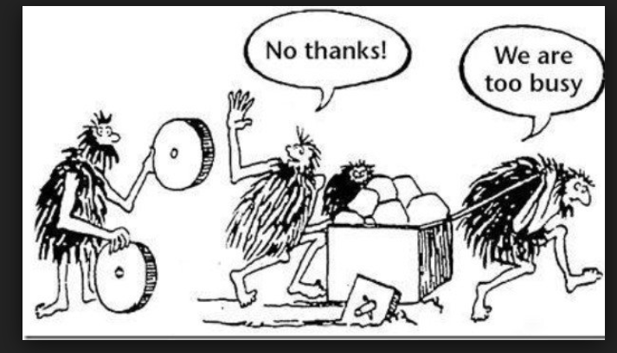
Working Smarter, Not Harder

Slide 27
Discussion:
So, what do you think about ISF?
Where do we go from here?

