Slide 1


VTPBIS Leadership Team Training
Within a Multi-Tiered System of Supports Refresher
Presented by:
Kristin Beswick,
Bonnie Poe, and Jean Haigh
June 2018
If you’re tweeting, use #VTPBIS or @VTPBIS
Materials at: http://www.uvm.edu/~cdci/best/?Page=AllPresentationMaterials2018.html
Wifi: ***
https://www.youtube.com/watch?v=RST-SrohzhU
1

Slide 2
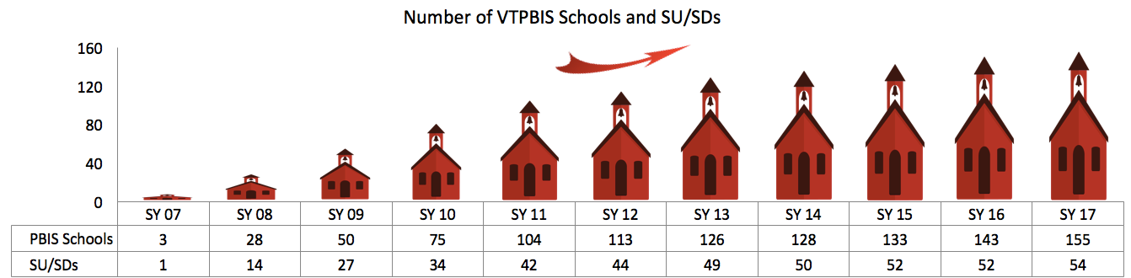
Welcome & Introductions
Notes:
The point to make here is that they are in a large “club” in VT. This is a “family” that continues to grow…

Slide 3


About Us
Kristin Beswick Bonnie Poe
Jean Haigh

Slide 4
All Hands on Deck: Collaborating to Chart a Course for Social and Academic Success
How will revamping PBIS help your crew even the keel for your learners?
Name a port (outcome) that you want to reach.
Notes:
Before we get started let’s find out who we are.
Use the word “OPPORTUNITY” after each set of directions. So, wait until directions are stated, then we will say OPPORTUNITY and you can begin the activity.
Directions: We have administrators, classroom teachers, special educators, para-educators, school counselors….
Find someone with the same role as you.
If you can’t find someone without the same role, raise your hand.

Slide 5
Taking Care of Business
Restrooms
Breaks
Parking lot
Team work
Materials: Markers/craft paper/graphic organizers

Slide 6

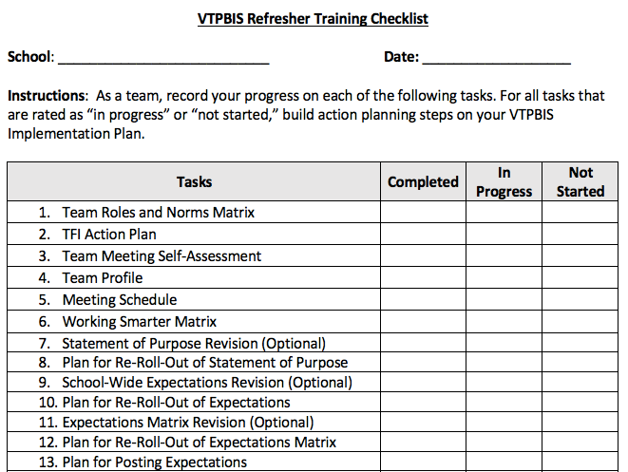
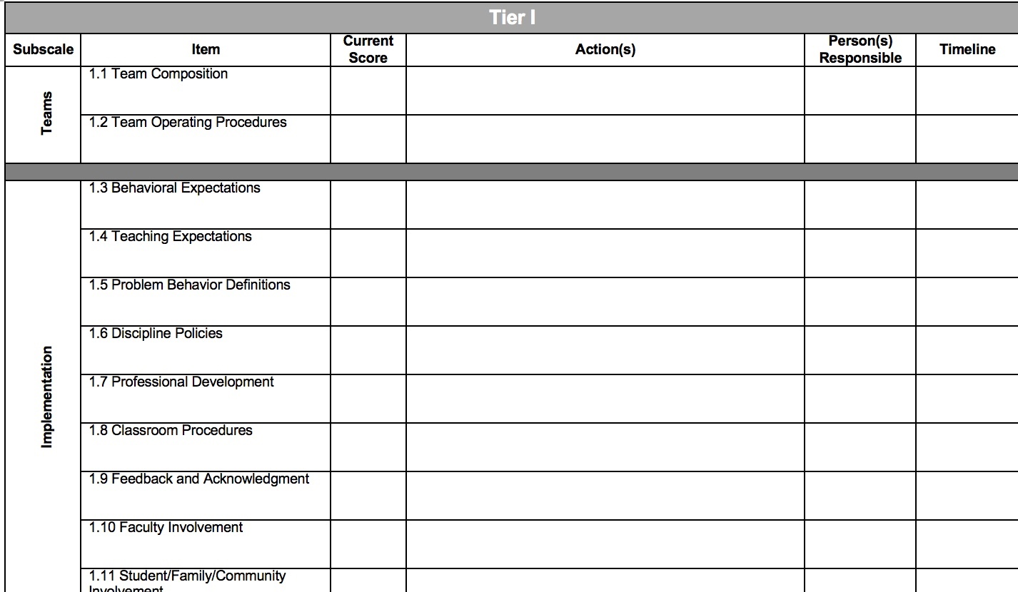
Handbook, TFI Action Plan, and Checklist
https://docs.google.com/document/d/1btzEfFPeCKTCkemNKNm3Xpf6ObAanuAKKon4CgkFumw/edit
Go to “File”, “Make a Copy,” name it, and share it with team
*Use these to organize afternoon team time!
Notes:
Three guiding documents for the work:
Universal Staff Handbook, TFI Action Pan, Checklist

Slide 7
Agenda for the Week*
Welcome and Intros
Setting Up for Success
Sustainability & Implementation Science
Team Structures
Enhance Fluency in PBIS Features
Identify Strategies for Analyzing Data
Family Engagement
Finalize Revitalization Plan and Staff Handbook
Present and Share Ideas!
*This agenda is flexible and may change based on the needs of the group.

Slide 8

How are we going to be together?
What will make this learning environment respectful and safe for all?
Notes:
Note power dynamics

Slide 9

BEST Expectations:
Teaching Matrix
BEST Expectation | All Settings
Be Respectful | Empathic responses to presenters and colleagues Silence cell phones Be present and wait for breaks
Engage | Take a Team role Ask clarifying questions
Strengths-based | Use positive statements and re-statements Remember, four positives to one negative
Team Solutions | Establish and follow team roles and norms Consider all ideas of team members

Slide 10
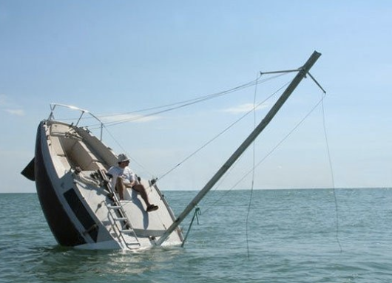
Setting Up For Success

Slide 11
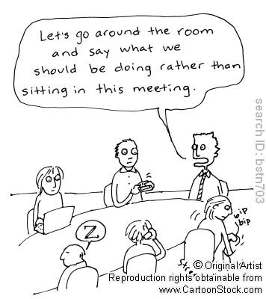
Importance of Roles and Norms
Effective collaboration
Accountability
Efficient and focused meetings
http://www.schoolimprovementcoach.org/manual/7%20Norms%20and%20Roles.pdf
Notes:
As we come together as learners and team members, it’s really important that we use our time during this training wisely so that we are most efficient. Setting up norms and roles during this training is critically important because………..Read SLIDE. In a few…… as leadership teams, you will spend some time creating your meeting norms and roles……that will be used throughout the training…….
Norms help make collaboration more effective by guiding team behavior
Norms enable team members to hold each other accountable
Roles and responsibilities help team build internal capacity for holding effective and focused meetings

Slide 12
Developing Team Roles
Facilitator
Note taker/Recorder
Data Analyst
Timekeeper
Reporter
Process Observer
Encourager
What else?
Notes:
See Team Roles Definitions Handout

Slide 13
Developing Team Norms
Norms:
  Make collaboration more effective by guiding team behavior
  Enable team members to hold each other accountable
  Examples:
    Begin and end the meeting on time
    Follow the agenda
    Have a parking lot
    What else?
Notes:
As we come together as learners and team members, it’s really important that we use our time during this training wisely so that we are most efficient. Setting up norms and roles during this training is critically important because…Read SLIDE. In a few… as leadership teams, you will spend some time creating your meeting norms and roles…that will be used throughout the training…
Roles and responsibilities help team build internal capacity for holding effective and focused meetings
http://www.schoolimprovementcoach.org/manual/7%20Norms%20and%20Roles.pdf

Slide 14
Opening Activity
Think about your current team
Discuss your team’s strengths
As a team, develop your matrix of team roles and norms
Notes:
Have team do norm matrix

Slide 15
Compass Points Activity

Slide 16
Here’s what we know about you…

Slide 17
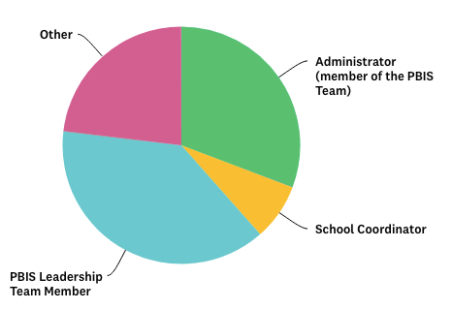
Who’s here?

Slide 18
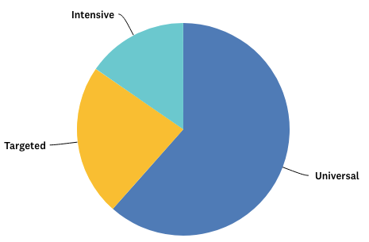
Level of Implementation

Slide 19
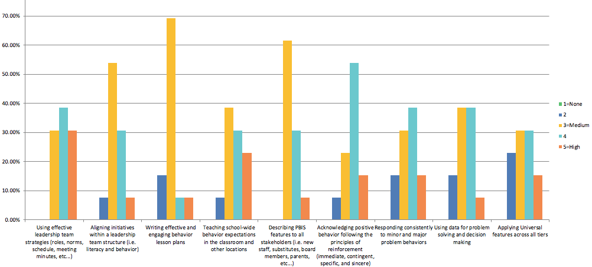
Here’s how you rated your PBIS knowledge:

Slide 20
Here’s what you said works well…
Universal language
Expectations displayed and lessons taught in specific areas
Students and adults know expectations
Positive acknowledgements for all students
Clearly defined classroom vs. office managed behaviors
Team that reviews data meets consistently
Reduced office referrals
Kids exiting intensive plans
PBIS assemblies

Slide 21
Here are the barriers you identified…
Utilizing meeting time and looking at data effectively
Keeping the momentum going
Alignment/integration of initiatives
Adults who don’t buy in
Adults getting burnt out
Differentiating for older grades
Balance between academics and behavior
Consistent responses to problem behaviors
Parent and community involvement

Slide 22
Objectives Based on your Needs
Improve teaming structures
Solidify plans for teaching expectations
Improve acknowledgement system
Improve classroom PBIS
Clarify discipline policies/responses to problem behaviors
Make plans for staff professional development, buy-in/momentum
Improve student/family/community involvement
Improve data-based decision making processes
Create shared vision of PBIS
Notes:
Learning outcomes based on the survey monkey you filled out and TFI

Slide 23
How will we meet those objectives?
Provide support
Help you use your data
Dig deeper into PBIS components
Reinforce the importance of building capacity
Support sustainability by establishing training, coaching, and evaluation systems
Provide examples and opportunities to share
Provide team work time

Slide 24
Activity
As a team, take a moment to reflect on your PBIS journey and identify a couple of strengths and challenges
Using the TFI Action Planning form, develop 3-5 learning targets for your team
We’ll hear a sampling of responses from the group.

Slide 25
Features & Systems & Practices…. OH MY!!!!
Notes:
Time for a Physical Brain Break.
Time to Stand up --- Get some room.

Slide 26
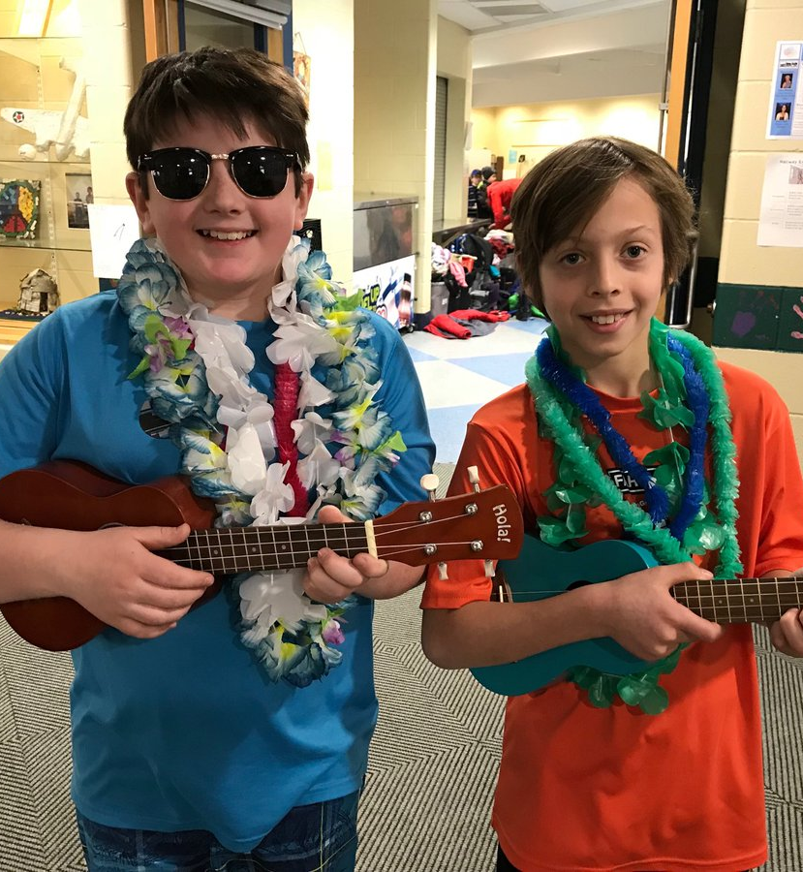
Jack Hartman Brain Break

Slide 27

A Brief Focus on Sustainability
Notes:
Taking this opportunity to share some key pieces of background information.
Frontloading it. “Pre teaching” or Activating some prior knowledge.
We’ll refer to it as needed later

Slide 28
Who Benefits from MTSS? Everyone! (Both Academically & Behaviorally)
1-5% of Students may need Intensive Supports
Few
10-15% of Students may need Targeted Supports
Some
ALL Students!
Universal Practices in place for 100% of students
80% of Students should be successful when accessing Universal Supports
Notes:
Why – consistent response for students and staff
Clearly articulated plan and framework
Review of data to demonstrate success and challenges

Slide 29



Designing School-Wide Systems for Student Success
Academic Systems Behavioral Systems
Intensive, Individual Interventions
•Individual Students
•Assessment-based
•High Intensity
1-5%
Intensive, Individual Interventions
1-5%
•Individual Students
•Assessment-based
•Intense, durable procedures
Targeted Group Interventions
•Some students (at-risk)
•High efficiency
•Rapid response
5-10%
5-10%
Targeted Group Interventions
•Some students (at-risk)
•High efficiency
•Rapid response
Universal Interventions
•All students
•Preventive, proactive
80-90%
80-90%
Universal Interventions
•All settings, all students
•Preventive, proactive
Notes:
Important for academic and behavior - simultaneously
We are focusing on the Universal --- however, remember, when a student needs a Tier 2 intervention --- they continue to receive Universal Interventions!!
EVERYONE benefits from Universal Interventions.

Slide 30
Keeping the Boat Afloat: Sustaining PBIS
Supporting
Staff Behavior
Supporting
Decision
Making
SYSTEMS
DATA
PRACTICES
Smallest effort
Evidence-based
Biggest, durable effect
Supporting
Student Behavior
Notes:
5 Components of MTSS cuts across Data, Systems and Practices
Ask: How many of you are struggling with PBIS Systems? Please raise your hand.
How many of you are struggling with PBIS Practices?
How many of you are struggling with Data?
EX: PRACTICES – want to focus on building relationships with students.
System is put in place – a faculty meeting is devoted to strategies for doing so
Strategies: do a survey to find out about student interests, family
greet at door
smile
demonstrate that you Believe in them
DATA: How will you know that your Practices are working (relationship)
Look at data around Classroom referrals and Classroom behaviors
WHAT is the common thread in this approach? (continuous evaluations)

Slide 31
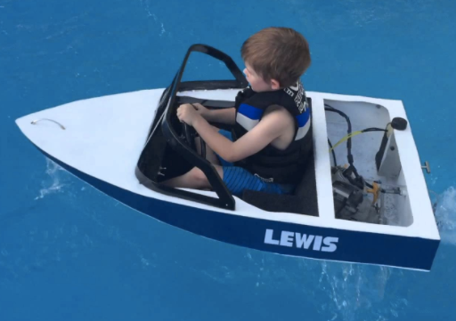

CHANGE ---
Takes time & it is sequential
Exploration
Installation
Initial Implementation
Full Implementation
Innovation
Sustainability
3-5 years (this is normal!)

Slide 32
Birth and Death Cycles of Innovations
(Latham, 1988)
Notes:
This is what we are trying to avoid! So how do we sustain what we’ve started…...next slide.

Slide 33

How do we break through these barriers and implement with fidelity so we can sustain PBIS?
Notes:
As you work toward building Sustainability of what you have in place and put in place, consider these suggestions.
Priority – stick to your list; don’t get side tracked
Monitor – how will you know if the practice is working…how will you evaluate your work (TFI, SAS, SET)
Data - Use it often
Efficiency – can’t do everything at once; remember the Change slide (3-5 years)
Evidence based practices – already tried- start with what has worked elsewhere BUT make sure it fits your needs and your school
CELEBRATE - Successes – your students reached their goal. Improvement - celebrate “we are almost at our goal of fewer playground referrals, let’s celebrate with 5 minutes of extra recess!”

Slide 34
What is Sustainability?
Definition:
  Durable implementation of a practice at a level of fidelity that continues to produce valued outcomes (McIntosh et al., 2009)
Notes:
Named one of the top ten jargoniest words by advertising age magazine

Slide 35
What is more important to sustainability?
Kent McIntosh, University of Oregon - 2014 OSEP PD Conference
Having a supportive administrator?
Having a strong PBIS team?
Notes:
Ask the group…..

Slide 36
Both!
PBIS is most sustainable with a supportive administrator and a strong team
If administrators take too much of a lead, sustainability can suffer
School teams can benefit from training in running meetings and using data
District systems (coaching, training) enable both admins and teams implement and sustain

Slide 37

Key to Sustaining PBIS: Understanding Implementation Science
Implementation Research:
A Synthesis of the Literature
Fixsen, D. L., Naoom, S. F., Blase, K. A., Friedman, R. M. & Wallace, F. (2005). Implementation Research: A Synthesis of the Literature. Tampa, FL: University of South Florida, Louis de la Parte Florida Mental Health Institute, The National Implementation Research Network (FMHI Publication #231).
Download all or part of the monograph at:
http://ctndisseminationlibrary.org/PDF/nirnmonograph.pdf
Notes:
37
National Implementation Research Network (NIRN)

Slide 38
Implementation Drivers
Staff competency development with PBIS practices
Organizational capacity to support staff in implementing PBIS with fidelity
Competency
Capacity
Leadership
Ability to provide direction/vision for PBIS implementation
Adapted from Fixsen & Blase, 2008
Notes:
Three categories of Implementation Drivers: Competency, Organization and Leadership.
Competency Drivers are mechanisms that help to develop, improve, and sustain educators’ competence and confidence to implement effective educational practices and supports.
Organization Drivers are mechanisms to ensure sustainability and improvement at the organization and systems level.
Leadership Drivers are mechanisms to help guide leaders to use the right leadership strategies for the situation.
Competency
Staff selection
Training
Coaching
Performance assessments
Organization
Decision support data system
Facilitative administration
Systems interventions
Leadership
Adaptive leadership
Technical leadership
Building Capacity of PBIS (or other initiatives) is one of the legs of achieving sustainability.
More than 1 person needs to have the knowledge and background on a part of PBIS.
Ex: one person is an expert in analyzing the SWIS data and then she moves…what plans can you have in place BEFORE this happens?
George Sugai, PBIS guru, has said if you are going to implement something new --- don’t bother unless you have a TEN year plan for doing so!
How many schools have a 10 year plan for anything they are doing? 5 year? 2 year?

Slide 39
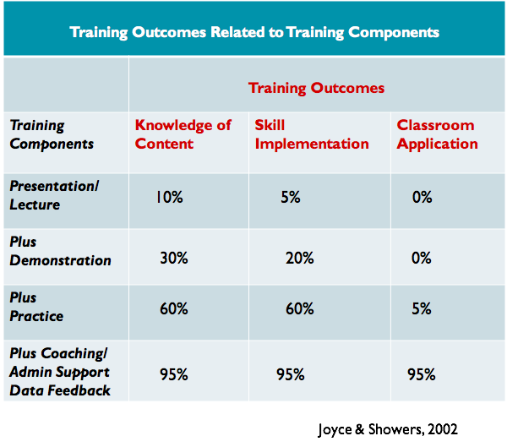
Notes:
IF your plans for building CAPACITY involve training in a particular area, keep this research in
this is what the research says works about training applications ---
What do you need to have successful implementation of new information/practices?
K: Will address how many of you have coaching in your schools...

Slide 40
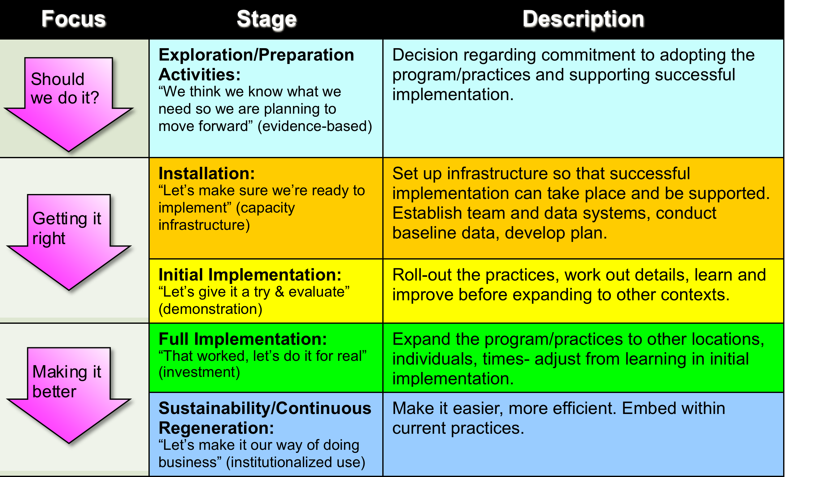
Stages of Implementation
3-5 Years
Notes:
Highlight the fact that each component within the stage must be completed before moving to the next stage. This will create a solid foundation.

Slide 41
Activity!
In your teams, discuss what stage of implementation you’re currently at. What evidence do you have that you are there?
Given the number of years implementing, does this correspond with the stage you’re in?
Why is this important?
We’ll hear a sampling of responses
from the group
Notes:
Approximately 5 minutes
Show next slide

Slide 42
Stages of Implementation
Notes:
Do you have systems in place that address changes that will impact PBIS implementation? If not, put it on your to-do list.

Slide 43
New principal?
New teachers?
New staff?
New team members?

Slide 44
Guiding Principles for Sustainability:
Never stop doing what is already working
Always look for the smallest change that will produce the largest effect
Do not add something new without also defining what you will stop doing
Collect and use data for decision-making

Slide 45
The Million Dollar Question:
How Can You Improve
Staff Buy-In?

Slide 46

Movement Break - 15 minutes
Notes:
Take a BREAK

Slide 47
Teaming Structures and Routines
Supporting
Staff Behavior
Supporting
Decision Making
OUTCOMES
Systems
Data
Practices
Supporting Student Behavior
Notes:
3
SYSTEMS

Slide 48
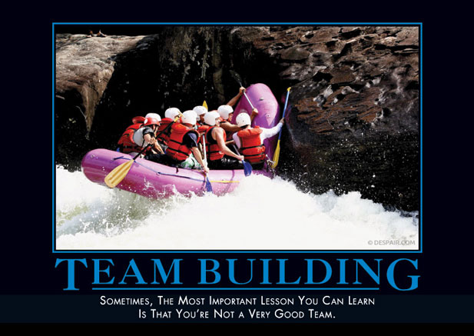
Notes:
Think of a successful team (committee) experience. What were some of the characteristics that made it successful?

Slide 49
Team Meeting
What do you notice about this
non-example?

Slide 50
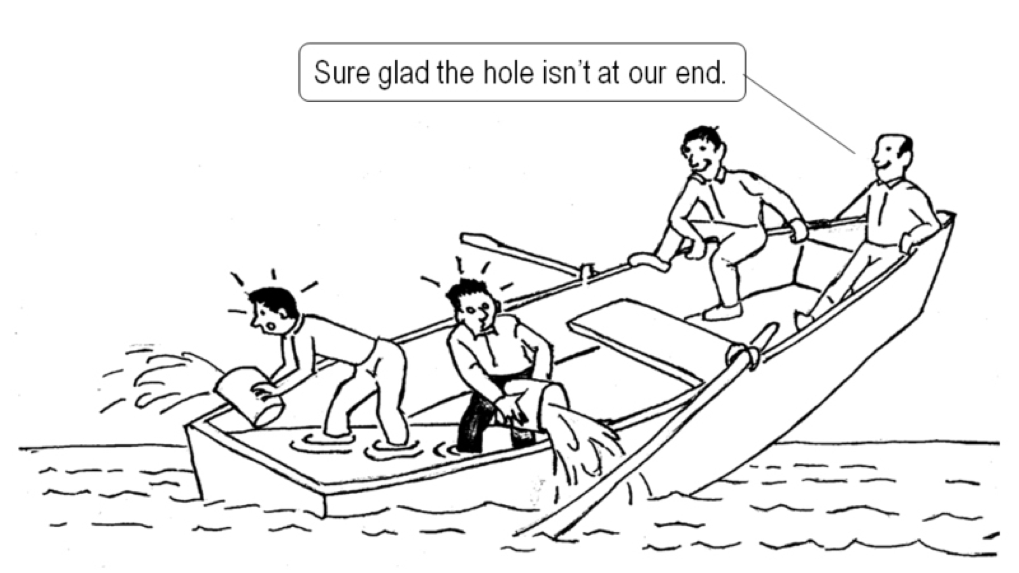
Buy-in and Team Building
Notes:
ONe thing that we hear consistently across schools is the issue of staff buy-in. One way to increase and sustain buy-in is to structure your team and your meetings so everyone feels like it is a good use of time.

Slide 51
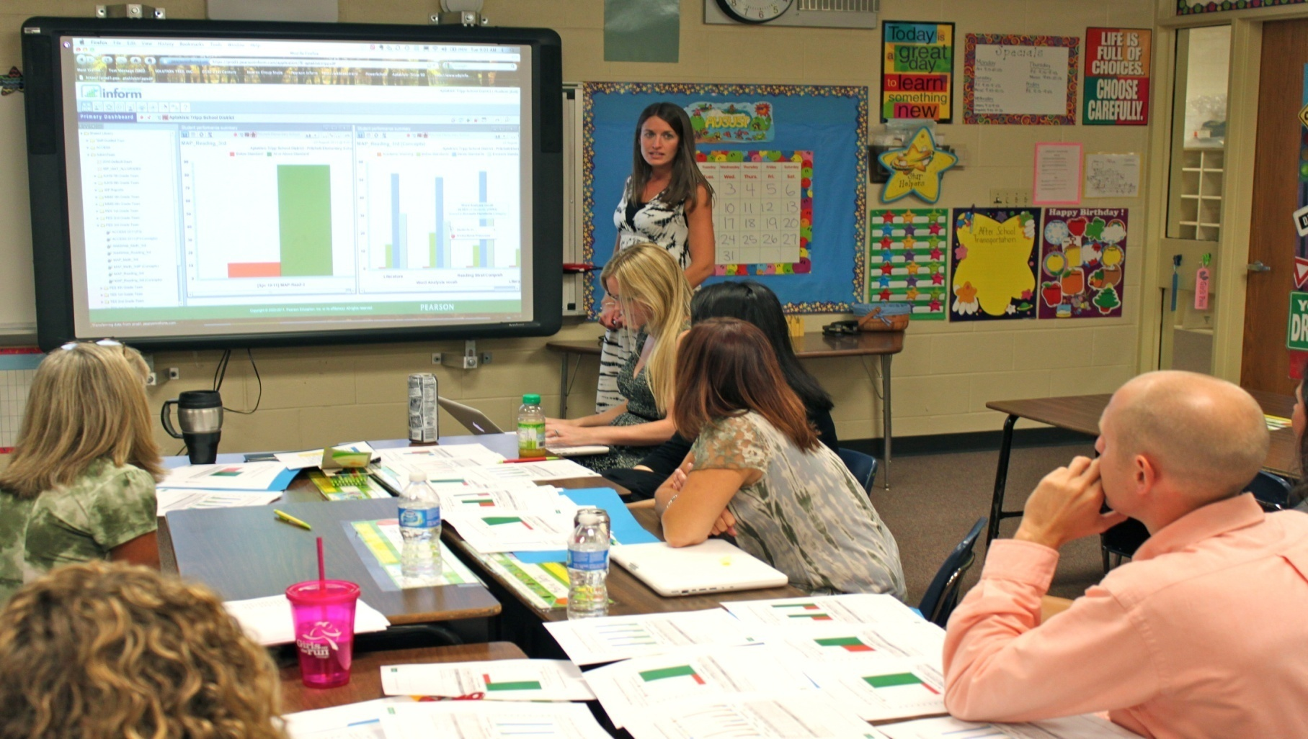
What do you see this
PBIS Leadership Team doing?
Notes:
Teams meeting regularly to:
Review their data
Determine if PBIS practices are being used
Determine if PBS practices are being effective
Identify the smallest changes that are likely to produce the largest effects
But focusing on the use of evidence-based practices

Slide 52

Meeting Organization
Meeting Components Meeting Process
Expectations Posted
Preparing
Beginning
Conducting
Concluding
Follow-up
What is expected?
How are decisions made?
How are conflicts resolved?
How are roles and responsibilities assigned?
How do we reinforce participation?
Notes:
Think about the Process behind this;
Link to sustainability

Slide 53

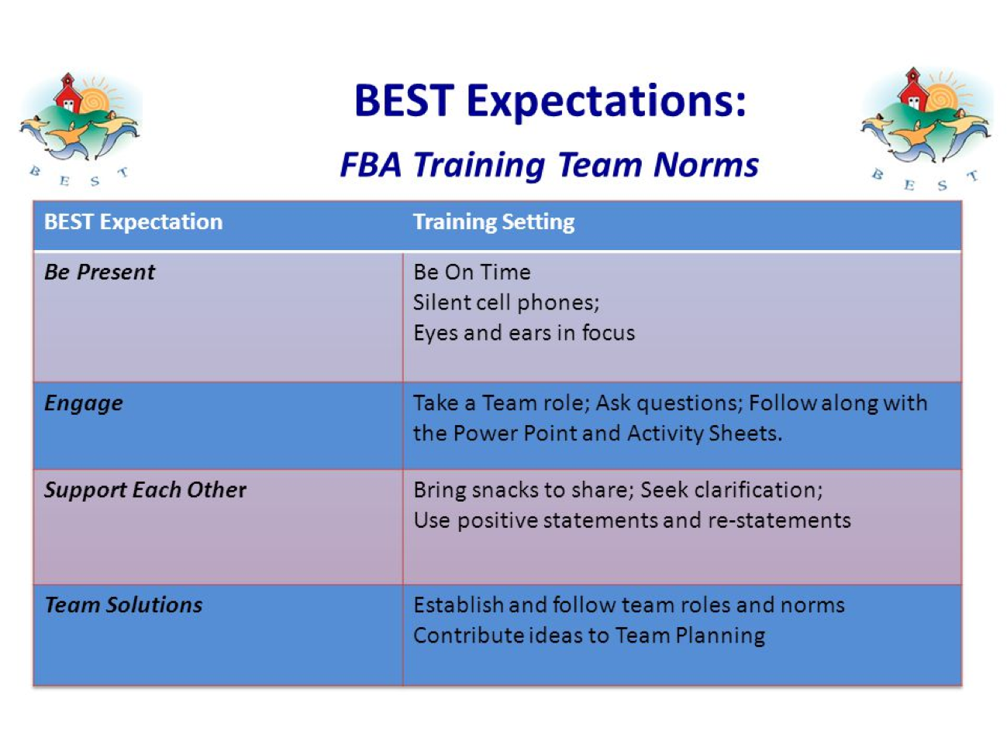


http://www.uvm.edu/cdci/best/pbswebsite/UniversalStaffHandbook2016.docx
Insert meeting roles chart here.
Notes:
Suggestions:
Post your expectations, assign someone to be the Norm Keeper
Abide by your time line - if your meeting is 45 minutes do not over-schedule items, prioritize, assign more time in the beginning if needed
Rotate meeting roles, rotate snack bringer
Identify and use a system for resolving conflicts - fist to 5

Slide 54
Example: Team Meeting Structure
Start with positives!
Review all relevant data
Brainstorm ideas based on data
Discuss, prioritize, make data-based decisions
Gain consensus and implement agreed upon steps
STICK WITH YOUR AGENDA
Notes:
Does this look like your current meeting structure?

Slide 55
Meeting Self-Assessment
Team Self-Assessment
When could you use this? How could you use the results? How often and by whom?
Do we have adequate representation?
Notes:
Once you have a process for running your meetings in place, teams can use this self-assessment to ensure ...

Slide 56

Team Meeting
What improvements do you note?
Team Meeting
Notes:
This is the follow up meeting to the 1st video.
Who is the person that is responsible for getting in put from all members.

Slide 57
Activity: TIPS
Review TIPS process checklist.
Review TIPS Meeting Minute Form.
Document any follow-up items on your TFI Action Plan
Notes:
B has noticed that schools that experience implementation dips have team structures/roles/norms/meeting agendas no longer in place.

Slide 58
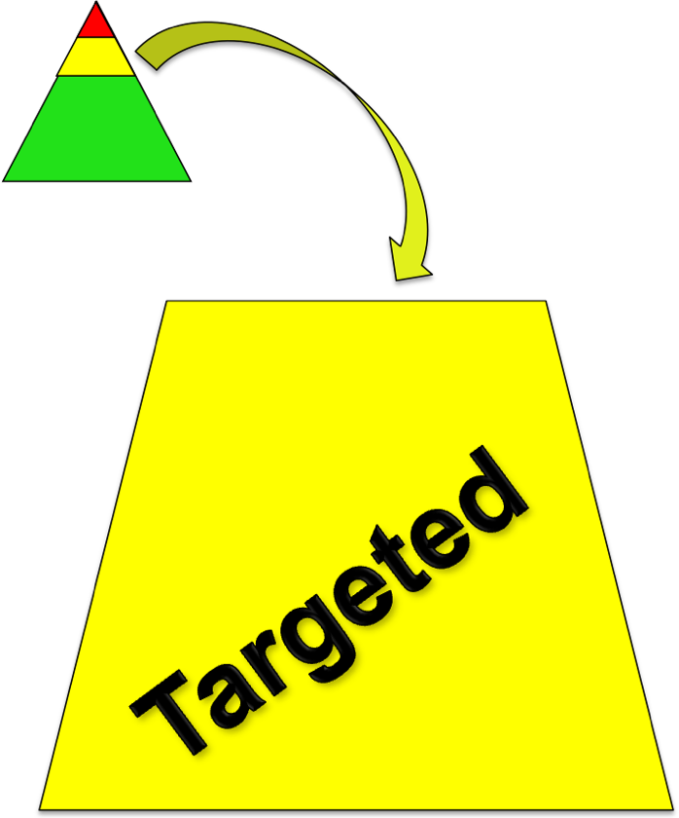
Teaming at the Targeted Level
Two Purposes of Targeted Planning:
Systems-level design and accountability
Individual student intervention planning and monitoring
Notes:
Many schools have PBIS teams that focus on the systems needed to be successful that consist of one group of people discussing both targeted and universal systems level issues such as - ODR forms, process for referral, lesson plan development, planning for faculty meetings. Also, this team should look at overall school-wide data to determine the impact of PBIS on behavior, fidelity of implementation. For targeted, review of overall targeted intervention success is a good use of the system’s level team.
This team does not discuss individual students. There is a separate team or conversation about individual students, matching them to interventions, looking at how they are doing, etc.
Either or both of these groups may also be the EST depending on how your EST functions.

Slide 59
Targeted Team and EST Considerations
EST and PBIS Targeted student planning team may be a separate or combined team but should not be duplicative.
Develop your PBIS targeted system to fit within your school’s context.
Goal: “Work smarter, not harder!”
Notes:
Many schools have PBIS teams that focus on the systems needed to be successful that consist of one group of people discussing both targeted and universal systems level issues such as - ODR forms, process for referral, lesson plan development, planning for faculty meetings. Also, this team should look at overall school-wide data to determine the impact of PBIS on behavior, fidelity of implementation. For targeted, review of overall targeted intervention success is a good use of the system’s level team.
This team does not discuss individual students. There is a separate team or conversation about individual students, matching them to interventions, looking at how they are doing, etc.
Either or both of these groups may also be the EST depending on how your EST functions.

Slide 60
Roles and Responsibilities of Key Members at All Levels
Administrator
Know what the practices look like when implemented with fidelity
Be aware of data using tracking tools; help decide what needs to change
Be active/visible on teams
Troubleshoot systems-level issues
Facilitates weekly/monthly meetings
School-Based Coordinator
Active member of implementation team and student planning team
Attend regional coordinator meetings and trainings
Prioritizes students for team meeting
Prioritizes requests for service
Creates graphs for meetings
Facilitates meetings
Maintains records
Supervisory Union/District Coordinator
Builds capacity to implement effective practices
Focus on student outcomes
Focus on fidelity of implementation of effective practices across District/Supervisory Union
Align SU/district systems, data, and practices

Slide 61

“Critical to success is the administrator’s active role in supporting the school-based team process.” – Tim Lewis
THANK YOU
Administrators!
Complete Administrator Self-Assessment for continuous improvement!
Notes:
Hand out self-assessment (optional for Admins to complete)

Slide 62
Having an effective team will help with:
Getting Everyone on Board
Notes:
Herding Cats video – 1 minute: Sometimes getting everyone board OR BACK on board is like “herding cats.”

Slide 63
Helpful Tool:
“Working Smarter” Team Matrix
Team, Committee or Initiative Related to School Climate & Student Behavior | Purpose ~ Intended Outcomes | Target Group | Staff Involved | What Action Plan goal does this address?
Eliminate all initiatives that do NOT have a defined purpose and outcome measure.
2. Combine initiatives that have the same outcome measure and same target group
3. Combine initiatives that have 75% of the same staff
4. Eliminate initiatives that are not tied to School Improvement Goals.
Consider how you can align/integrate initiatives
*Remember, PBIS is framework that EBPs can fit into*
Notes:
It’s important to keep revisiting so you are making sure that you are using the least effort to make the biggest change.
The goal is to make sure you work smarter, not harder by eliminating duplicative efforts

Slide 64
Team Activity
  As a leadership team:
    Complete the Leadership Team Meeting Self-Assessment tool (handout).
    Using the Staff Handbook, review and update the “Team Profile and Meeting Schedule,” if needed (at each level of implementation)
    Using the Staff Handbook, complete/revisit the “Working Smarter, Not Harder Matrix,” if needed.
    Identify and celebrate 2-3 team strengths and 2-3 action steps your team will take and note on TFI Action Plan.
Notes:
Approximately 15-20 minutes
Finish during team time….

Slide 65
Parking Lot
Take 3 minutes to post:
Questions
Additional Resources Desired

Slide 66
Refresher in PBIS Critical Features
Supporting
Staff Behavior
Supporting
Decision Making
OUTCOMES
Systems
Data
Practices
Supporting Student Behavior
Notes:
3
PRACTICES

Slide 67
What is School-wide PBIS?
Framework for enhancing adoption & implementation of
Continuum of evidence-based interventions to achieve
Academically & behaviorally important outcomes for
All students
Notes:
Don’t lose sight of what PBIS is.

Slide 68
Traditional Approaches Ineffective
School wide Discipline Problems
Reactive
Non-constructive
Poor implementation fidelity
Emphasis on punishment
Limited effects
Notes:
“Drowning Frogs”
“Green to Yellow to Red” Cards
“Full to partial to limited” privileges

Slide 69
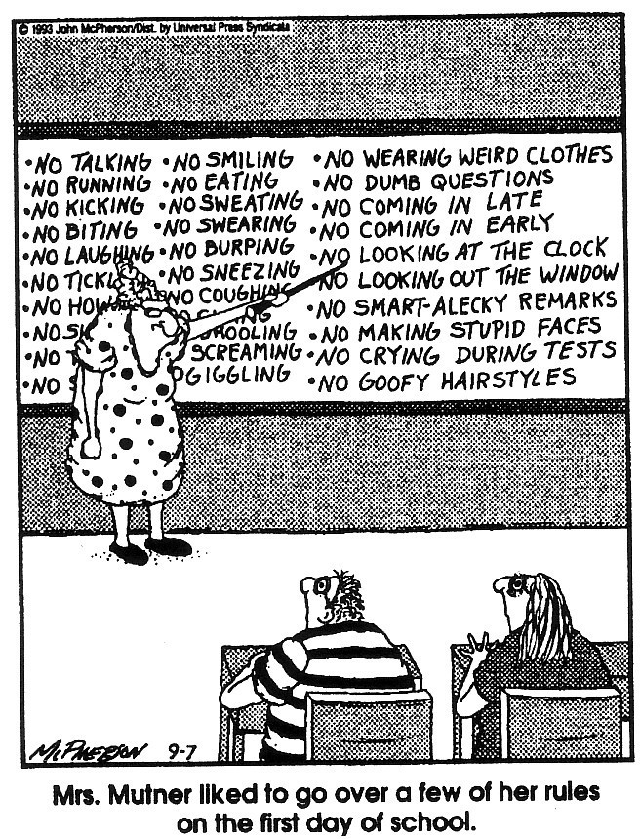
Notes:
(Close to Home c Reprinted with permission of Universal Press Syndicate. All rights reserved.)

Slide 70
Embracing Person-First Language
Do say…
“students receiving intensive supports”
“students needing targeted interventions”
“student with autism”
“student receiving specialize instruction”
“children with disabilities”
Don’t say…
“red zone kids”
“targeted kids”
“the autistics”
“sped students”
“disabled kids or handicapped kids”
Notes:
Implementing PBIS is a systemic change that starts with climate
HOW we refer to students can have a positive or negative impact on students.

Slide 71
Continuum of Support for “Dylan” within MTSS-B/PBIS & MTSS-A
Universal
Targeted
Intensive
Anger Mgt.
Math
Label Behavior, Not Students!
Science
Adult relationships
Attendance
Reading
Peer Interaction
Notes:
Every student has competencies. Label behavior not STUDENTS. Everyone at one point or another needs targeted or intensive supports. Dylan is doing great in reading but may need more support in Math and with anger management.

Slide 72
Questions to Consider When Refreshing PBIS…
Why is it important?
What does is look like?
How do we differentiate?
Notes:
Explaining why it’s important and how it relates to their concerns can

Slide 73
Example School Refresher Presentation: Charlotte
(can be found in Materials)

Slide 74
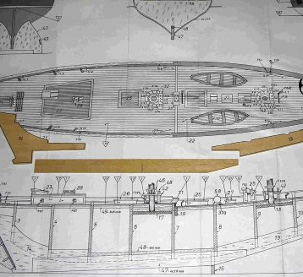
PBIS Critical Features
Purpose Statement
Defining behavior expectations
Teaching expected behavior
Acknowledging expected behavior
Discouraging problem behaviors
Creating procedures for record-keeping and decision making
Notes:
Purpose Statement

Slide 75
1. Purpose Statement Examples
DES: Our mission is to provide a quality education through shared responsibility in a safe supportive environment for all students to meet the challenges of a global society.
BES: We believe our mission at Brighton Elementary School is to engage
students in acquiring skills that promote lifelong learning, engaged and responsible citizenship, critical thinking, communication, and appreciation for diversity. We commit ourselves to the collective responsibility of upholding high, attainable, and consistent expectations in a learning environment that supports the academic and social-emotional development of all students.
ABS: The purpose of our PBIS team is to teach and promote positive behaviors through consistent responses, common language, and data driven decisions.

Slide 76


1. Purpose Statement Status
Our purpose statement is completed.
It has been/will be shared with staff, students and families (roll-out, website, pamphlet, etc.)
Notes:
Why is this important?

Slide 77
A Restorative Practice Approach to PBIS Expectations
The Restorative Approach is about:
    Voluntary Participation
    Exploring Relationships
    Meaningful Engagement
    Participatory Decision-Making
As we review the next 2 components, think about how you can shift from setting the expectations and teaching the expectations to building agreements together and engaging students in what these agreements mean in action.
*Consider assigning a Restorative Approaches Monitor role*
Notes:
The way the PD is currently structured, does not easily allow for building community/consensus around the expectations and what they look like; how can you work around this?
Restorative Monitor role – someone whose job it is to keep these restorative approaches in mind and make sure they are beginning considered throughout this PBIS journey

Slide 78
2. Defining Behavior Expectations
Why is it important?
Research indicates that schools should utilize 3-5 behavioral expectations that are positively stated and posted throughout the school
These expectations should be clear and general enough to apply to all school settings (e.g. classroom, hallways, playgrounds)

Slide 79
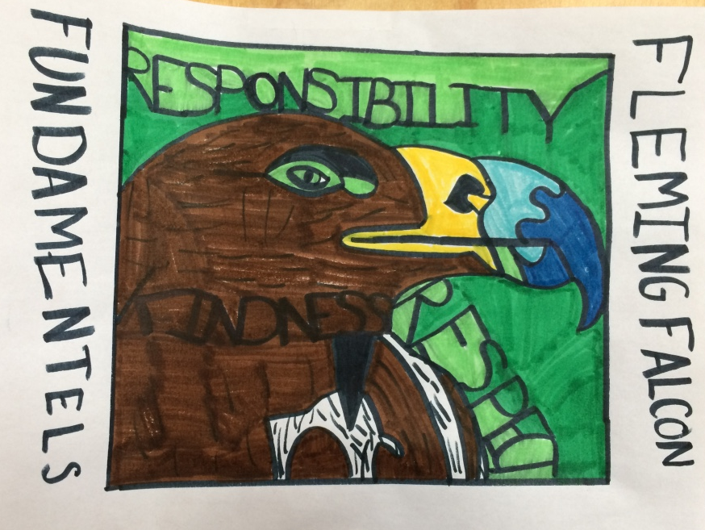

2. Expectations Examples
Be Responsible
Be Respectful
Be Safe
Be Kind
PRIDE: Positive Attitude, Respect, Integrity, Determination, Empathy
3-5 behavioral expectations that are positively stated
Our expectations are on our website; students, staff & families know them

Slide 80
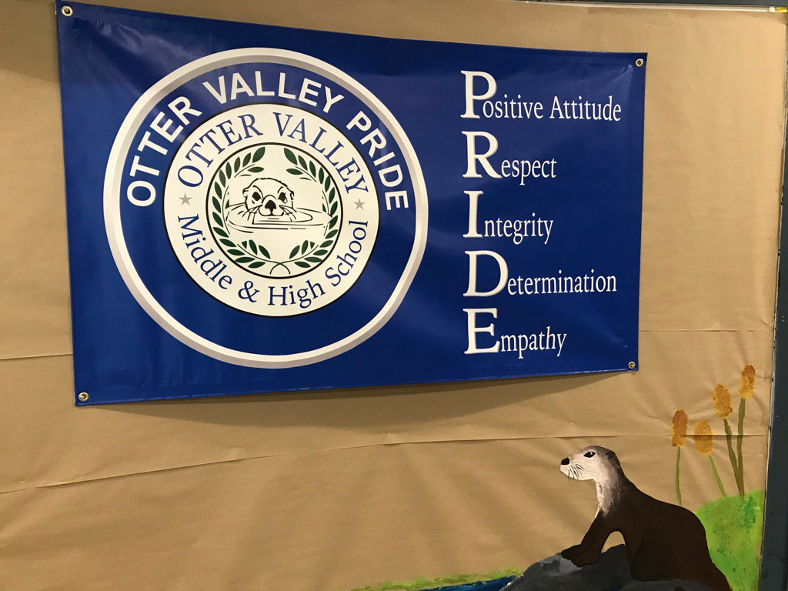
2. Example: Otter Valley PRIDE

Slide 81
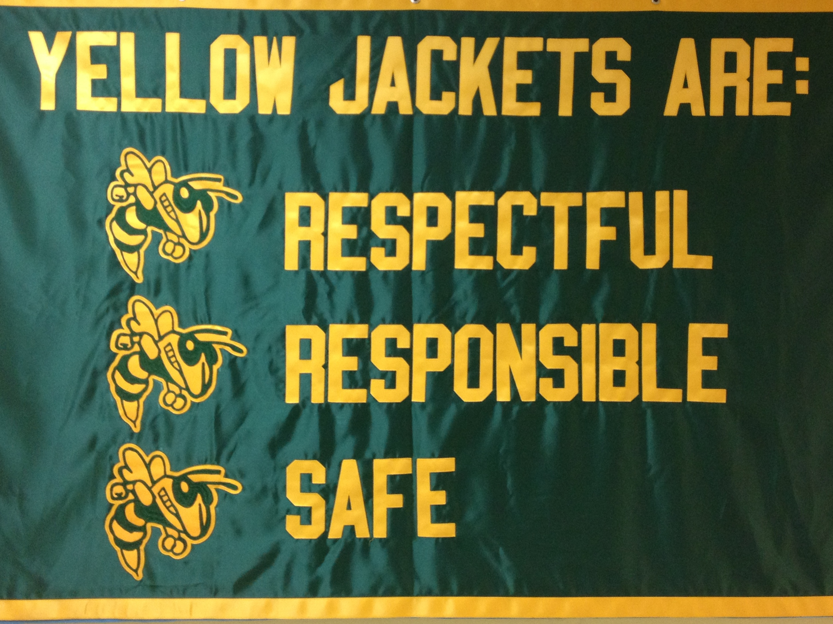
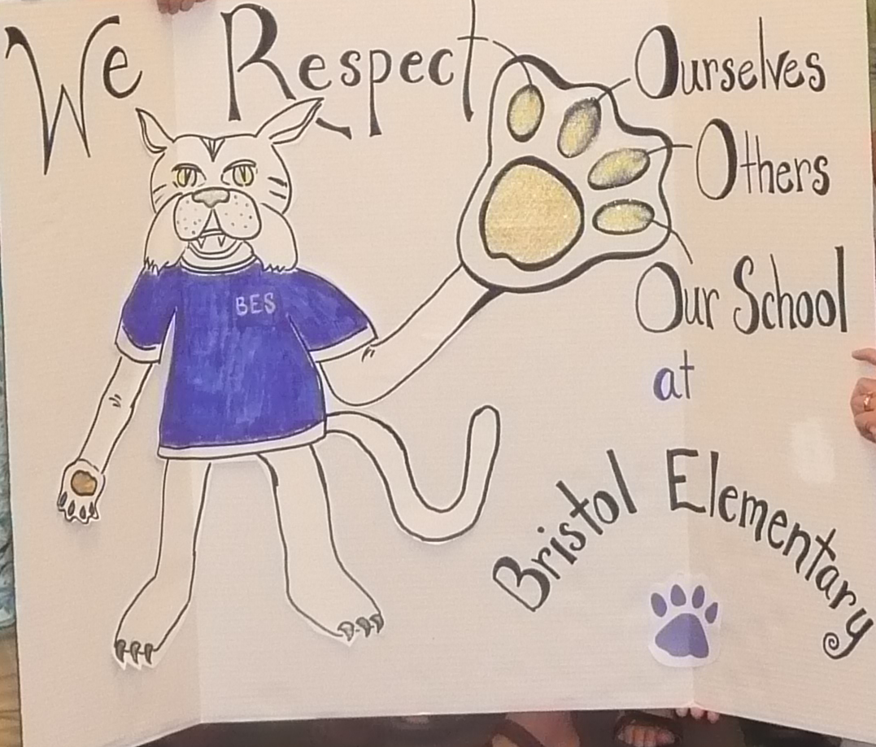
2. Examples
Windsor State Street (pre-k – 12)
Bristol Elementary

Slide 82
2. Defining Behavioral Expectations
Ideas for keeping expectations visible:
  Post in classrooms, hallways, computer wallpaper, and/or screen saver
  Print in the school handbook
  Videos
  Flags hanging in the hallway outside of classrooms
  Staff and/or student lanyards
  Hats, t-shirts, bracelets, bumper stickers
  What else?
What do you do to keep expectations visible?
Do you need to make any adjustments to them?

Slide 83
3. Teaching Behavioral Expectations
Teaching Matrix |  | SETTING
 |  | All Settings | Hallways | Playgrounds | Cafeteria | Library/ Computer Lab | Assembly | Bus
 | Respect Ourselves | Be on task. Give your best effort. Be prepared. | Walk. | Have a plan. | Eat all your food. Select healthy foods. | Study, read, compute. | Sit in one spot. | Watch for your stop.
 | Respect Others | Be kind. Hands/feet to self. Help/share with others. | Use normal voice volume. Walk to right. | Play safe. Include others. Share equipment. | Practice good table manners | Whisper. Return books. | Listen/watch. Use appropriate applause. | Use a quiet voice. Stay in your seat.
 | Respect Property | Recycle. Clean up after self. | Pick up litter. Maintain physical space. | Use equipment properly. Put litter in garbage can. | Replace trays & utensils. Clean up eating area. | Push in chairs. Treat books carefully. | Pick up. Treat chairs appropriately. | Wipe your feet. Sit appropriately.
2. NATURAL CONTEXT
1. SOCIAL SKILL
Expectations
3. BEHAVIOR EXAMPLES
Teaching & Lesson Plans

Slide 84

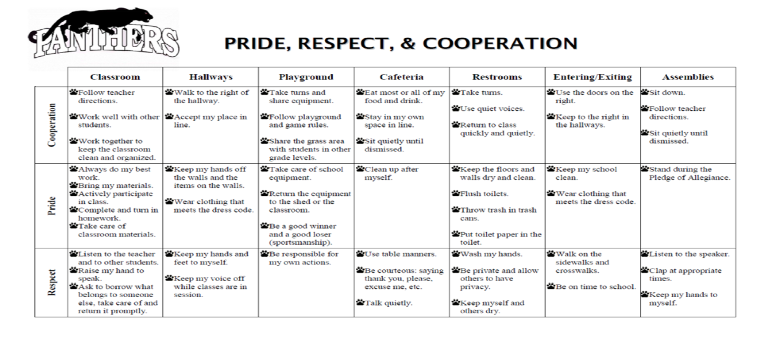
3. Teaching Behavioral Expectations
School Wide Matrix by location
School Sample
Derby Sample

Slide 85
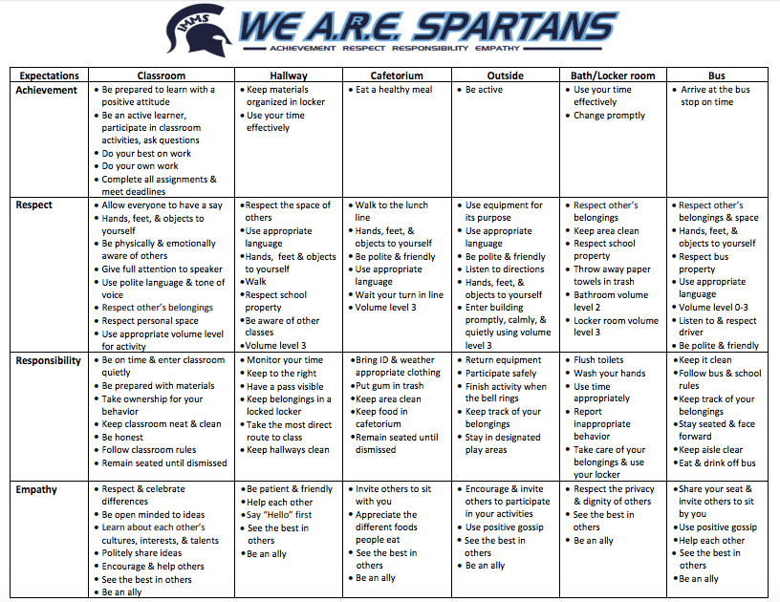
3. High School Matrix Example
Notes:
http://www.mcfarland.k12.wi.us/schools/middle/IMMS%20We%20ARRE%20Spartans%20matrix%202015-16.pdf

Slide 86
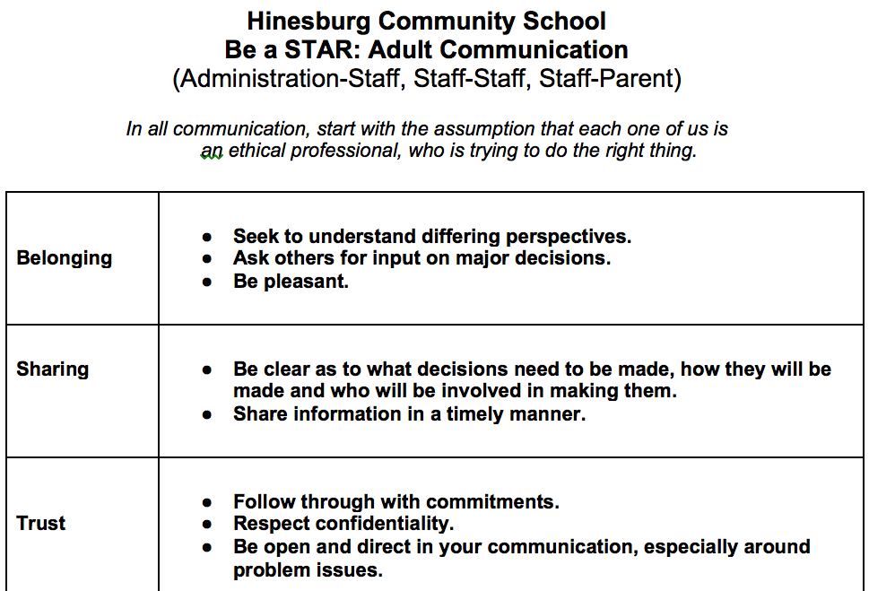
3. Matrix for Adults

Slide 87
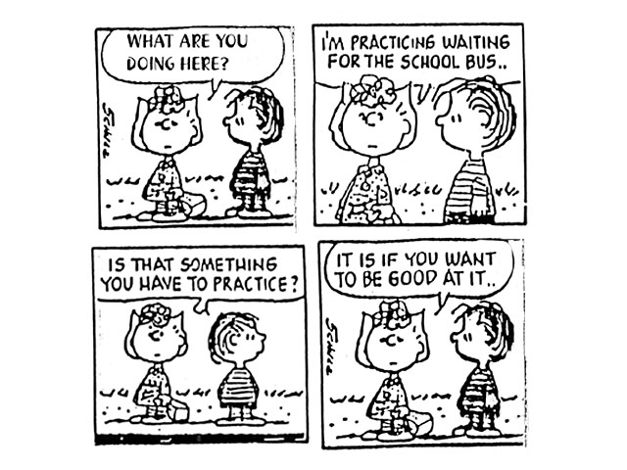
3. Teaching Behavioral Expectations

Slide 88



3. Teaching Behavioral Expectations
Behavioral errors more often occur because of:
▪ Acquisition Deficits (can’t do)
▪ Performance Deficits (won’t do)
▪ Fluency Deficits (not enough practice)
Notes:
At the high school level, older students may take an active role in teaching younger or new students (Bohanon, Borgmeier, Fenning, Flannery, & Malloy, 2009) through an "orientation" process. THIS COULD also work with middle school students teacher younger students if you are in a K-6 or K-8 or 5-8 school configuration.
Acquisition Deficits
Absence of knowledge for executing skill or failure to discriminate which social behaviors are appropriate in specific situations (can’t do)
Performance Deficits
Skill is present in repertoire, but youth does not perform at acceptable levels (won’t do)
Fluency Deficits
Lack of exposure to sufficient or skilled models of social behavior, insufficient rehearsal/practice or low rates or inconsistent delivery of reinforcement of skilled performances

Slide 89

3. Teaching Behavioral Expectations
Repetition is key to learning new skills:
For a child to learn something new, it needs to be repeated on average of 8 times
For a child to unlearn an old behavior and replace with a new behavior, the new behavior must be repeated on average 28 times
(Harry Wong)
Notes:
Does the repetition have to be the same or can it be the same message delivered in multiple ways. Examples?

Slide 90
3. Teaching Behavior Expectations
Use a specific, positive statement
Provide the reason and describe
Model and provide practice
Use prompts and reminders
Give acknowledgement and feedback
Evaluate effectiveness of instruction - redesign instruction if necessary
How can you engage students in the teaching?
Define Simply
Model
Practice in Setting
Monitor and Acknowledge
Adjust for Efficiency

Slide 91
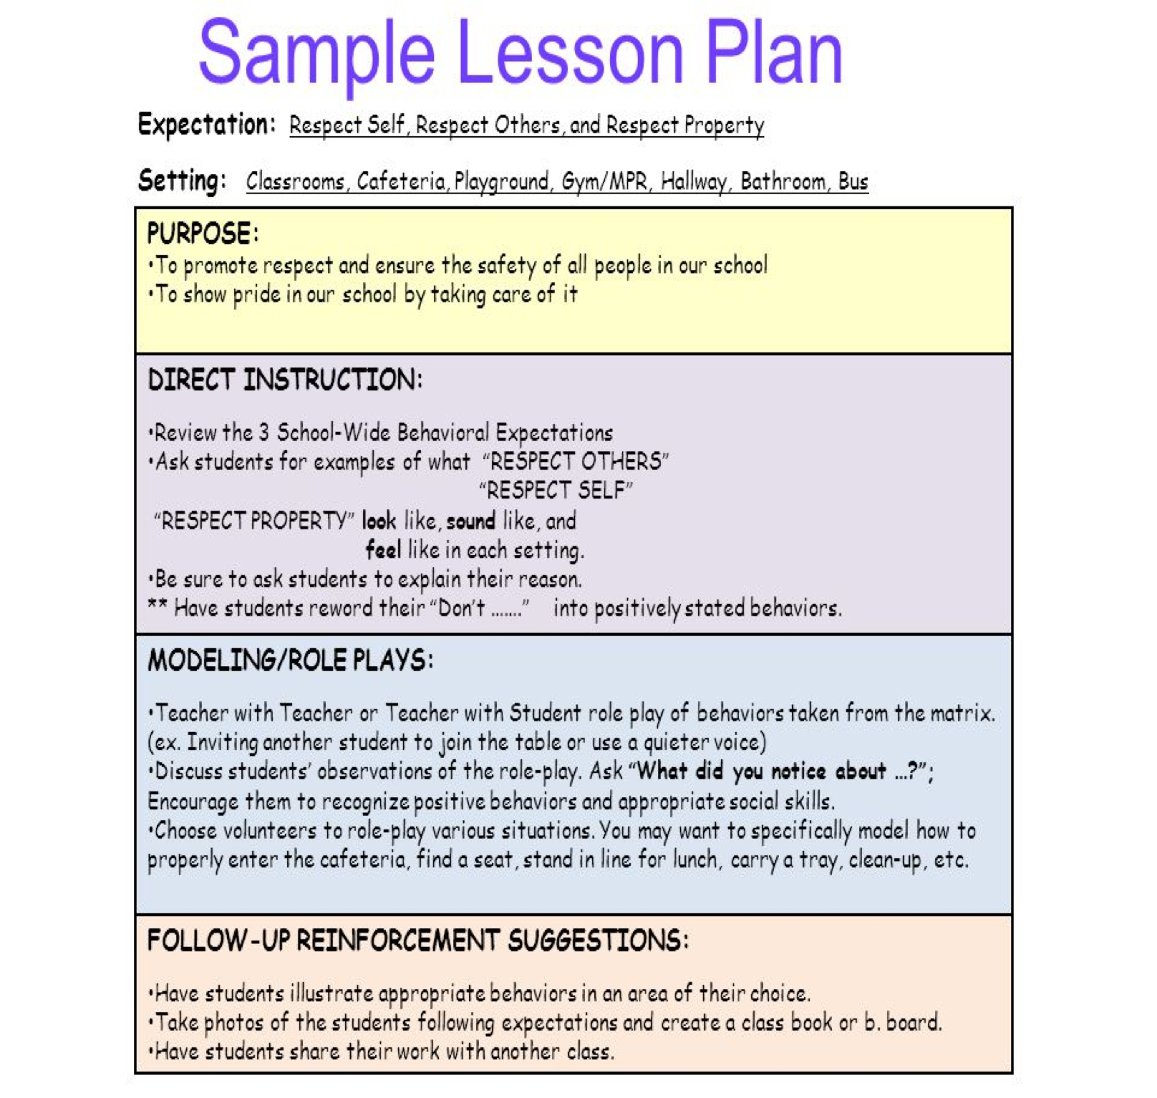


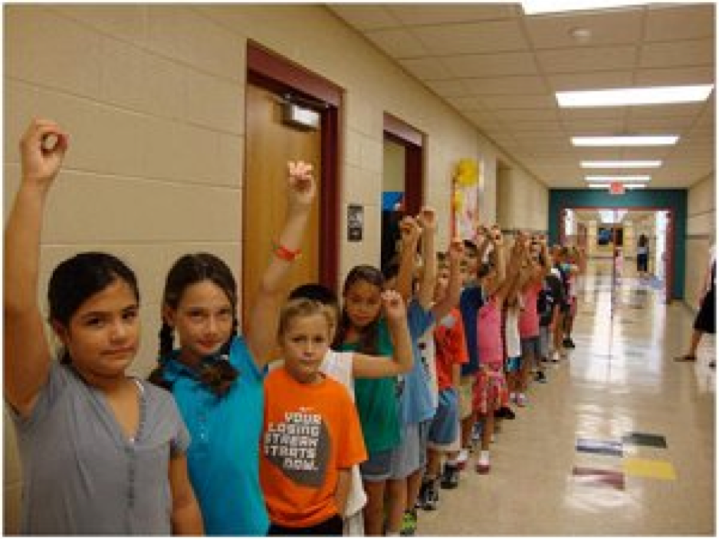
3. Teaching Behavioral Expectations
Sample Lesson Plans
Schedule for teaching the expectations.

Slide 92
When it comes to teaching the expectations, what is meant by the term “all means all”?

Slide 93
Universal Design for Learning (UDL)
English Language Learners
  Posting and teaching expectations in home languages
Students with significant disabilities (Hawken & O’Neill, 2006)
  Develop lesson plans for all that include effective instructional methods (i.e. systematic instruction, judicious review, visuals, social stories, video modeling) to teach expectations
  Collaborate with special educators
UDL: the use of multiple means of representation, expression, and engagement to ensure successful instruction for a wide range of learners (Hitchcock, Meyer, Rose, & Jackson, 2005)
*Consider assigning a UDL Monitor role*
Loman, S.; Strickland-Cohen, M K.; Walker, V. (2018). Promoting the Accessibility of SWPBIS for Students With Severe Disabilities. Journal of Positive Behavior Interventions. Vol. 20(2) 113–123. DOI: 10.1177/1098300717733976
Notes:
*UDL Monitor Role’s job is to keep UDL in mind and suggestion opportunities to be more UDL throughout the training
http://udlpbis.pbworks.com/w/page/70880954/Resources%20and%20Tools
http://udlpbis.pbworks.com/w/page/70880952/Presentations

Slide 94
Unit/Lesson Re-Design Worksheet (udlpbis.pbworks.com)
Course/Lesson: Playground Instructor/s: Loman
Date: Nov. 6
Key Goals/Outcomes (Usually tied to CCSS or SW Rules) | What I Want Students to Do to Demonstrate Learning | What I Do Now | Applying UDL: Representation of Content | Applying UDL: Student Actions/ Expression | Applying UDL: Student Engagement/ Motivation
Students will be safe at the playground | Keep hands to themselves, Play by the rules, Stay where an adult can see them | Show them the poster at the playground and remind them of their rules | Provide pictures as prompts for students Use video examples of the expectations Role play and practice examples and non-examples Social Narratives/ Powercards | Students use different ways to communicate they understand the expectations- create posters/videos, use voice output devices, state what the expectations look like and sound like | Meaningful reinforcement Leadership in supporting safety at the playground- Peer-mediated Interventions Social Narratives Self-management/ reinforcement

Slide 95



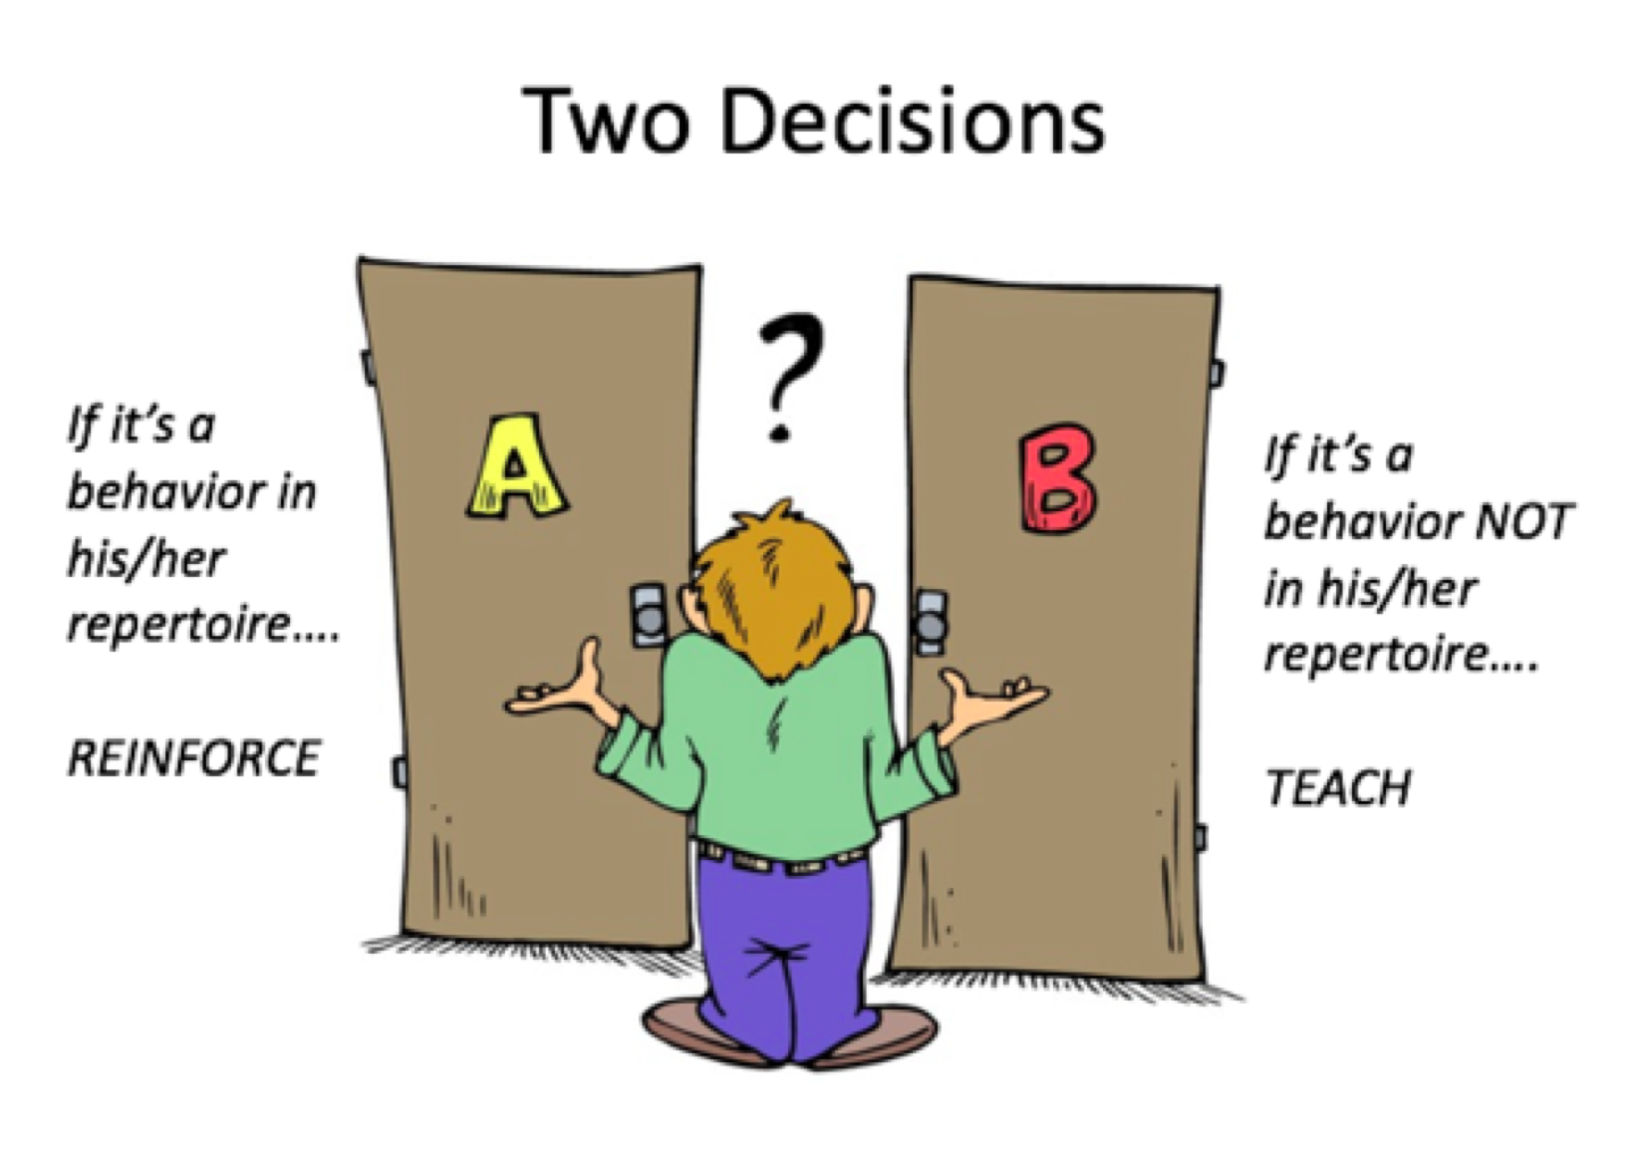
Provide lesson plans for each location
Teach in the natural setting
Evaluate effectiveness of instruction - redesign instruction if necessary

Slide 96
Activity!
Count off by 6 and go to your assigned table
As a new Crew, discuss the following questions found on your table regarding the Purpose Statement, 3-5 Behavioral Expectations, and Teaching Behavior Expectations
Select 1-2 people to record your answers on the Post-it notes at your table and place on designated chart paper on the wall.
Walk around the room to see the ideas on the posters.
Get back into your original team
Notes:
Create One-pager….

Slide 97
Team Activity
1. Using the PBIS Staff Handbook, complete/revise:
Statement of purpose
3-5 expectations
School-wide matrix
Lesson Plans by location
Schedule for teaching the expectations
2. Document any follow-up items on your TFI Action Plan
3. Determine a date to re-roll-out to staff, students, and families

Slide 98
Use a graphic organizer or post-it to share what’s on your mind…
What’s been most useful today?
How can we help?

Slide 99




4. Importance of Acknowledging Behavior
Behavior is learned.
Learning is facilitated by guided feedback.
Positive feedback has a greater likelihood of shaping behavior than negative feedback.

Slide 100
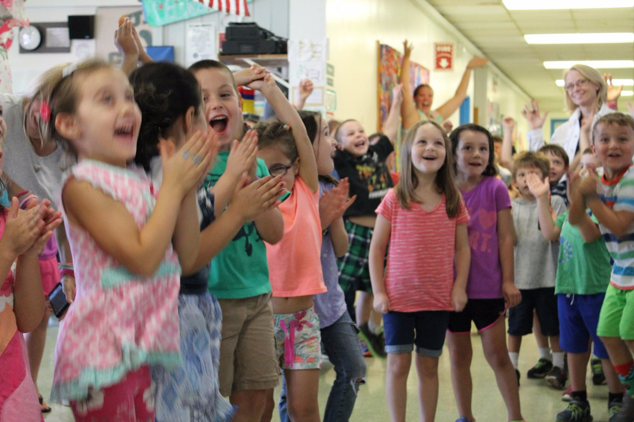
4. Acknowledging Behavior
Why is it important?
Rewards make a difference
    Initial behavior change
    Sustained behavior change (Doolittle, 2006)
Rewards can be used badly
    But they do NOT inhibit intrinsic motivation (Reese, 2005)
Notes:
Rewards are effective when used:
To build new skills or sustain desired skills, with
contingent delivery of rewards for specific behavior, and
gradually faded over time.
Akin-Little, Eckert, Lovett, Little, 2004
“In terms of the overall effects of reward, our meta-analysis indicates no evidence for detrimental effects of reward on measures of intrinsic motivation.”
Cameron, Banko & Pierce, 2001 p.21
“…our research team has conducted a series of reviews and analysis of (the reward) literature; our conclusion is that there is no inherent negative property of reward. Our analyses indicate that the argument against the use of rewards is an overgeneralization based on a narrow set of circumstances.”
Judy Cameron, 2002
Cameron, 2002
Cameron & Pierce, 1994, 2002
Cameron, Banko & Pierce, 2001
“The undermining effect of extrinsic reward on intrinsic motivation remains unproven”
Steven Reiss, 2005

Slide 101



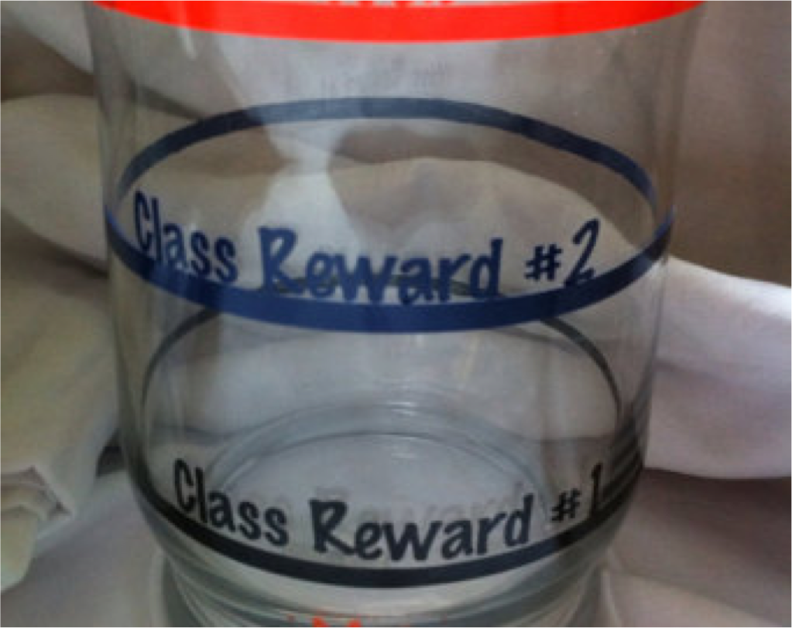
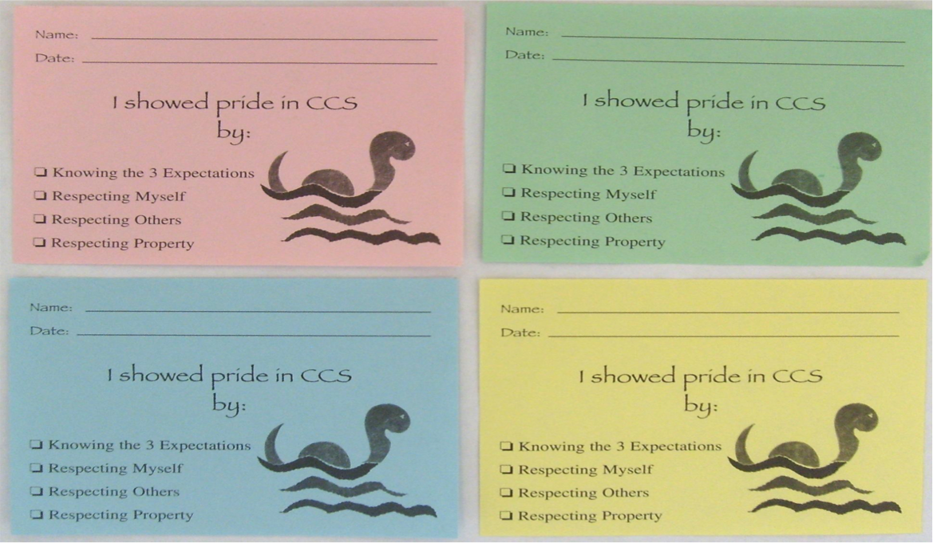
4. What does it look like?
Identify what your school will use for reinforcement.

Slide 102

4. Acknowledging Behavior
In order for youth behavior to change, adult behavior must change first.
Adults should provide a higher rate of positives than negatives (6-8:1 ratio).
Timely, specific feedback increases learning.
Link acknowledgements to the overall benefit of others (make a connection).
Make acknowledgements age- and context-appropriate.
(Gable, Hester, Rock, & Hughes, 2009; Kerr & Nelson, 2006; Nafpaktitis, Mayer, & Butterworth, 1985; Scott, Anderson,
& Alter, 2011; Stichter et al., 2009; Walker, Ramsey, & Gresham,2004)
Notes:
Oxygen mask analogy
Can’t start with 6-8? Make it doable - start with 4:1 ratio.

Slide 103


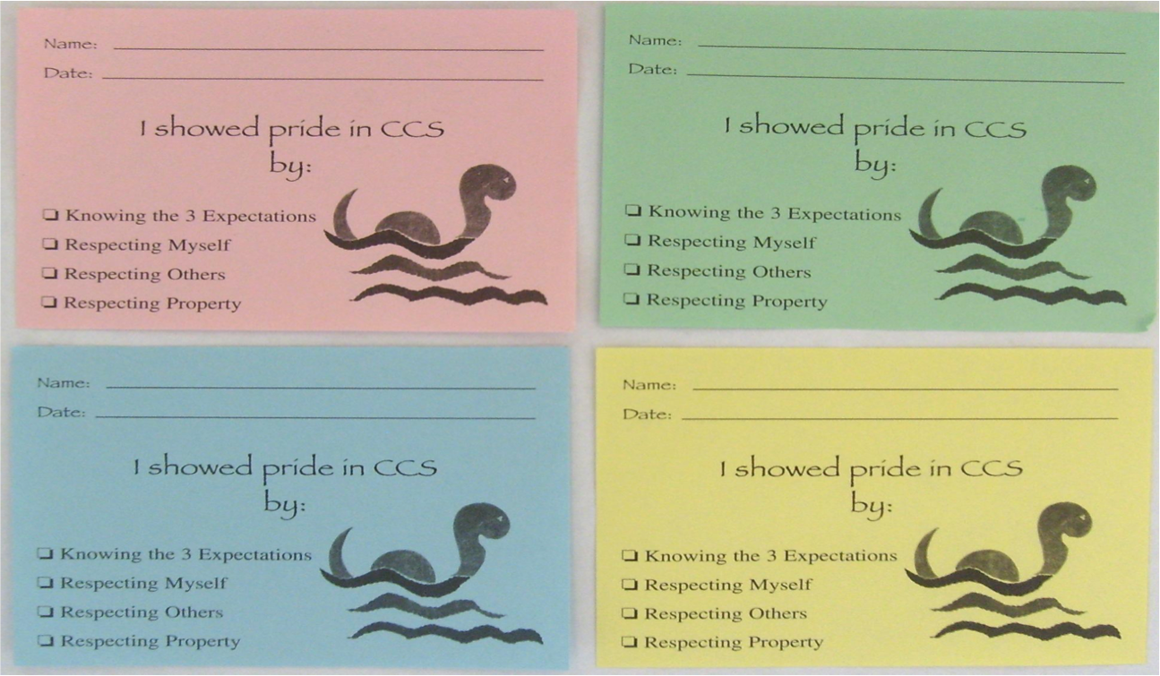


4. How Do Students Get It?
Identify how students receive the reinforcement. Provide positive acknowledgement:
Use a specific, positive statement
State the expectation they are meeting
Pair this verbal feedback with your school’s tangible
Notes:
Use a specific, positive statement
Provide the reason and describe
Hand student the tangible

Slide 104
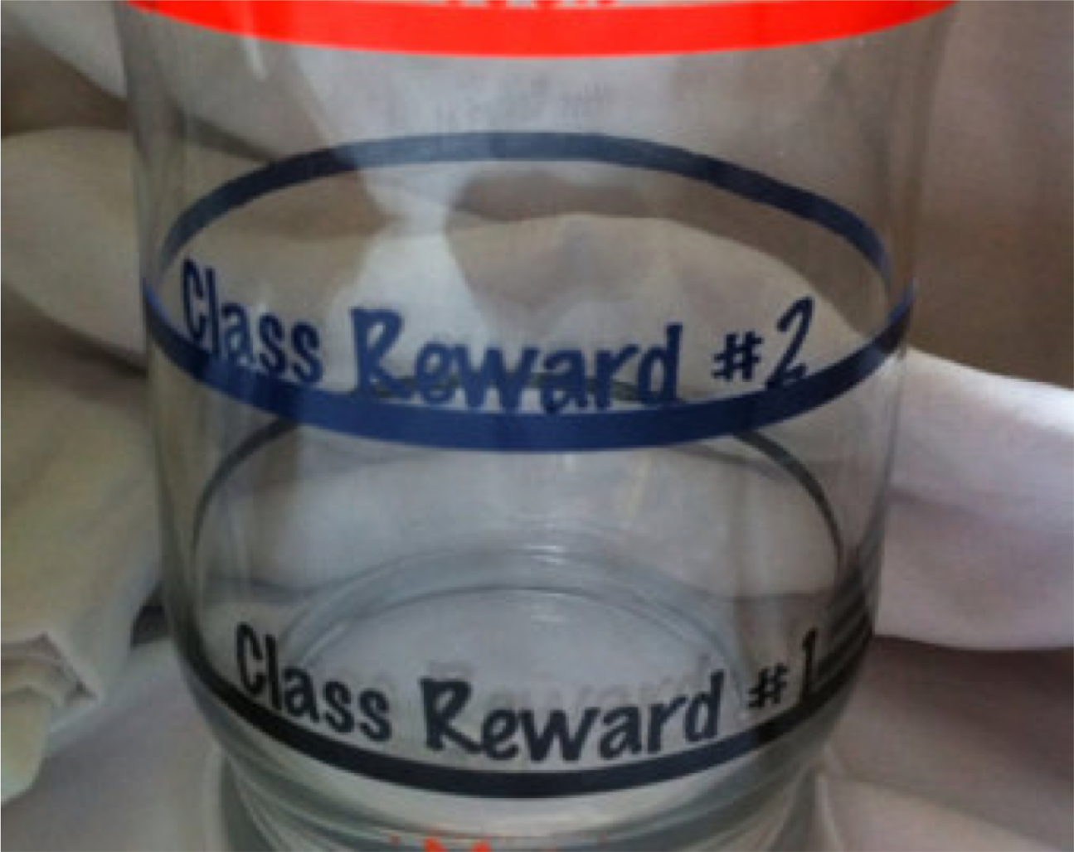
4. What Do Students Do With It?
Classroom
Celebrations
Pajama day
Hat day
Extra 5 minutes of recess
Other suggestions
The best way to know what will be reinforcing to students? ASK!

Slide 105
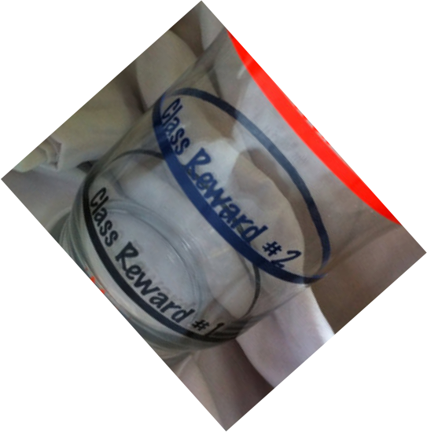
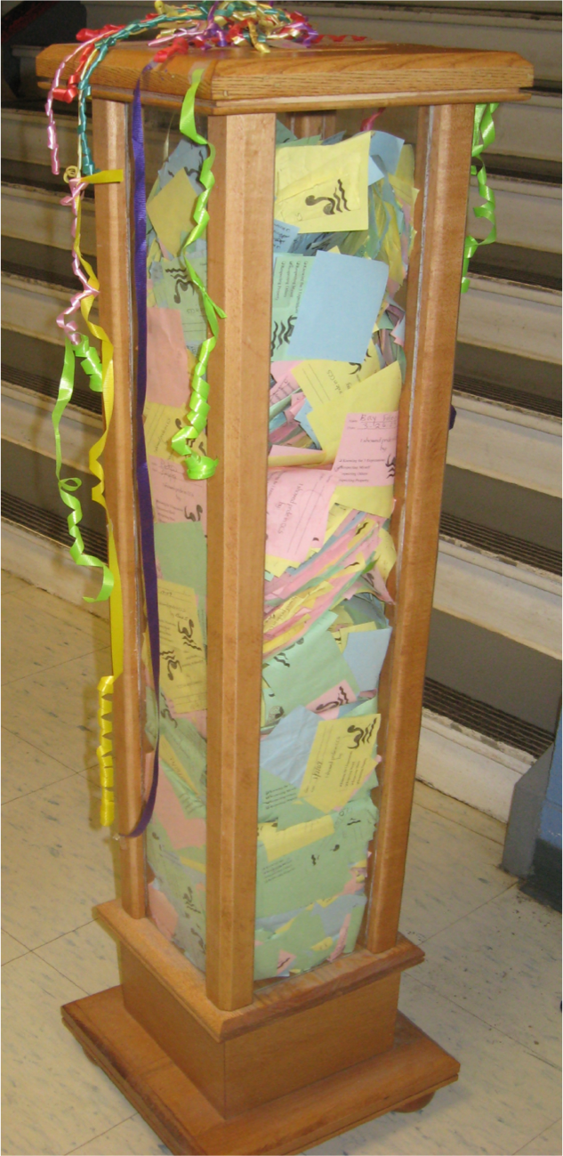
4. Classroom to School-Wide
School-Wide
Celebrations
End of the day dance party (10 mins)
Extra recess time
Sliding party (family participation)
Other suggestions
Consider how you might include the community!

Slide 106

Team Activity or Homework
Read this article and discuss with your team.
What improvements do you need to make to your student acknowledgement system? How can you keep the momentum going throughout the year?
Notes:
https://www.pbisapps.org/community/Pages/5-Ways-to-Reward-Students-the-Right-Way.aspx

Slide 107
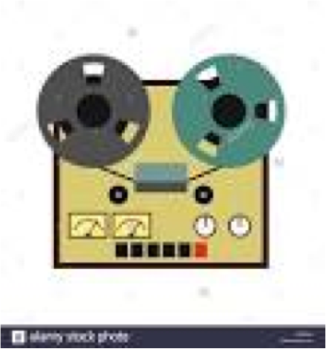



Strategies for Improving Adult Skills
Record yourself in the classroom
Ask a colleague to observe
Set a reasonable goal
Practice in the moment
Take a break and think

Slide 108

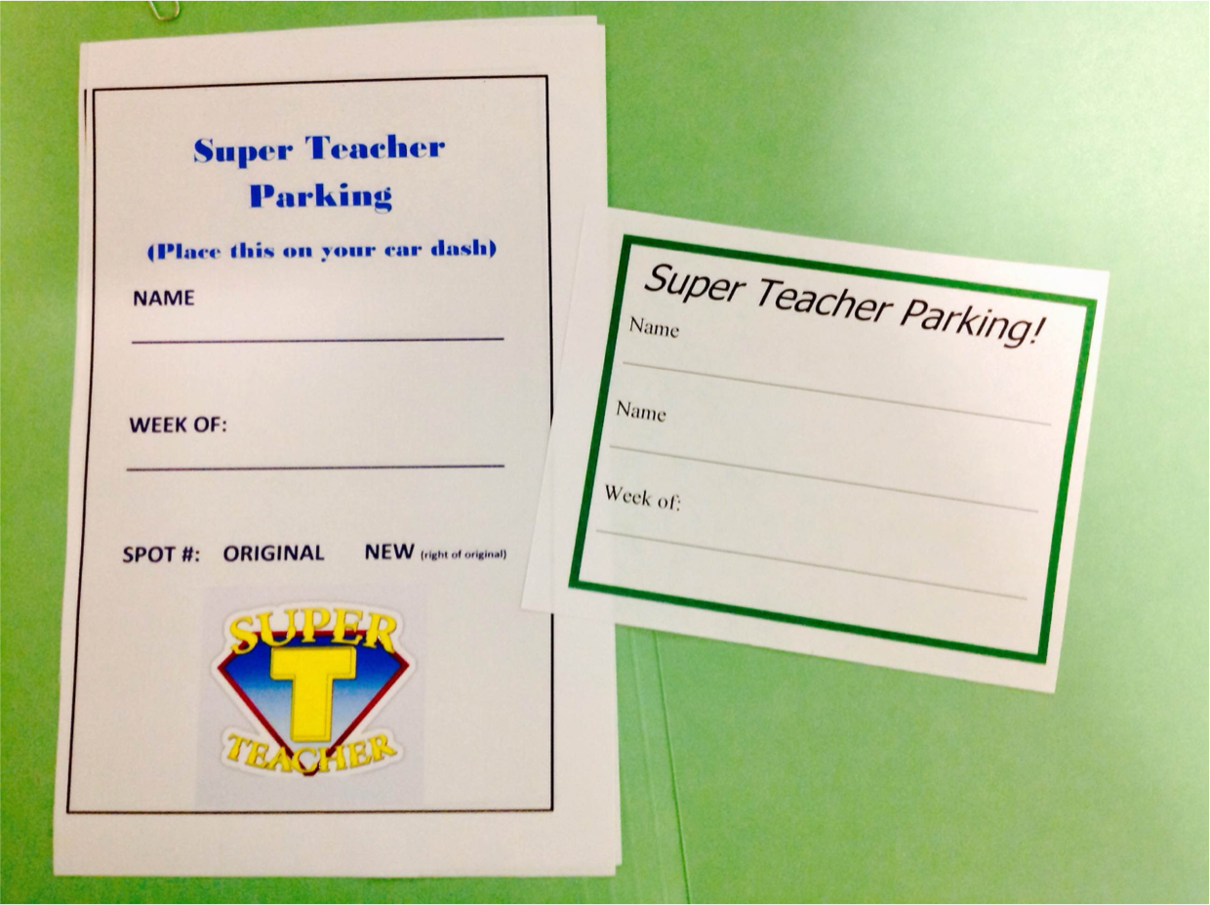
4. Acknowledging Behavior
Don’t forget to acknowledge your staff!
https://youtu.be/Cbk980jV7Ao
Notes:
End at 2:36

Slide 109
4. Why reinforce staff?
Teacher emotional exhaustion is associated with low level PBIS implementation in the classroom (Reinke, Herman, & Stormont, 2013)
Teachers who experience high levels of burnout or feel emotionally exhausted demonstrate lower quality teaching and impaired relationships (Maslach & Jackson, 1981)
Teacher stress contributes to teacher turnover (Johnson, et.al, 2005)
High stress and low coping of teachers is correlated with poor student behavior and academic outcomes (Herman, Hickmon-Rosa, Reinke, 2018)

Slide 110
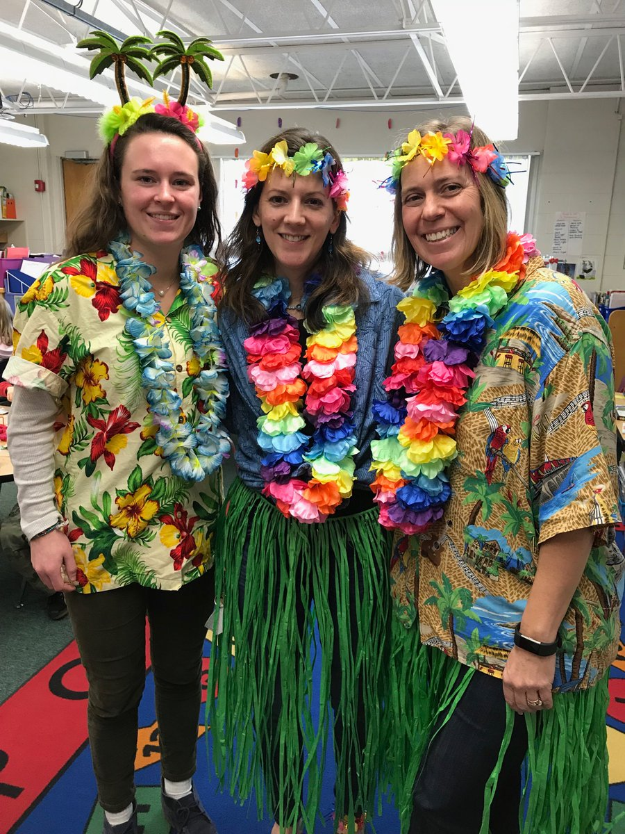
Team Activity
Discuss creative ways to reinforce staff
Write each idea on a post-it
Place on chart paper
The best way to know what will be reinforcing to staff? ASK!
Notes:
Have each school share what they are doing – put on post its.
Move post-its to chart paper.
Take a picture of the chart paper and share with all.

Slide 111

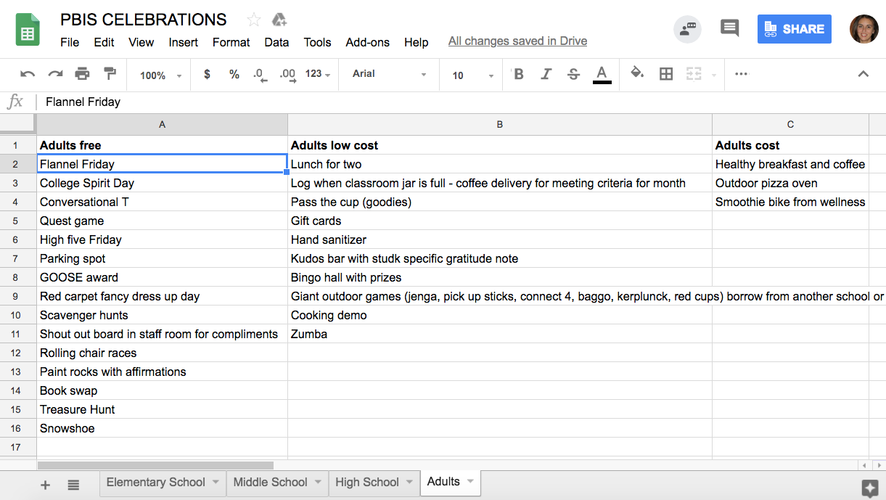
Where can you find more ideas?
Additional resources for
reinforcing staff.
Notes:
https://docs.google.com/spreadsheets/d/1oVFyZtS401_HQwwAeK5-eLKgiFkNFO4i8BLUrk5hBUI/edit?usp=drive_web

Slide 112
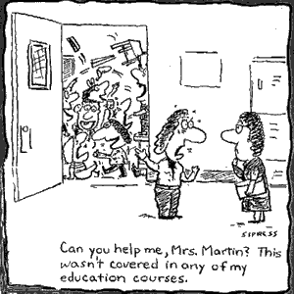
5. Discouraging Problem Behavior
This involves:
  Consistent practices for preventing problem behaviors
  Distinguishing between minor and major behaviors
  Practices for responding to problem behaviors
  Continuum of Procedures for responding to problem behavior

Slide 113
Activity!
Count off by 5’s. Go to the poster that corresponds with your number. Discuss responses to these questions:
What in-class strategies should all teachers try before a problem behavior is recorded as a minor or major?
How can you ensure a balance between “discipline procedures” for responding to problem behavior and “practices” to prevent the re-occurrence?
What are effective prevention and response strategies?
How are staff supported to learn effective response strategies for problem behaviors?
Is there a role for punishment in PBIS?
Notes:
Put definition of punishment on paper

Slide 114
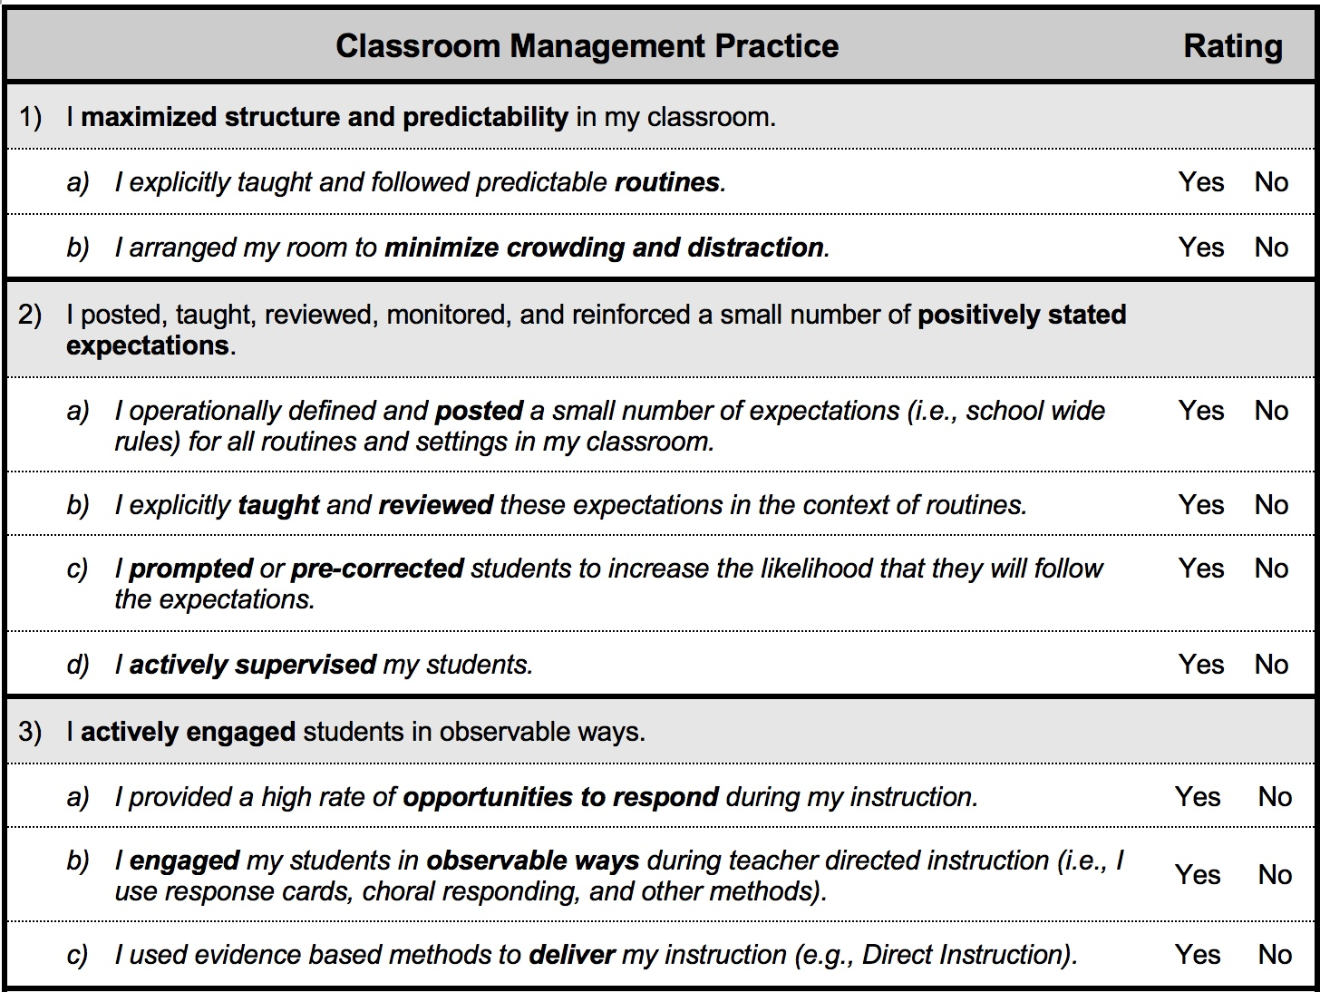
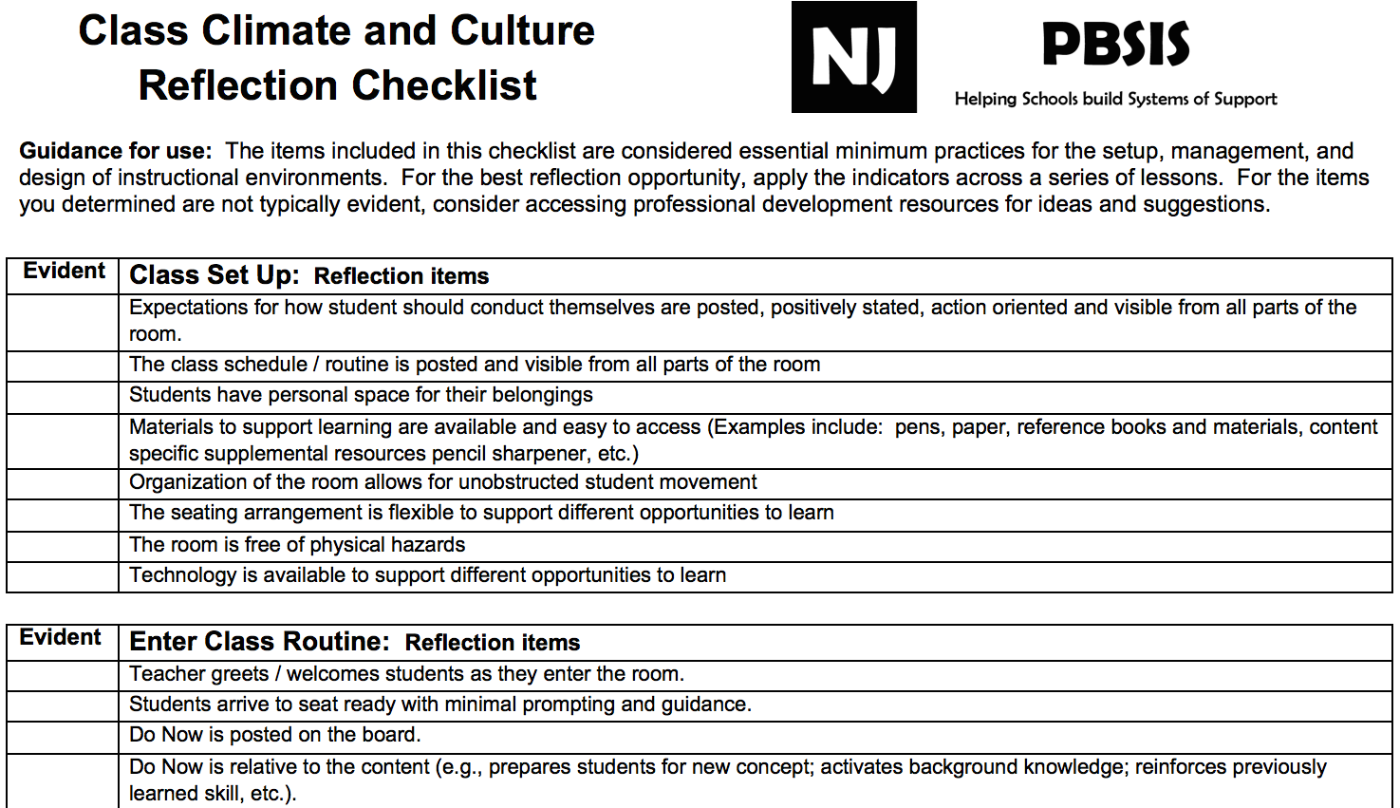
5. Discouraging Problem Behavior: Prevention Strategies
Change the environment, not the student!
Redesign of teaching environments…not students!
Notes:
Handout Class Climate Checklist!

Slide 115
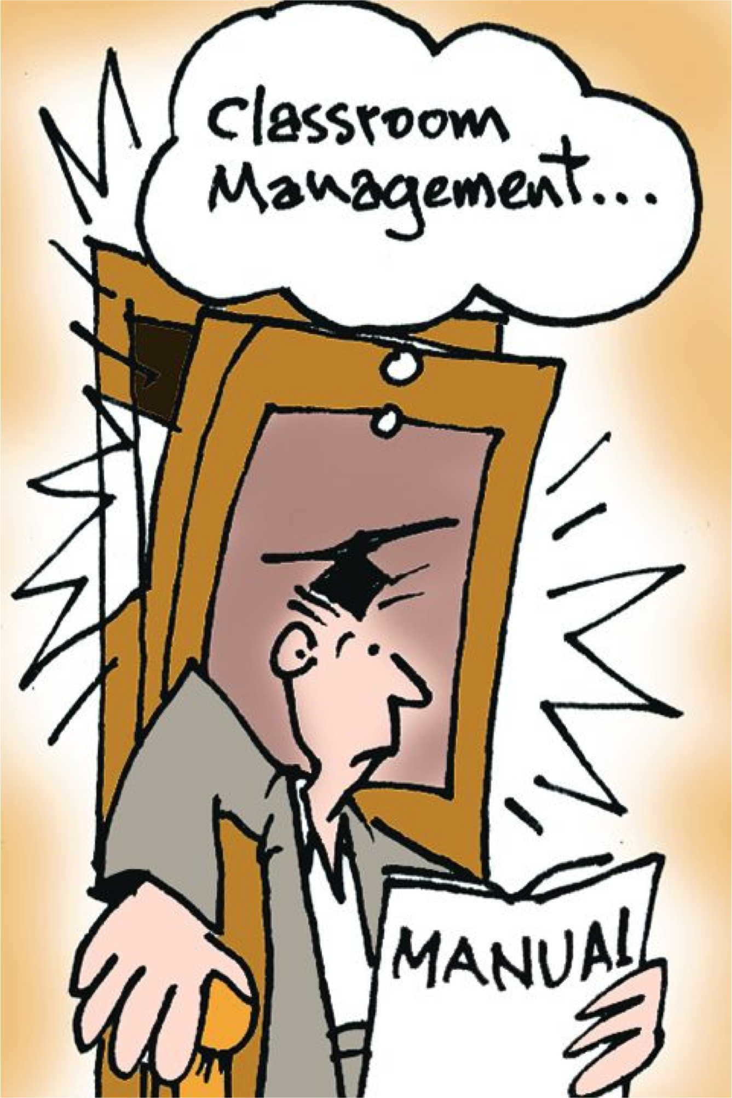
5. Discouraging Problem Behavior:
Prevention Strategies
Rapid, consistent response to minor behaviors
Scanning and moving around the room
Engaging lessons
High frequency of opportunities to respond
Consistent routines
What else?
Notes:
De-Escalation Techniques:
When student shows anxiety….Be supportive!
What does anxiety look like?
What can adults do to be supportive?
When student is defensive…Be directive!
What does defensive behavior look like?
What can adults do to be directive?

Slide 116
5. Discouraging Problem Behavior: Prevention Strategies
Two Important Articles:
Simple, Evidence-Based Interventions (Behavior-Specific Praise; Behavior Momentum; Choice)
Function-Based Thinking
How can you bring the information from these articles back to your staff?
Notes:
Handout Article! Online!
Real story experienced by Ken Kramberg to demonstrate Behavior Momentum: A student, (on the autism spectrum) wouldn’t get off the swing at recess when recess was over. The student would have a fit and refused to come in. The team of teachers got together and came up with three things the student says “yes” to………

Slide 117

5. Discouraging Problem Behavior:
Minors vs. Majors
Calibrate your staff!
Identify and define minor vs. major behaviors
Define adult expectations prior to referring
∗ The first grade class writes in a journal. The topic focuses on a particular letter each day. During the letter “F” day, Sarah writes an inappropriate word she has learned from some older students on the playground. She shows her journal to all of the students around her.
DEFINE “Close Confusers!”

Slide 118
Activity!
Complete the Discipline Categories Exercise #1
We’ll review answers as a large group!
Consider: do you need to revise your majors/minors list or clarify any “close confusers”?
Notes:
Recommended to bring back and do with staff!

Slide 119
5. Discouraging Problem Behavior:
Practices for Responding to Minor Problem Behaviors
Signal that expectation has not been met
State the expected behavior
Ask student to show expected behavior
  WALK AWAY to give the student time to make a choice
Give positive feedback
Consider use of scripts
  Ross Greene’s Emergency Plan B: “I notice that you are …. what’s up?”
https://www.livesinthebalance.org/
Notes:
Do role play
What are you doing? Objectively describes the rule-breaking behavior
What are you supposed to be doing? Clarifies that the student knows what behavior or task is expected.
What are you going to do? The student makes a choice communicated by either words or actions.
You could also say:
“What can I do to help you make a good choice?”

Slide 120
5. Discouraging Problem Behavior:
Is there a role for punishment in PBIS?
Definitions:
Consequence - something produced by a cause or necessarily following from a set of conditions (can be positive or negative)
Punishment - a response that reduces a targeted behavior

Slide 121
Is there a role for punishment in PBIS?
The key to PBIS is prevention, not punishment
Emphasize proactive, instructive, and restorative approaches to student behavior that are implemented consistently
Punishment is only punishment if it serves to reduce the behavior; it should always be followed-up with teaching and reinforcing the expected/replacement behavior to prevent it from happening again
Schools need to identify a consistent way to respond to problem behavior when it occurs. Response strategies need to be shared with staff, students, and families

Slide 122
Consider a Restorative Approach
A framework for building community and for responding to challenging behavior through authentic dialogue, coming to understanding, and making things right.
Puts repairing harm done to relationships and people over and above the need for assigning blame and dispensing punishment

Slide 123
PBIS and RP
“PBIS shifts adults’ focus from punishing and excluding to teaching and rewarding positive student behavior, while restorative practices encourage personal reflection, accountability, and healing for both students and adults. Both approaches seek to enforce positive behavior and uplift student strengths.”
(California Conference for Equity and Justice 2013)

Slide 124
Goals of PBIS and RP
To build a safe, respectful, and productive learning environment
To establish a positive school climate where students and adults have strong, positive relationships and students understand what is expected of them as learners at school
https://www.pbis.org/common/cms/files/pbisresources/TECBD_RJP%20in%20SWPBIS%20Eber,%20Swain-Bradway.pptx

Slide 125
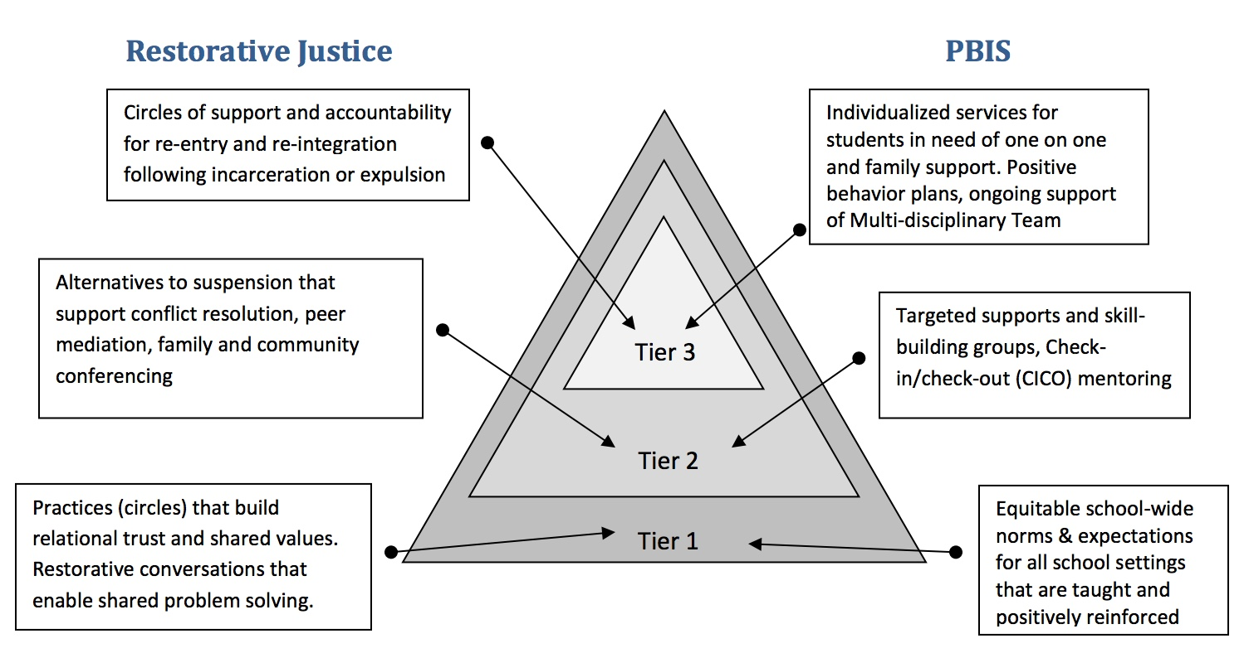
Restorative Approach and PBIS
Oakland Unified School District – Family, Schools, and Community Partnerships Department
http://www.uvm.edu/~cdci/best/pbswebsite/RJandPBIS.pdf

Slide 126
Activity!
Count off by 6 and go to your assigned table.
As a new Crew, discuss the following questions found on your table regarding the Acknowledging Behavior and Discouraging Problem Behavior.
Select 1-2 people to record your answers on the Post-it notes at your table and place on designated chart paper on the wall.
Notes:
Create One-pager….

Slide 127
Team Activity
Walk around the room to see the ideas on the posters.
Return to your original Crew and complete practices and procedures for acknowledging positive behavior and discouraging problem behavior. Does your flow chart need revision?

Slide 128
15 Minute Break
5 Piano Guys
Charlie Brown
Mozart
Mission Impossible

Slide 129
Supporting
Staff Behavior
Supporting
Decision Making
OUTCOMES
Systems
Data
Practices
Supporting Student Behavior
Notes:
3
DATA

Slide 130
Types of Data to Consider
Intensive:
TFI
I-SWIS
EST
FBA/BSP
Targeted:
TFI
Universal Screening
SWIS-CICO
EST
FBA/BSP
Universal:
TFI
SAS
SWIS
Attendance
Grades
Leadership Team Self-Assessment
Notes:
What else?

Slide 131
Big Ideas About Data
All data should serve a purpose
Collect data with fidelity
Be prompt about looking at data and acting upon it
Use multiple sources of data to confirm what you see
Use data to support, not punish

Slide 132
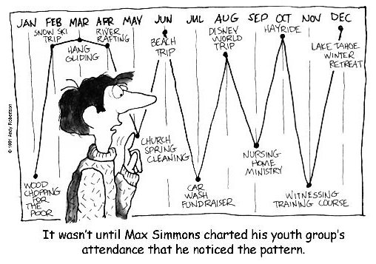
Using Student Outcome Data

Slide 133
Activity!
In your teams, discuss the following:
  What data systems are you using to monitor student behavior? How is it working?
  How are you using that data?
  What will the data look like if progress is being made? What if progress was not being made?

Slide 134
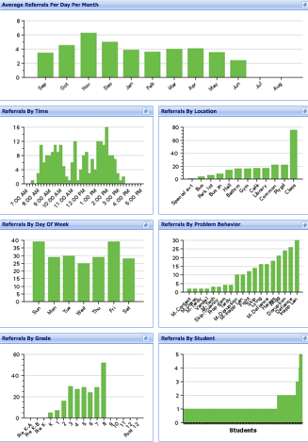
Office Discipline Referrals
Avg. Referrals Per Day Per Month
Time
Location
Day of Week
Problem
Behavior
Grade
Student

Slide 135
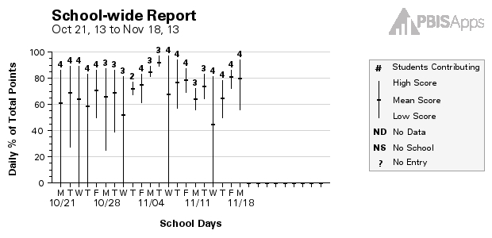
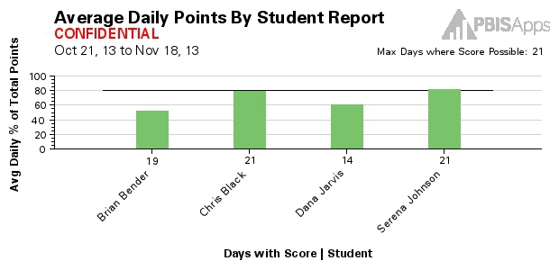



SWIS-CICO
Reports:
School-wide Report
Average Daily Points
Student Count
Student Period
Student Single Period

Slide 136
6. Procedures for record keeping and decision making
Why is it important?
  Identify patterns
  Document pre-referral interventions
  Determine whether a particular teacher needs support
  Communicate with parents and answer questions
  Inform behavior support planning
Moving away from “admiring the problem”

Slide 137
Importance of Data
Showing staff behavioral data is the number one predictor of whether PBIS will sustain
Staff should be shown SW data regularly (at least 4x/year) and provide input on universal foundations (e.g. expectations, acknowledgements, definitions, consequences) at least every 12 months
Remember to share SUCCESSES!

Slide 138
Use of Data
Teams should review and use discipline and academic outcome data at least monthly for decision making
If data indicate an academic/behavioral problem school-wide, an action plan is developed to enhance/modify Tier 1 support
Your team will also use fidelity assessments (TFI and SAS) annually to action plan

Slide 139

Consider Paperless Referrals

Slide 140
Other Possible Data Sources
School climate
Staff retention
Student/staff attendance
Nurse visits
Parent satisfaction
Student’s perceived safety
In/out-of-school suspension
Academic achievement
What else?

Slide 141

Using Data to Make Decisions
Notes:
How many of you have been in a meeting and heard things like…
“I think it is getting better”
“It feels less chaotic, I don’t know why.”
“The behaviors are getting worse. I have tried everything and nothing is working.”

Slide 142
Looking for a Data Protocol?
Consider Using TIPS:
A process for using data to make decisions:
Formal problem solving steps that a group can use to build and implement solutions
Access to the right information at the right time in the right format
A structured meeting process
Formal roles (facilitator, recorder, data analyst)
Specific expectations (before, during & after meetings)
Access and use of data
Use of electronic and projected meeting minutes

Slide 144
What, Who, When, Where, and Why?
Team-Initiated Problem Solving (TIPS II) Model
Identify Problem
with
Precision
How do we want the problem to change?
What next?
Make Summative
Evaluation
Decision
Identify
Goal for Change
Collect and Use Data
Has the problem been solved?
Monitor Impact
of Solution and
Compare against Goal
Identify
Solution and
Create
Implementation
Plan with
Contextual Fit
Implement
Solution with
High Integrity
What are we going to do to bring about desired change?
Did we implement with fidelity?
Meeting
Foundations
Notes:
The outer circle ( Problem Solving Meeting Foundations) refer to the process and procedures and team uses to function. Roles are determined and defined, meetings are scheduled for the year, electronic equipment and internet access are available, and an agenda is established.
The inner circles and arrows define a problem-solving model designed to improve the decision-making and problem solving of PBIS Team. This model is called “TIPS,” which stands for “Team-Initiated Problem Solving.” The model uses data for during problem solving and decision making, during meetings. We will also apply a metric for determining if rates of problem behavior at a school or below, at, or above the national average to determine if there is a problem or not. TIPS teaches teams to use their SWIS data to define precision problem statements. Once the problem statement is precise, a variety of solutions are discussed based on prevention, teaching, reward, correction and extinction and teams will determine which solution(s) they want to implement. The TIPS model then moves the team to action planning ,evaluation and measurement determination.

Slide 145
TIPS Problem-Solving “Mantra”
Innovation neutral: Use for Reading, Behavior, Math, School Improvement
Do we have a problem?
(identify)
What is the precise nature of our problem? (define, clarify, confirm/disconfirm inferences)
Why does the problem exist, & what can we do about it? (hypothesis & solution)
What are the actual elements of our plan? (Action Plan)
Is our plan being implemented, & is it working? (evaluate & revise plan)

Slide 146

1. Do we have a problem (identify)?
Look for gaps and trends in your data
Notes:
What data to monitor
ODR per day per month
OSS, ISS, Attendance, Teacher report
Team Checklist/ SET (are we doing what we planned to do?)
What question to answer
Do we have a problem?
What questions to ask of Level, Trend, Peaks
How do our data compare with last year?
How do our data compare with national/regional norms?
How do our data compare with our preferred/expected status?
If a problem is identified, then ask
What are the data we need to make a good decision?

Slide 147
What trend do you notice?

Slide 148

Which location might need attention?

Slide 149
2. What is the precise nature of our problem (define, clarify, confirm/disconfirm inferences)?
Question | SWIS Table/Graph
What problem behaviors are occurring? | Referrals by problem behavior
When are problem behaviors occurring? | Referrals by time
Where are problem behaviors occurring? | Referrals by location
Who is engaging in problem behaviors? | Referrals by student
Why do problem behaviors keep happening? | Referrals by motivation
What is the data we need for a decision?

Slide 150
Precise Problem Statement
Include information about the what, when, where, who, when and why
Inappropriate language and disruptive behavior is increasing in the cafeteria during “first lunch period,” is being done mostly by ten 6th grade boys, and seems to be maintained by social praise from the bystander peer group.
Inappropriate behavior is increasing

Slide 151

3. Why does the problem exist, & what can we do about it? (hypothesis & solution)
Problem Statement: The sixth graders are disruptive & use inappropriate language in the cafeteria between 11:30 AM and 12:00 PM
Hypothesis: We believe they are trying to get attention from their peers.

Slide 152
4. What are the actual elements of our plan?
Prevention | Maintain current lunch schedule, but shift classes to balance numbers.
Teaching | Teach behavioral expectations in cafeteria
Reward | Establish “Friday Five”: Extra 5 min of lunch on Friday for five good days.
Extinction | Encourage all students to work for “Friday Five”… make reward for problem behavior less likely
Corrective Consequence | Active supervision, and continued early consequence (ODR)
Data Collection | Maintain ODR record and supervisor weekly report

Slide 153

…including logistics:
Notes:
Action Plan Elements:
Who?
By When?
Goal with Timeline
Fidelity of Implementation Measure
Effectiveness of Implementation Measure

Slide 154

5. Is our plan being implemented & is it working? (evaluate & revise plan)
Notes:
Define the goal for solving the problem
What will ‘it’ look like when you say it is not a problem
Define how you will know that the solutions were implemented as planned (with fidelity)?
How often will you conduct a status review?
Define how you will know that the solutions had a positive effect on student achievement, social competence, and/or safety?
How often will you monitor student progress?
What will the data tell you when the problem is solved?
Base on team-established standard
Easier to monitor if quantifiable (“countable”)
Record on meeting minute form for progress monitoring at future meeting(s)

Slide 155
Your Turn!
What is the precise nature of our problem?
Question: | Fill in the information below:
What problem behaviors are occurring?
When are problem behaviors occurring?
Where are problem behaviors occurring?
Who is engaging in problem behaviors?
Why do problem behaviors keep happening?
Notes:
As a team, we need to develop a precise problem statement! This Slide is a handout and we will use this to explore the data is SWIS.

Slide 156
What are the actual elements of our plan?
Precise Problem Statement:
Prevention: Remove/alter “trigger” for problem behavior
Teaching: Define, instruct & model expected behavior
Reward: Expected/alternative behavior when it occurs; prompt as necessary
Extinction: Increase acknowledgement of presence of desired behavior
Corrective Consequence: Use non-rewarding/non-reinforcing responses when problem behavior occurs
Data Collection: Indicate how you know when you have a solution
Notes:
Prevention: *Maintain current lunch schedule, but shift classes to balance numbers.
Teaching: *Teach behavioral expectations in cafeteria
Reward: Establish “Friday Five”: Extra 5 min of lunch on Friday for five good days.
Extinction: Establish “Friday Five”: Extra 5 min of lunch on Friday for five good days.
Corrective Consequence: Active supervision, and continued early consequence (ODR)
Data Collection: Maintain ODR record and supervisor weekly report
Prevention
: How can we avoid the problem context?

Who, When, Where

Schedule change, curriculum change, etc

Teaching:
How can we define, teach, and monitor what we want?

Teach appropriate behavior

Use problem behavior as negative example

Recognition
: How can we build in systematic reward for desired behavior?

Extinction
: How can we prevent problem behavior from being rewarded?

Consequences
: What are efficient, consistent consequences for problem
behavior?

How will we collect and use data to evaluate (a) implementation fidelity, and
(b) impact on student outcomes?

Slide 157
Activity
Using the TIPS Problem Solving Process (handout) as a guide:
  Identify the precise nature of the problem
  What are the elements of your plan?
Consider: Is there a benefit to sharing data with students?

Slide 158
Using Fidelity Data

Slide 159

Example: What’s working well?
TFI:
What do you notice? Progress?
Areas for Improvement?
Notes:
Six schools

Slide 160
Team Activity
In your teams, analyze your school’s TFI data using the TFI Summary/Planning Tools and identify the following:
  What is your most significant implementation dip? (Area in most need of improvement)
  What are 2-3 areas of strength?
  Identify at least two strategies to overcome identified implementation dips

Slide 161

Your SAS Data

Slide 162





Slide 163

SAS Team Summary Tool

Slide 164
Team Activity
In your teams, analyze your school’s SAS data using the SAS Team Summary Tool and identify the following:
  What is your most significant implementation dip? (Area in most need of improvement)
  What are 2-3 areas of strength?
  Identify at least two strategies to overcome identified implementation dips

Slide 165
Sharing Data with Your Staff
Introduce team members
Acknowledge staff support for the process
Identify data trends using graphs
Be specific about areas for improvement and areas of growth (i.e. violation system, consistency in responses)
Elicit feedback on ways to improve
Review data regularly (quarterly, monthly, etc.)
Identify the team’s response based on feedback
End by identifying who staff can go to if they have questions/comments
Notes:
Consider: Turning this into a checklist for the PBIS team.

Slide 166
Annual Evaluation (TFI item)
Team should document fidelity and effectiveness (including on academic outcomes) of Tier I practices at least annually (including year-by-year comparisons) that are shared with stakeholders (staff, families, community, district) in a usable format
Use this evaluation to inform action plan

Slide 167
Activity
Using the template provided in the materials (Staff Data Presentation Template TFI/SAS 2018), create a presentation of your SAS and TFI results, including action steps.
Notes:
The staff presentation ppt will be posted at www.pbisvermont.org. Handouts will also be available.

Slide 168



Family Engagement

Slide 169

Benefits of Family Engagement
TFI
Higher test scores
Better grades
Better attendance
Higher levels of homework completion
More positive student motivation/self-confidence
Improved attitudes about school work
Decrease in at-risk behaviors
http://www.pbis.org/family/family_partnership.aspx
Darsch, Miao, & Shippen. (2004) A Model for Involving Parents of Children with Learning and Behavior Problems in the Schools: Preventing School Failure 48(3), 24-35
Notes:
The benefits of family-school partnerships have been studied for nearly three decades. Benefits include:…

Slide 170

Family Engagement Checklist
Muscott & Mann, 2004
Adapted from Epstein (2003) and Fullen (1991)
Five areas & 19 tasks:
Climate (4 tasks)
Parent Involvement in Learning Activities at Home (3 tasks)
Communication with Parents/Families (3 tasks)
Parent/Family Involvement at School (Volunteering, Assisting) (3 tasks)
Parent/Family Involvement in Decision-Making (6 tasks)
Notes:
Use the Family Engagement Checklist to assess how your school is doing and make future plans. The checklist consists of five areas and 19 tasks.
One of the after-webinar activities will be for your team to look at your Checklist. What’s working? What still needs to be done?

Slide 171

Family Engagement Checklist

Slide 172
Family Engagement Modules
Universal Level Family Engagement Module:
https://www.youtube.com/watch?v=lD7BrV11wCA
Targeted Level Family Engagement Module: https://www.youtube.com/watch?v=1w3DDUNJrbM
Intensive Level Family Engagement Module: https://youtu.be/cuZsh9Xd8Ho
Vermont Family Network

Slide 173


NEW Family Engagement Survey and Resources!

Slide 174
Addresses the following questions:
What do families know about PBIS in your school?
How are families’ perceptions about PBIS similar/different from school leadership team perceptions?
What can you do when there is a discrepancy?
What resources are available to help engage families in PBIS?

Slide 175
SAS & TFI: Family Engagement
SAS items:
  School-Wide #13
  Individual Student #6, #7
TFI items:
  1.1
  1.15

Slide 176
Team Activity
As a team, review the Family Engagement Checklist, Family Engagement Survey, SAS, & TFI, and discuss how you can use these tools:
  Identify 2-3 things you will do to increase family engagement in your school.
  Explore the Family Engagement Resources at http://www.pbisvermont.org/resources/for-families/family-resources
We’ll hear a sampling of responses
Notes:
Research shows that Family Engagement has an impact on student behavior and academics; what do you see as some barriers for engaging families?
What kinds of Family Engagement activities does your school do?
What if your school had a family member (not a teacher who had kids in your school) on the PBIS team? Any concerns? Thoughts? Would it work?
Share out!

Slide 177
Work at Three Levels
Intervene Early & Provide Focused Youth Development Activities
Implement strategies and provide supports that address risk factors and build protective factors for students at risk for severe academic or behavioral difficulties.
Provide Individualized Intensive Supports
Provide coordinated, intensive, sustained, culturally competent, individualized, child- and family- driven and focused services and supports that address needs while building assets.
Build a School-wide & Community Foundation
Social Emotional Learning, youth development, caring school climate, positive and proactive approach to discipline, personalized instruction, cultural competence, and strong family engagement.
Notes:
Taken from Dr. David Osher powerpoint: Aligning SEL, PBIS, and Restorative Justice

Slide 178
How can you continue this work?
With a VTPBIS Coach!
What is coaching?
  Support for schools/SUs/SDs in fidelity of PBIS evidence-based practices and development of local implementation capacity
  Goal is to create school/SU/SD capacity for internal coaching
Why?
  Someone with expertise who can bring experience, expertise and an external perspective
How?
  Contract with State-Approved VTPBIS Coaches directly!
  SU/SD apply for BEST/Act 230 funds
  More information at: http://www.pbisvermont.org/resources/coaches-a-coordinators/coaches
Notes:
Emphasize that even if they don’t know what they need coaching in, they can still hire a coach – the coach will help them determine what they need help with!

Slide 180

Team Activity!
Look over the VTPBIS Professional Development Calendar.
Determine what professional learning events your team members and other staff members should attend and make plans for this to happen.

Slide 181
How did we do on our objectives?
Improve teaming structures
Solidify plans for teaching expectations
Improve acknowledgement system
Improve classroom PBIS
Clarify discipline policies/responses to problem behaviors
Make plans for staff professional development, buy-in/momentum
Improve student/family/community involvement
Improve data-based decision making processes
Create shared vision of PBIS
Notes:
Learning outcomes based on the survey monkey you filled out and TFI

Slide 182

Activity!
As a team, plan your revitalization roll-out using the Staff Handbook (staff, students, families, stakeholders).

Slide 183
FINAL ACTIVITY!
As a team, list all tasks & projects that still need to be finished and schedule next meeting date(s).
IMPORTANT!
Email a copy of your Staff Handbook before you leave to Anne Dubie at anne.dubie@uvm.edu

Slide 184

Where do we go from here… thoughts and/or questions…
Notes:
SWIS Trainings
Post Implementation SET
Support Available
Grad Course

Slide 185
Vermont PBIS System of Support
SUPPORT LOOPS
School Level:
School
Coordinators
SU/SD Level:
SU/SD Coordinators
State Level:
TAs
Trainers
Coaches
Leadership Teams at ALL Levels of Support
FEEDBACK LOOPS
Notes:
We’ve learned the importance of identifying a contact at each level of the cascade.
We’ve learned that the beauty of a healthy cascade is that it will continue to sustain if one piece is missing….

Slide 186




The elements necessary to sustain PBIS include:
Data
Communication
Sharing Information
Participation
Notes:
1) Data: The school completes annual assessments ( SAS and Annual TFI). The school also collects discipline data and uses it to problem solve and maintains an annual PBIS action plan.
2) Communication: A school initiates at least bi- monthly contact with their Implementation Coach or their State TA. The schools communicates regularly with its Supervisory Union/District Coordinator and/or sends progress reports to the Superintendant at least twice a year.
3) Participation: A school participates in at least three of the four Regional Coordinators Meetings and provides opportunities for all staff to participate in progress updates and problem solving at least three times a year.
4) Training/Information Sharing The school actively works toward fidelity of implementation at all tiers.

Slide 187


Stay Connected!
https://www.facebook.com/groups/PBISVermont/
https://twitter.com/vtpbis
Please share all of the awesome things you are doing by using #VTPBIS or @VTPBIS

Slide 188


Slide 189
Questions? Contact a VTPBIS TA
When in doubt, contact Anne Dubie!
(802) 656-5775 or Anne.Dubie@uvm.edu

Slide 190

THANK YOU!
Safe Travels!

Slide 191
PBIS Targeted and Intensive Levels

Slide 192

Understanding Function Across the Tiers
Notes:
At the universal level: ALL staff can define behavior in observable and measurable terms and make a guess as to the function of the behavior
Targeted level: SOME staff can lead the simple FBA/BSP process
Intensive level: A FEW staff can do a more extensive and intensive level of assessment

Slide 193
Establishing Continuum of School-Wide PBIS Support
INTENSIVE PREVENTION
INTENSIVE PREVENTION
Function-based support
Wraparound
Person-centered planning
~5%
~15%
TARGETED PREVENTION
TARGETED PREVENTION
Check in/out
Targeted social skills instruction
Peer-based supports
Social skills club
UNIVERSAL PREVENTION
Teach SW expectations
Proactive SW discipline
Positive reinforcement
Effective instruction
Parent engagement
UNIVERSAL PREVENTION
~80% of Students

Slide 194

Targeted Inventory of Support

Slide 195
Examples:
Targeted Interventions Based on
Functions of Behavior
Access Adult Attention/Support:
  Check-In/Check-Out
  Adult Mentoring Programs
Access Peer Attention/Support:
  Social Skills Instruction
  Peer Mentoring
  Self-Monitoring with Peer Support (function: academic task escape)
Academic Skills Support
  Organization/Homework planning support
  Homework completion club
  Tutoring

Slide 196



Where to Find Evidenced-Based Practices
http://www.nrepp.samhsa.gov/
http://www.ojjdp.gov/mpg
http://www.blueprintsprograms.com/programSelector.php

Slide 197
Optional
Finalize your Inventory of Formal and Informal Targeted Systems of Supports (handout)

