Slide 1
De-escalation and
Relationship Building Skills
Applying the Foundations of Life Space Crisis Intervention
Ken Kramberg

Slide 2
Life space Crisis Intervention
Establishing effective positive helping relationships with children
Diagnosing and correcting self defeating patterns of behavior

Slide 3
Self Defeating vs. Bad Behavior
Cooperative Problem Solving Discipline approach
The Power Of Language

Slide 4
CHILDREN WHO ARE HEARD LISTEN
Kids want to tell their story

Slide 5
WHEN DEALING WITH IN AN EMOTIONALLY CHARGED EVENT
YOU MUST DEAL WITH THE FEELINGS FIRST
BEFORE YOU CAN DEAL WITH THE BEHAVIOR
FEELINGS , THOUGHTS , BEHAVIOR

Slide 6
The Power of Relationships
The Effectiveness Of An Intervention Often Hinges On The Quality Of The Relationship With The Helping Adult
Well Designed and Informed Behavior Support Plans Often Fail Because The Helping Adult Fails To Establish A Positive Helping Relationship With the Child
Sometimes A Poorly Designed Or Marginal Plan Is Successful Because Of The Quality Of The Relationship

Slide 7
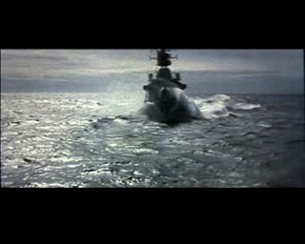
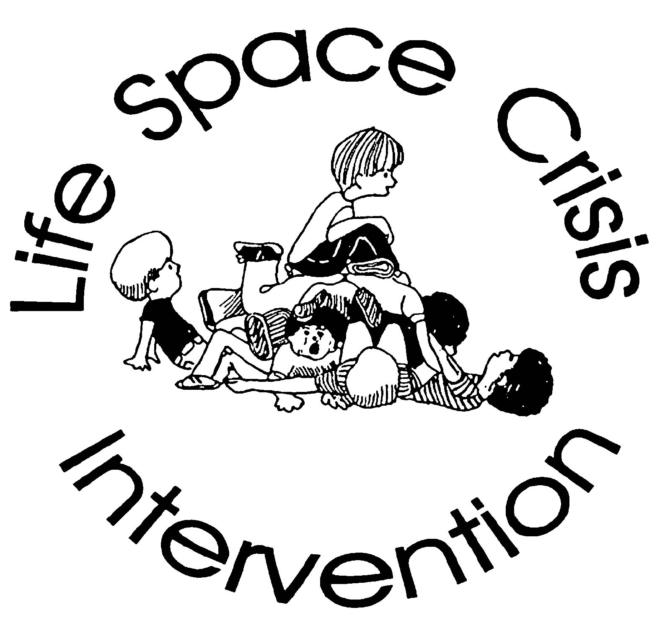
Click Below for:
The Lighthouse and the Battleship

Slide 8
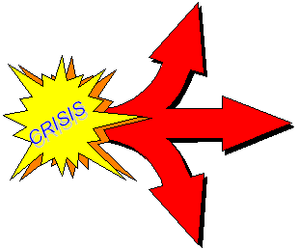
Life Space Crisis Intervention
Three Possible Outcomes of a Crisis
Staff- Child Relationship Improved
Staff- Child Relationship Unchanged
Staff- Child Relationship Damaged
Notes:
Three Possible Outcomes of a Crisis –
Participant Manual page 4
Staff- Student Relationship Improved / Unchanged / Damaged
In schools or other settings for children and youth, the staff reaction to a crisis or conflict is punishment. Many settings have an established list of “consequences” for specific infractions.
There is little or no consideration of the circumstances surrounding the situation or the student’s perception of the event.
For many troubled or challenging students, these rote punishments have little effect on changing behavior because they address only the symptoms, and not the beliefs and feelings which underlie the behavior.
The student does not feel that the staff is genuinely concerned about him, and his relationship with them is not changed. As a result, nothing changes and the likelihood of future problems increases.
Illustration:
A large urban school district adopted a zero-tolerance policy regarding weapons. A comprehensive policy statement was prepared listing all manner of weapons and devices that were not permitted on school grounds or on school transportation, and what staff were to do should they discover contraband. The policy was distributed to all school employees, students, and parents. Clearly, the awareness-level of the importance of safety had been raised.
Shortly after the policy was in place, a kindergarten student was standing at his bus stop when he noticed a razor blade lying on the ground. Recognizing this as one of the dangerous weapons he had learned about, he did the responsible thing; he picked it up, brought it on the bus, and gave it to the driver.
The driver consulted the policy statement regarding possession of weapons, reported the incident to the principal, and turned in the “weapon.” The principal in turn brought the matter to the superintendent.
Following the zero tolerance policy, the young student was suspended and transferred to another school in the district despite the parent’s appeal to the board. Instead of using this situation as a learning experience, the adults chose to throw out reason and create a hostile situation where none needed to exist.

Slide 9
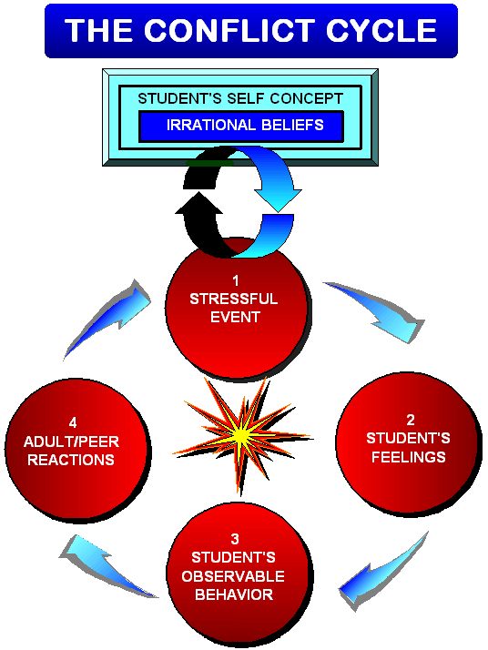
Notes:
The Conflict Cycle
Participant Manual page 24
This is simply a full page visual for participants to refer back to. Nothing new here.

Slide 10
Student’s Belief: Adults are all unfair…I can’t trust anyone…I can’t do anything right!
Student’s Thoughts: She’s picking on me. Why do I have to answer?
Student’s Stressful Event
Teacher:
“Answer the next
question.”
Adult Reaction:
“Don’t talk
to me that way.
You’ll do as
I say.”
Student’s Feelings:
ANXIOUS
Conflict
Cycle 1
Student’s Behavior:
“I’m not
going to do it.
Leave me the
#$% alone.”

Slide 11

THE CONFLICT CYCLE PARADIGM
A STRESSFUL EVENT occurs which activates a troubled student’s irrational beliefs.
These NEGATIVE THOUGHTS determine and trigger feelings.
FEELINGS, not rational forces, drive inappropriate behaviors.
Inappropriate BEHAVIORS incite adults.
Adults take on the student’s feelings and may MIRROR his behaviors.
This negative adult REACTION increases the student’s stress, escalating the conflict into a self-defeating power struggle.
The student’s SELF-FULFILLING PROPHECY (irrational beliefs) is REINFORCED; the student has no motivation to change thinking or behavior.

Slide 12
Click to View Video:
Conflict Cycle
Video Example

Slide 13
Activity
Discuss the students reactions and behavior.
Discuss the teachers reactions and behavior.
What was the driving force and interest for each of them?

Slide 14
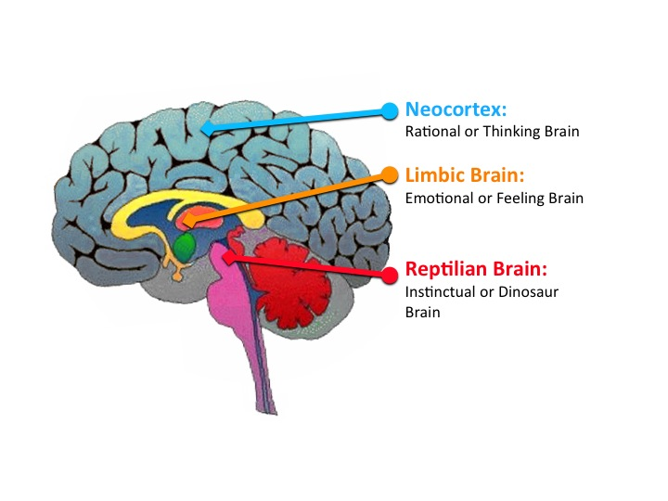

Slide 15
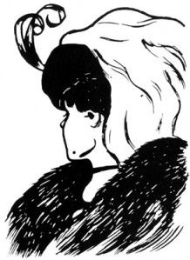

Slide 16
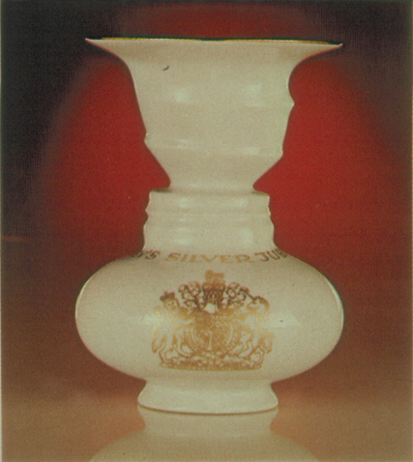
What is interesting about this photo of a vase?
Notice that you can see only one image at a time.
One image is always the foreground, the other, the background.
LSCI Institute

Slide 17
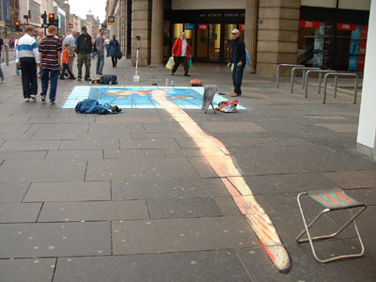

Slide 18
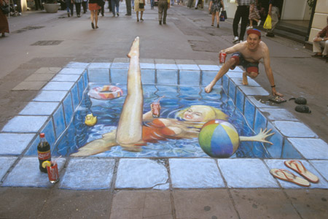

Slide 19
COGNITIVE THEORY
Stream of Consciousness: Continuous flow of observation and thought in the present.
Perceptual Set: Fundamental beliefs based on personal history.
Active Self-Talk: Conscious internal dialogue filtered by the Perceptual Set.
LSCI Institute

Slide 20
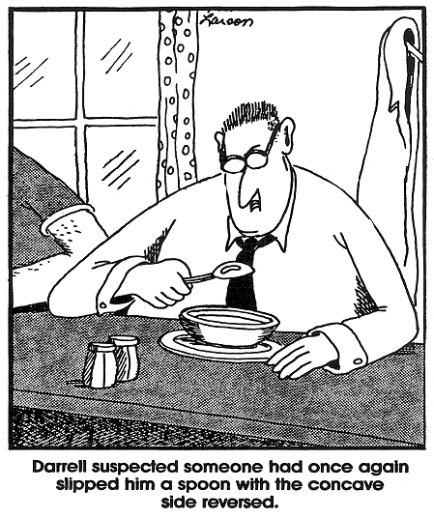
It’s not the event which causes the feeling…
It’s HOW you think about it.
Notes:
It’s not the event which causes the feeling…
It’s HOW you think about it.
Some students can be like the fellow in this cartoon who have an irrational belief that someone is always messing with him. The emotions which follow that way of thinking are not usually useful in problem solving.
Here are some other irrational beliefs --- (next slide)

Slide 21

People are disturbed not by things, but by the view which they take of them.
--- Epictetus,
1st Century A.D.
Notes:
“People are disturbed not by things, but by the view which they take of them.”
--- Epictetus,
1st Century A.D.
Participant manual page 18
Cognitive restructuring is the process of changing one’s view about the half-empty glass.
Our task working with troubled kids is to help them recognize and refute “faulty thinking,” with the goal of replacing their cognitive distortions with more accurate and beneficial ones.
This is accomplished by leading the child to:
Gain awareness of detrimental thought habits
Learn to challenge them
Substitute more accurate thoughts and beliefs.

Slide 22

What kids believe about themselves is more important in determining their behavior than any facts about them.
Notes:
If they believe they’re monsters, then they are monsters in their own eyes. Our goal is to help kids change their feelings about themselves. When we do this, we can help a student change their life!
What kids believe about themselves is more important in determining their behavior than any facts about them.
Participant Manual page 18

Slide 23
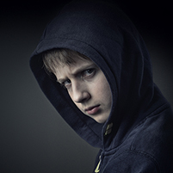
LOOK
BEYOND
BEHAVIOR

Slide 24
Turn & Talk
What are the most common behavioral issues that come up in school?
When a student does X behavior, what do you think he is really trying to say? What need does he have?

Slide 25
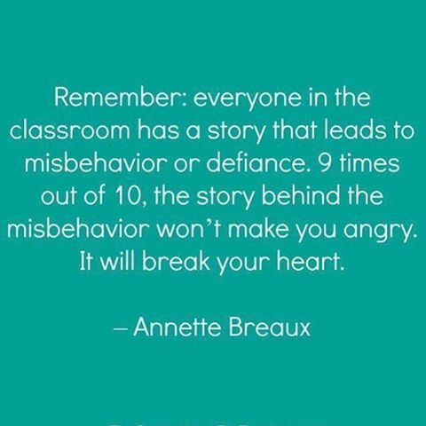

Slide 26

Breaking the Conflict Cycle
Skill 1: Be a Thermostat
Notes:
Remember, during crisis, act like a thermostat, not like a thermometer!
Participant Manual page 28
You will have counter-aggressive feelings; things will go wrong. This is the reason volunteers don’t last long in a program serving troubled students. When we treat others with kindness and respect, and we do good for them, we expect some kind of reciprocation; at least appreciation. Our students do not usually respond in ways that endear them to volunteers. As the responsible staff, our response to the student’s behavior is the critical point. We will either reinforce the student’s self-fulfilling prophecy, or present him with an alternative example. To make a difference we must do what’s best for the student not act on our feelings. In effect, we have to bring the student’s emotions under control while controlling our own emotions. A good analogy is that of the thermometer and the thermostat. A thermometer reflects the heat in the setting whereas the thermostat controls the temperature. Helping adults will be good emotional thermostats.
If you do what comes “naturally” you will usually make matters worse.

Slide 27
Remember, during crisis act like a thermostat, not like a thermometer!
Notes:
Remember, during crisis, act like a thermostat, not like a thermometer!
Participant Manual page 28
You will have counter-aggressive feelings; things will go wrong. This is the reason volunteers don’t last long in a program serving troubled students. When we treat others with kindness and respect, and we do good for them, we expect some kind of reciprocation; at least appreciation. Our students do not usually respond in ways that endear them to volunteers. As the responsible staff, our response to the student’s behavior is the critical point. We will either reinforce the student’s self-fulfilling prophecy, or present him with an alternative example. To make a difference we must do what’s best for the student not act on our feelings. In effect, we have to bring the student’s emotions under control while controlling our own emotions. A good analogy is that of the thermometer and the thermostat. A thermometer reflects the heat in the setting whereas the thermostat controls the temperature. Helping adults will be good emotional thermostats.
If you do what comes “naturally” you will usually make matters worse.

Slide 28
Cognitive Map of the Six Stages of LSCI
Stage 1: Drain Off
Staff de-escalating skills to drain off the student’s intense feelings while controlling one’s counter-aggressive reactions
Diagnostic Stages
Stage 2: Timeline
Staff relationship skills to obtain and validate the student’s perception of the crisis
Stage 3: Central Issue
Staff diagnostic skills to determine if the crisis represents one of the six LSCI patterns of self-defeating behavior
Stage 4: Insight
Staff clinical skills to pursue the student’s specific pattern of self-defeating behavior for personal insight and accountability
Reclaiming Stages
Stage 5: New Skills
Staff empowering skills to teach the student new social skills to overcome his pattern of self-defeating behavior
Stage 6: Transfer of Training
Staff consultation and contracting skills to help the student re-enter the classroom and to reinforce and generalize new social skills

Slide 29

1 DRAIN OFF
Drain off the student’s intense emotions by acknowledging the feelings
2 TIMELINE
Use affirming and listening skills to discover the student’s point of view
3 CENTRAL ISSUE
Identify the student’s vital interest and give them their choices

Slide 30
            THE “SCRIPT”
            Acknowledge the feelings: Make 2-3 validating statements
            Affirm : Make 2-3 affirming statements
            Get the child’s perspective and restate
            Set limits and give choices as needed

